Slide 1


Yarmouk University
IntelliShield: AI for Substance Misuse Prevention
College of Information Technology and Computer
Science, Department of Data Science and Artificial Intelligence
Prepared by:
Duaa Sawalmeh Sarah Bani Khalaf
Supervisor: Dr. Enas Khashashneh
Second Semester 2025

Slide 2

Project Goal
Objective: Use machine learning to predict youth susceptibility to cannabis use based on psychological and demographic data.
Impact: Empower early intervention, data-driven prevention strategies, and support public health efforts.

Slide 3

Dataset Overview
Name: NSDUH Trimmed Dataset (2015–2016)
Source: U.S. Department of Health and Human Services – SAMHSA
Size: 56,276 records × 12 features
Key Features:
Demographics: Age, Gender, Education
Personality Traits: Big Five (e.g., Neuroticism, Openness,agreeableness,conscientiousness,extraversion)
Behavior: Impulsiveness, Sensation Seeking
Target: Cannabis Use (Yes / No)

Slide 4

Methodology Overview
Exploratory data analysis -to study the most important relationships in a data set
Data Cleaning – Removed ambiguous labels
Train/Test Split – Stratified 80/20 split
Feature Scaling – Winsorizer + MinMaxScaler
Balancing – SMOTE to address class imbalance
Feature Selection -Three Experiments for Trait Importance
We conducted three experiments to select the most relevant features:
Experiment 1: Using all available features in the dataset.
Experiment 2-1: Using only the following traits:
[Age, Openness, Extraversion, Agreeableness, Neuroticism, Conscientiousness, Sensation Seeking, Impulsiveness],
based on feature importance analysis using H2O.
Experiment 3: Using only the top 5 features identified by XGBoost importance, which are:
Age, Sensation Seeking, Impulsiveness, Conscientiousness, and Extraversion.
Model Evaluation – F1 Score
Deployment– The final model was deployed as a **website using Streamlit**, allowing users to interact with the model through a user-friendly interface.

Slide 5
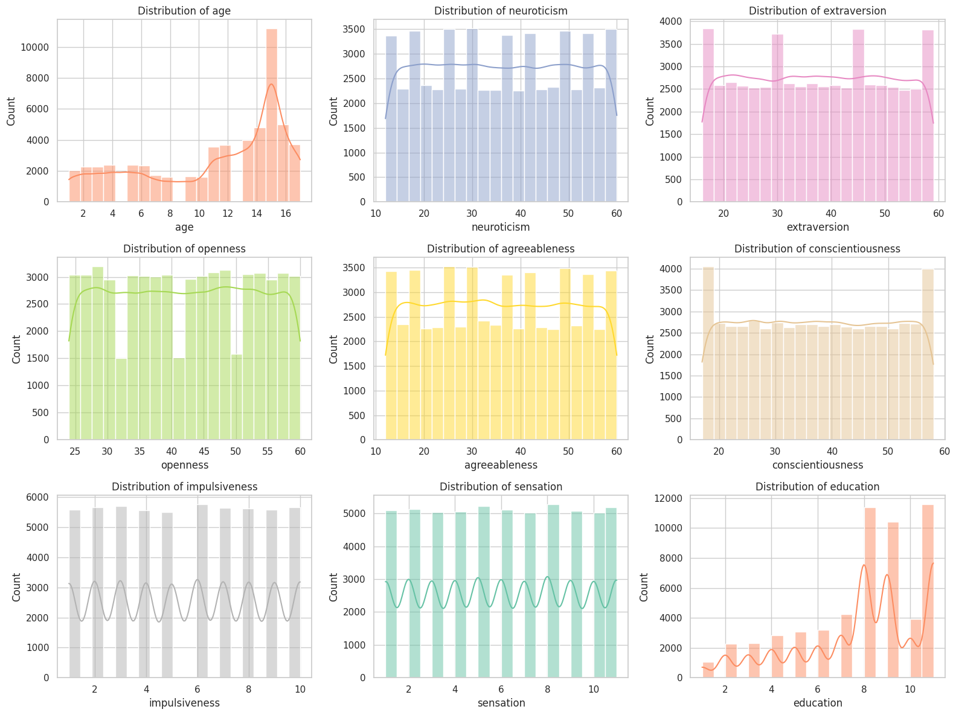
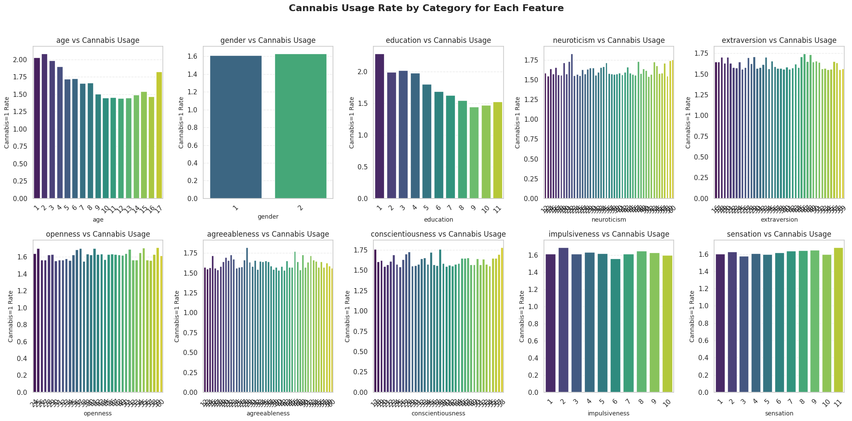

Slide 6
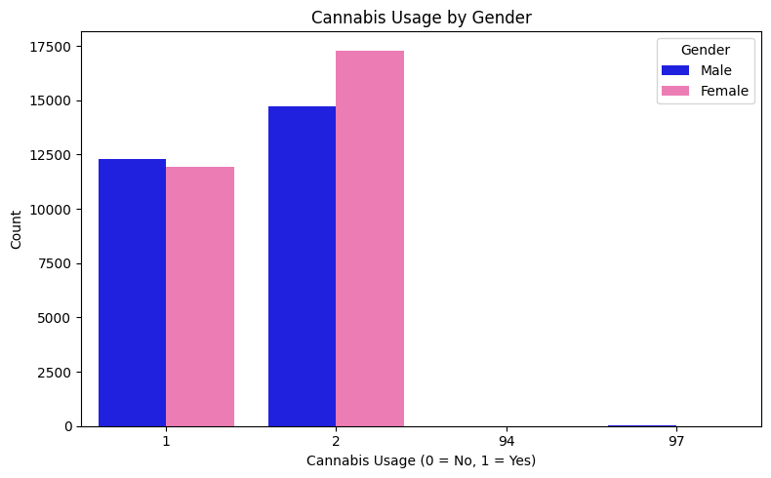
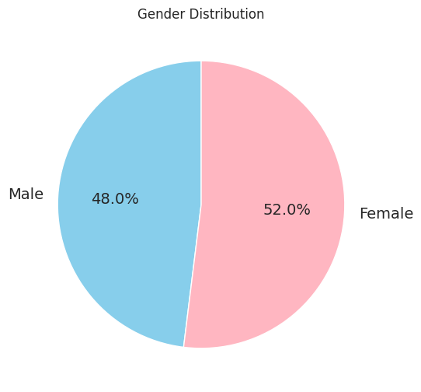
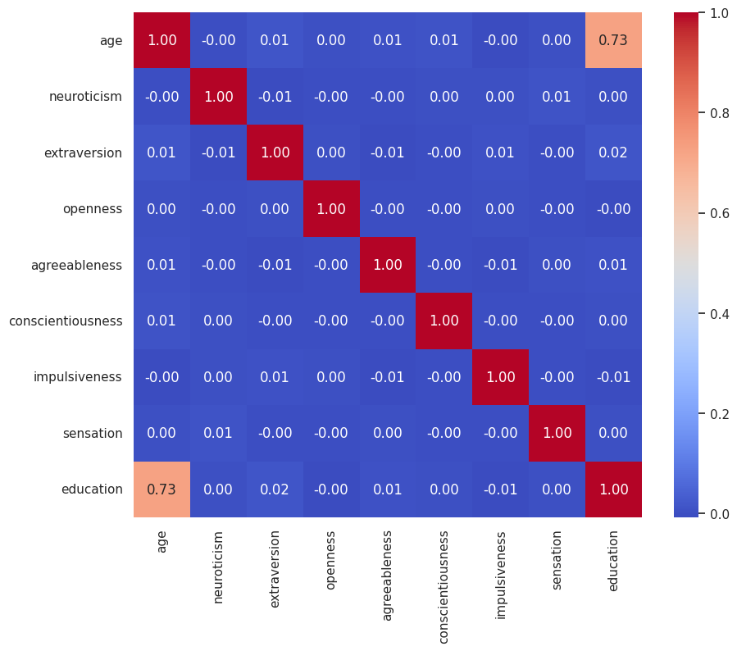
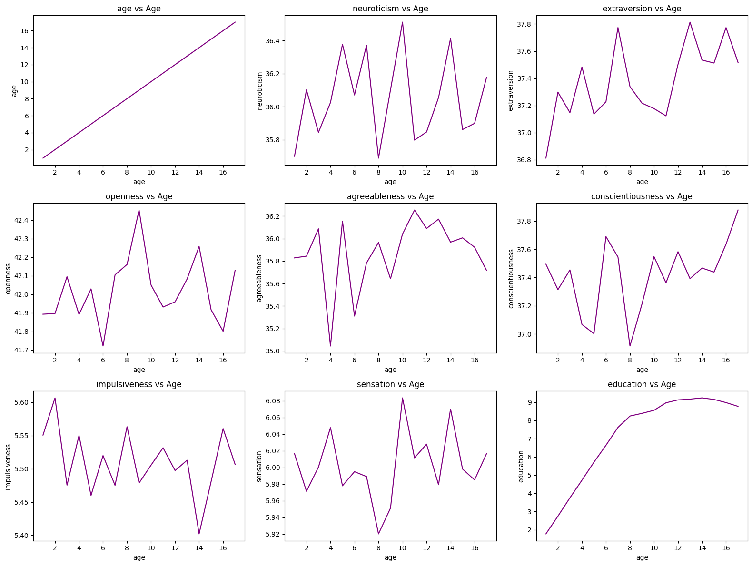
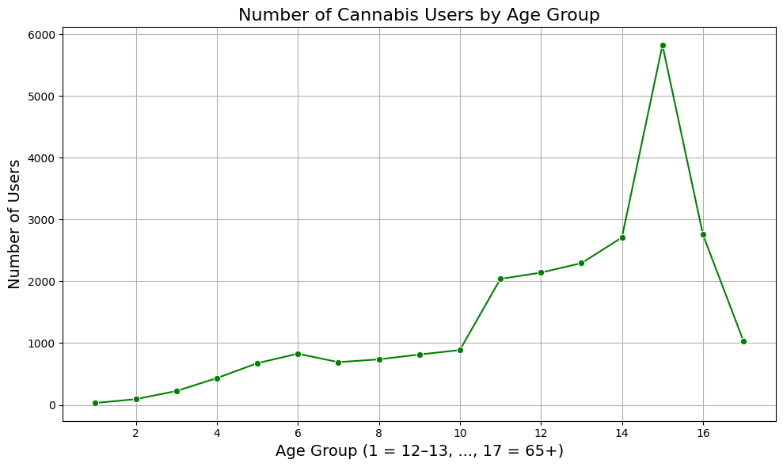
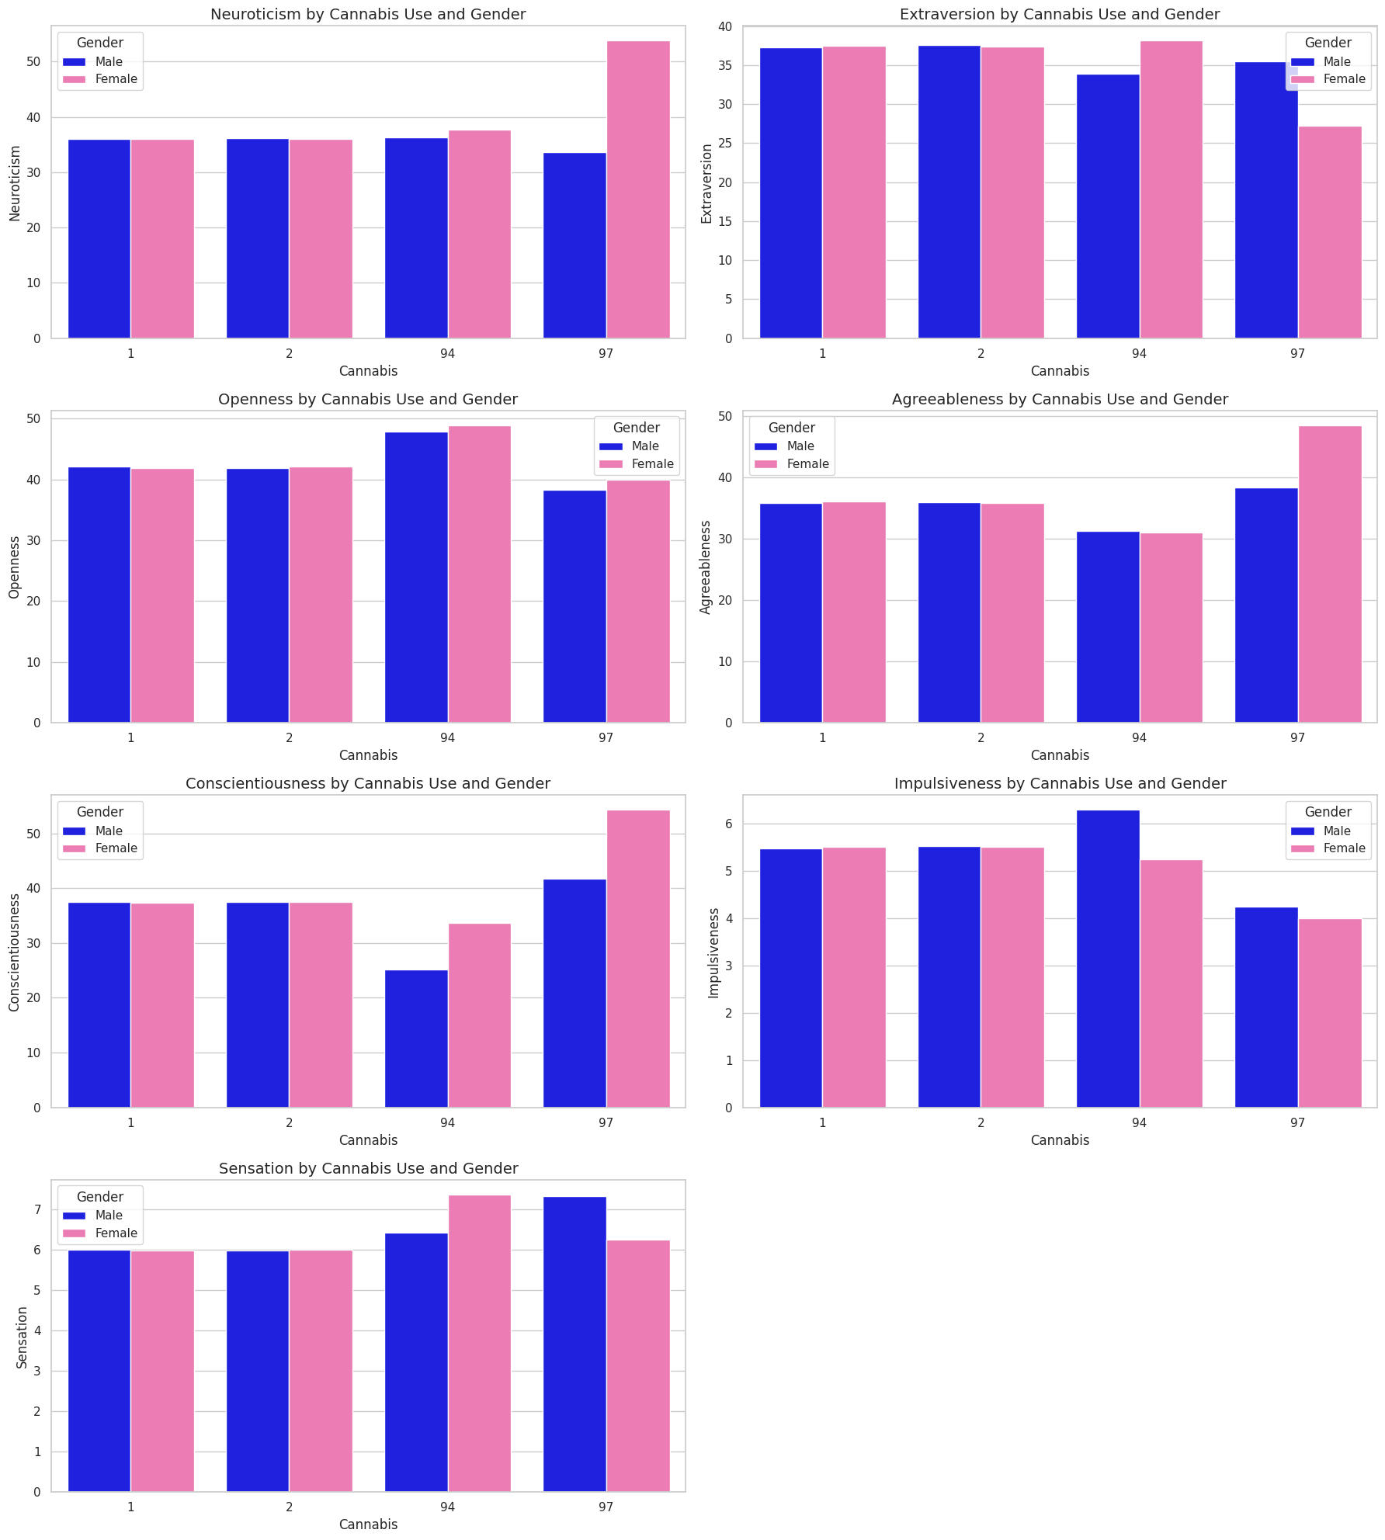

Slide 7
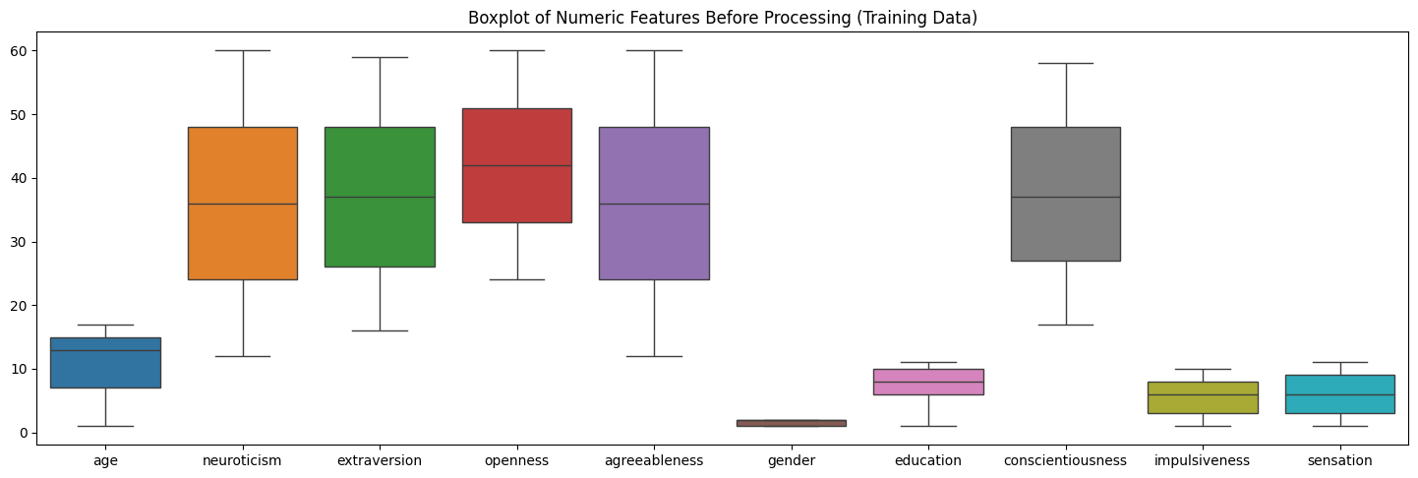
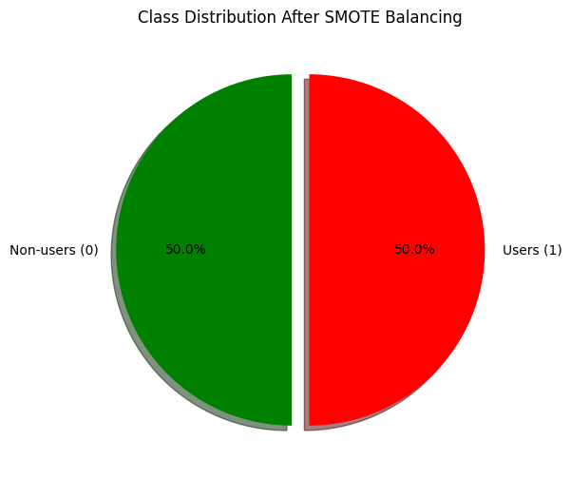
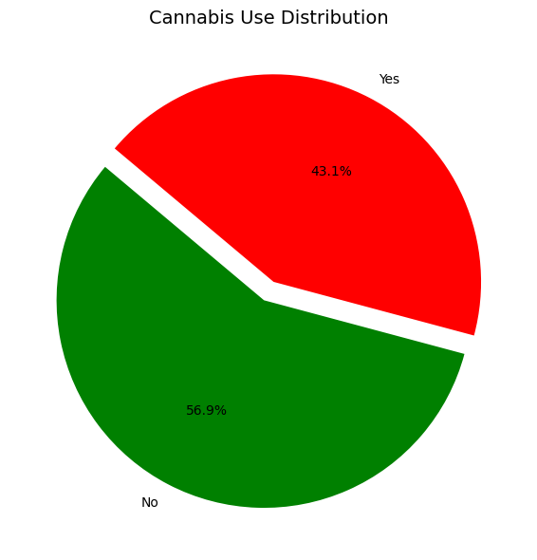

Slide 8

Models Used
Model | Reason for Use
Logistic Regression | Used as a baseline for performance comparison
Decision Tree | Chosen for its simplicity and interpretability
Random Forest | Captures feature interactions effectively
XGBoost | Provides high accuracy and handles imbalance
LightGBM | Offers fast training and efficient boosting
CatBoost | Automatically processes categorical features
SVM | Suitable for robust binary classification
Naive Bayes | Based on a simple probabilistic framework
KNN | Relies on instance-based learning
Gradient Boosting | Delivers strong results with flexible tuning

Slide 9

Experiment 1 – Baseline Modeling with All Features
Model | F1 Score (Training) | F1 Score (Testing)
Logistic Regression | 0.5829 | 0.6098
Decision Tree | 0.5829 | 0.6268
Random Forest | 1.0000 | 0.6481
Gradient Boosting | 0.6248 | 0.6340
XGBoost | 0.7639 | 0.6634
LightGBM | 0.6826 | 0.6575
CatBoost | 0.7428 | 0.6630
K-Nearest Neighbors | 0.7519 | 0.6142
Naive Bayes | 0.5493 | 0.5690
Support Vector Machine | 0.5829 | 0.5154

Slide 10
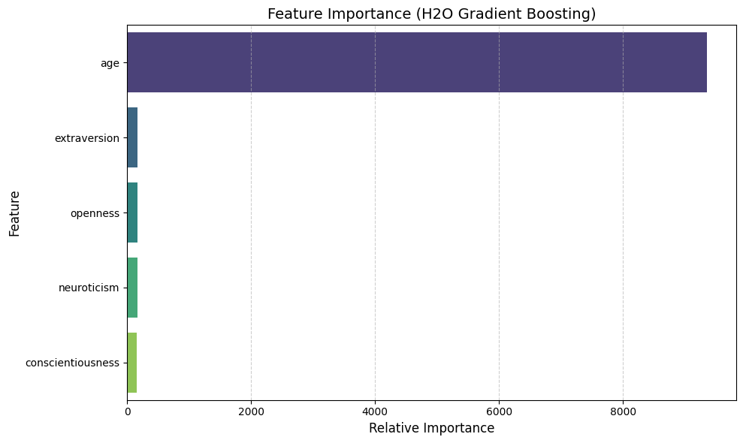

Slide 11

Experiment(2-1):using [ age, openness, extraversion, agreeableness, neuroticism, , sensation conscientiousness, impulsiveness ]
Model | F1 Score (Training) | F1 Score (Testing)
Logistic Regression | 0.5648 | 0.5862
Decision Tree | 1.0000 | 0.6215
Random Forest | 1.0000 | 0.6351
Gradient Boosting | 0.6007 | 0.6074
XGBoost | 0.7457 | 0.6419
LightGBM | 0.6438 | 0.6202
CatBoost | 0.7175 | 0.6348
K-Nearest Neighbors | 0.7479 | 0.5982
Naive Bayes | 0.5434 | 0.5620
Support Vector Machine | 0.5407 | 0.5521

Slide 12
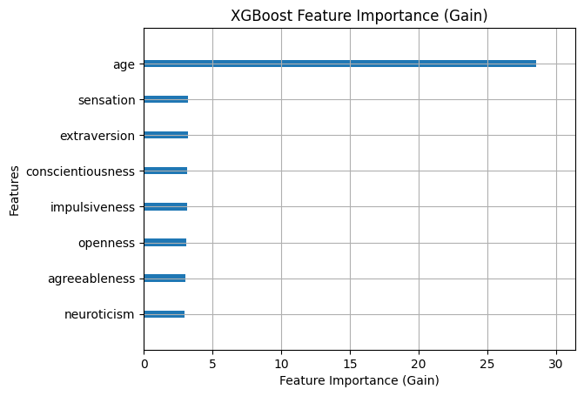

Slide 13

Experiment(2-2):using [age, conscientiousness, extraversion, sensation, impulsiveness]
Model | F1 Score (Training) | F1 Score (Testing)
Logistic Regression | 0.5644 | 0.5860
Decision Tree | 0.9996 | 0.6177
Random Forest | 0.9996 | 0.6395
Gradient Boosting | 0.5948 | 0.6064
XGBoost | 0.7037 | 0.6413
LightGBM | 0.6282 | 0.6162
CatBoost | 0.6755 | 0.6329
K-Nearest Neighbors | 0.7489 | 0.6074
Naive Bayes | 0.5428 | 0.5620
Support Vector Machine | 0.5407 | 0.5573

Slide 14
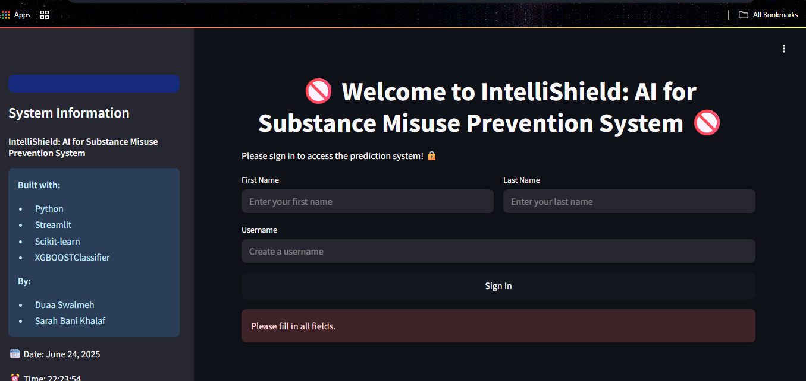
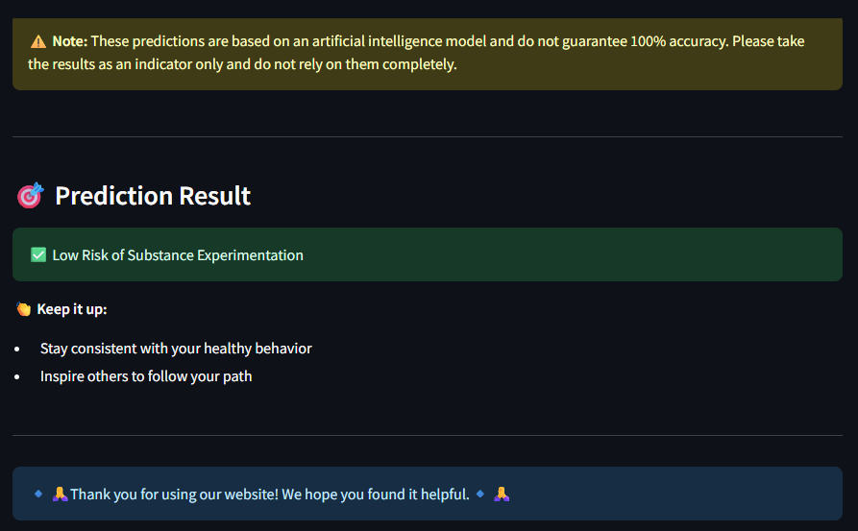

Slide 15

Future Work
Use Local Data-Collaborate with national entities (e.g., Ministry of Health, Anti-Narcotics Department) for improved relevance.
Deploy as a Decision Support Tool- Launch a web-based app to help policymakers identify at-risk groups and tailor awareness campaigns.
Integrate with Survey Platforms- Connect to real-time tools (e.g., U-Report, Google Forms) for instant feedback and predictions.
Continuous Model Updates- Automate retraining with new data to maintain accuracy over time.
Add Explainability (e.g., SHAP)-Help stakeholders understand prediction drivers for better intervention planning.

Slide 16


