Slide 1

Diamonds Prices Regression
Duaa Zaid; Yusuf Qwareeq; Zaid Adarbeh

Slide 2

Introduction
In this project, we were asked to produce a machine learning model that is capable of predicting the prices of diamonds using a dataset containing 10 features and a target variable (price). This is a typical supervised regression problem since we already know the labels (prices) for the diamonds in the dataset and we’re trying to predict the price of diamonds outside of the dataset.

Slide 3
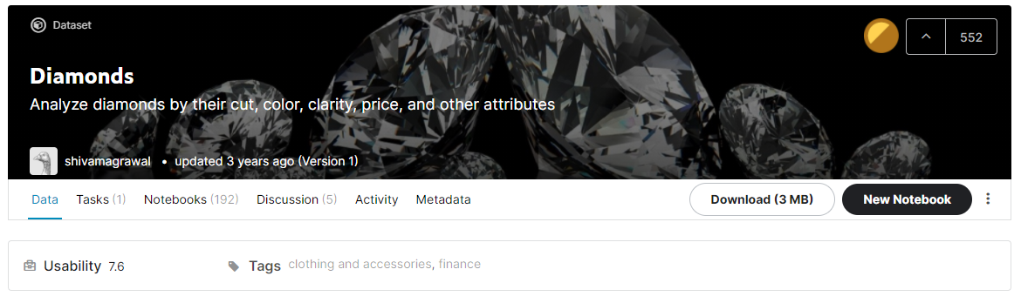
Loading the Data
The dataset was obtained from Kaggle and read as a pandas DataFrame.

Slide 4
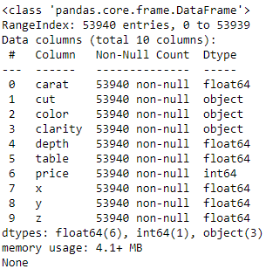
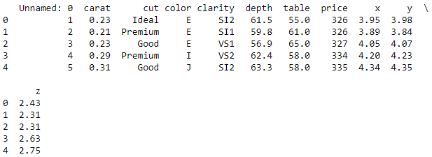
Making Sense of the Data
We have exactly 53,940 entries (rows) describing 53,940 diamonds. There exists a feature (column) named “Unnamed: 0” which appears to be an index column. We will remove it later since we have no use for it. We can also notice that there is no null data in the dataset. Let’s take a closer look at each of the remaining columns.

Slide 5
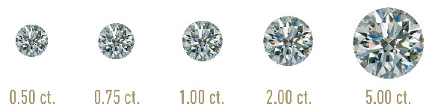
Making Sense of the Data
Carat
Put simply, carat measures how much a diamond weighs.
All else being equal, the price of a diamond increases with diamond carat because larger diamonds are rarer and more desirable. However, two diamonds of equal carat weight can have very different prices depending on other factors.
In the dataset, the values of the carat feature range from 0.2 to 5.01, where each carat is equal to 200 milligrams.

Slide 6
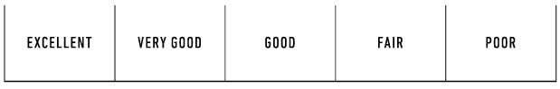
Making Sense of the Data
Cut
Diamond cut means how well a diamond’s facets interact with light.
A well cut diamond is desirable and valuable when it has that distinctive and tremendous light return, aka sparkle and fire.
Cut standards are very broad and there can be huge differences even within one grade. Therefore, it comes as no surprise that the cut scale in the dataset (Ideal, Premium, Very Good, Good, and Fair) is different from the one used by the GIA (Gemological Institute of America) shown below, although it can be viewed as analogous.

Slide 7
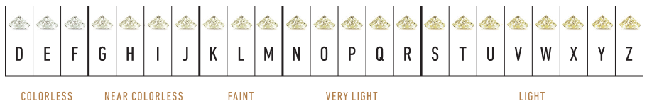
Making Sense of the Data
Color
Color refers to how white, or "colorless," the diamond appears.
The better the color, the more rare and more expensive that diamond will be.
Colorless diamonds will have a grade of D, E, or F according to the GIA color-grading scale shown below.
The dataset includes diamonds of 7 different colors, D; E; and F (colorless) and G; H; I; and J (near colorless).

Slide 8
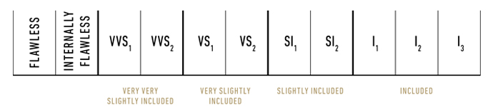
Making Sense of the Data
Clarity
Clarity is a measure of how many imperfections are in the diamond.
The cleaner a diamond is (the less imperfections), the rarer it is and the more it will cost even if the imperfections are barely visible to the naked eye. The GIA scale below lists clarities from best to worst going from left to right.
The dataset includes diamonds with clarities IF (internally flawless), VVS1, VVS2, VS1, VS2, SI1, SI2 and I1.

Slide 9
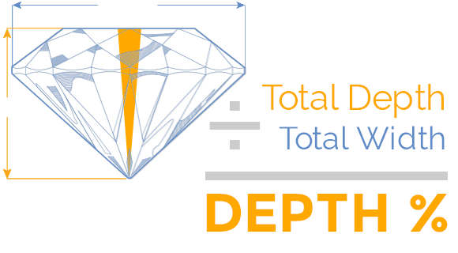
Making Sense of the Data
Depth
The depth is the distance from the table to the culet, or point, of the diamond, described in percentages.
To find the depth percentage, divide the diamond’s physical depth measurement by its width.
The ideal depth is between 59.5 and 62.9 percent.
In the dataset, the depth ranges from 43 to 79 percent.

Slide 10
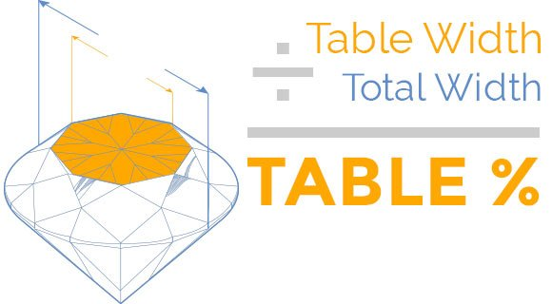
Making Sense of the Data
Table
Described in percentages as is the case for depth.
Dividing the width of the table by the overall width of the diamond, you can find the table percentage.
The most ideal table percentages are between 54 and 60 percent.
In the dataset, the table percentages range from 43 to 95 percent.

Slide 11
Making Sense of the Data
x, y, z
Describe the dimensions of the diamond.
x is the length of the diamond, ranging from 0 to 10.74 millimeters in the dataset.
y is the width of the diamond, ranging from 0 to 58.9 millimeters in the dataset.
z is the depth of the diamond, ranging from 0 to 31.8 millimeters in the dataset.
Price
The price of the diamond in US dollars.
In the dataset, the prices range from $326 to $18,823.

Slide 12
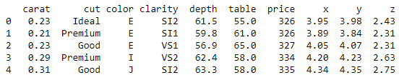
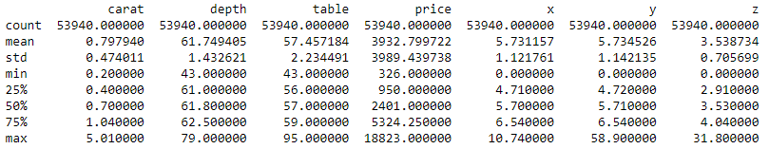
Visualizing and Cleaning the Data
We will start off by dropping the “Unnamed: 0” column since it serves no purpose in bettering our predictions. We now have 10 features, 6 of which are numerical and the rest are categorical.
We will also drop duplicate rows as their existence might mess with the cross-validation process later on (the same rows appearing in two different folds).
Next, we will use the describe() method to take a look at some statistical measures of the numerical features.

Slide 13
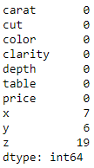
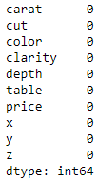
Visualizing and Cleaning the Data
We can see that the x, y, and z columns have a minimum value equal to 0. This shows that for these entries, these features are either missing or measured incorrectly (degenerate diamonds don’t exist).
By replacing 0 entries in the x, y, and z columns with NaN, we can see how many rows have this issue.
Since they aren’t that many when compared to the entire dataset, we have opted to drop them completely.

Slide 14
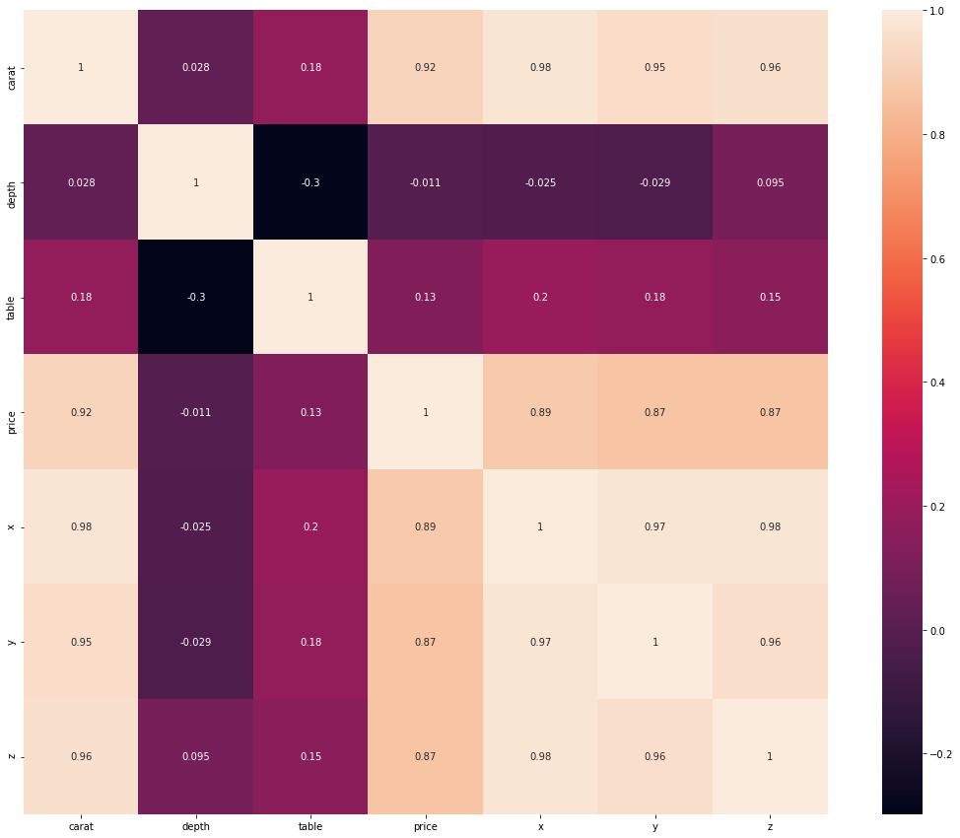
Visualizing and Cleaning the Data
We then plotted a correlation heatmap. It could be seen that carat, x, y, and z have the highest correlation with the price, while table and depth barely have any.
x, y, and z have a strong correlation with each other, which is why we’ll combine them later on into a single feature (volume).

Slide 15
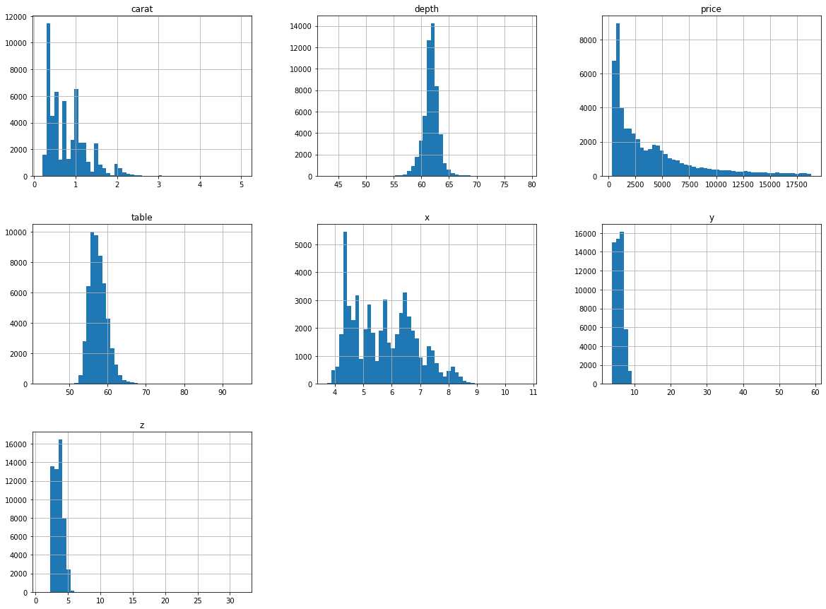
Visualizing and Cleaning the Data
To get a feel for the data we are dealing with, we plotted a histogram for each numerical attribute.
Let’s take a closer look at each feature individually to try to get a better understanding of what’s going on.

Slide 16
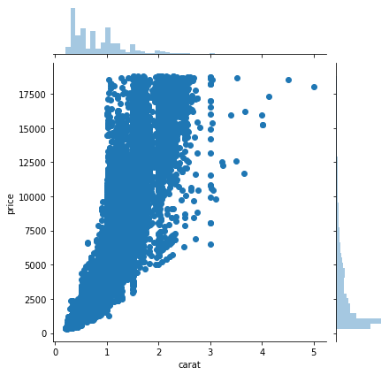
Visualizing and Cleaning the Data
The carat weight of the diamond is the most significant feature for determining its price. This is because larger diamonds are harder to find which makes them rarer and more desirable.
The price of the diamond increases exponentially with the carat weight. This means that a diamond with carat weight 1.0 costs more than two diamonds with a carat weight of 0.5 each.

Slide 17
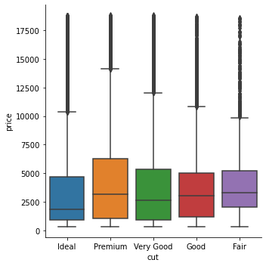
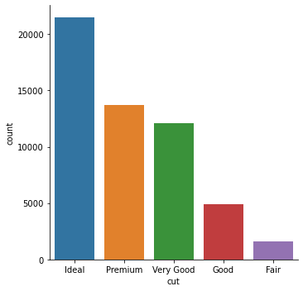
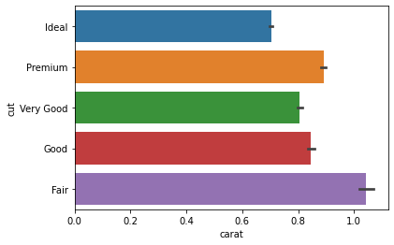
Visualizing and Cleaning the Data
Ideal cuts seem to be the most popular cuts. This may be because they are the most marketable (they look the best to customers). On average, diamonds with an ideal cut have lower prices than diamonds with other cuts. This shouldn’t come as a surprise, as a lot of diamonds with high carat weight have non-ideal cuts.

Slide 18
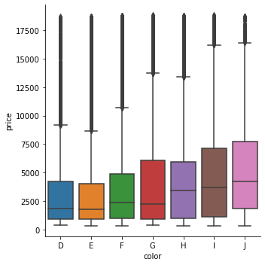
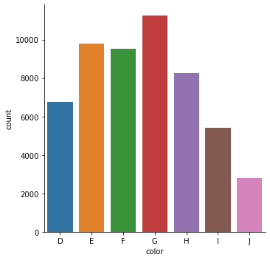
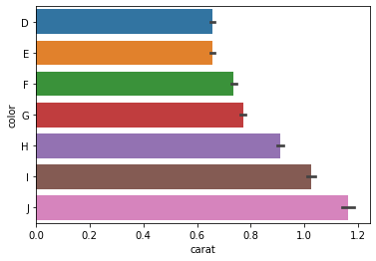
Visualizing and Cleaning the Data
As is the case with cut, diamonds with the best color (D) weigh less than diamonds with the worst color (J). This explains why diamonds with better colors have lower prices.

Slide 19
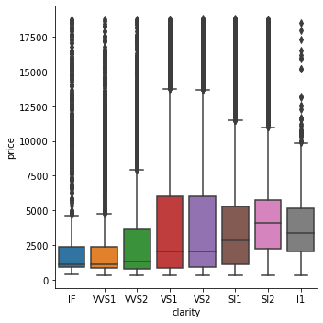
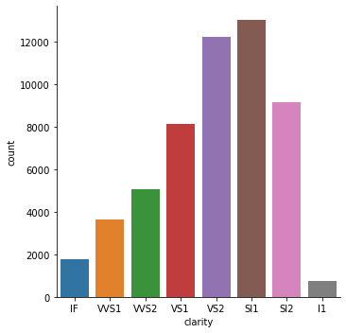
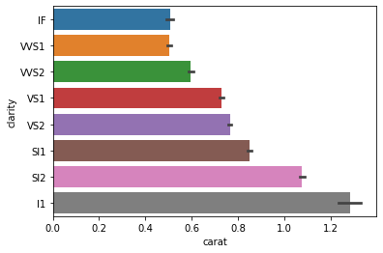
Visualizing and Cleaning the Data
Again, diamonds with worse clarities have higher prices which is easily explained by the fact that they have higher weights.
It is also good to notice that for all 3 categorical features, the upper quartile is bigger than the lower quartile in the box plots. This proves that diamonds can have high prices regardless of which categorical value they take.

Slide 20
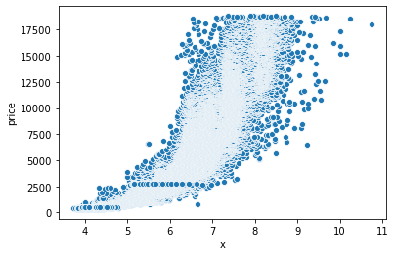
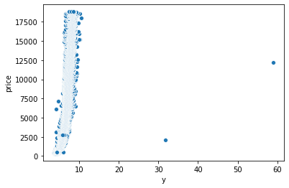
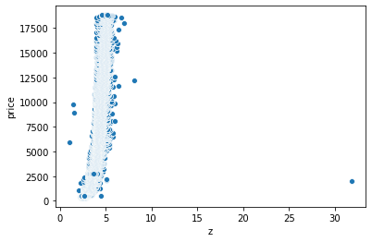
Visualizing and Cleaning the Data
x, y, and z increase exponentially with price. There appears to be outliers that are widely off and need to be removed.

Slide 21
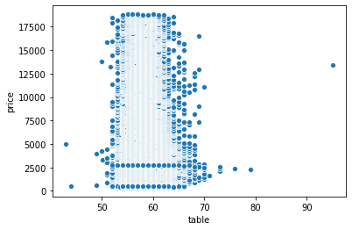
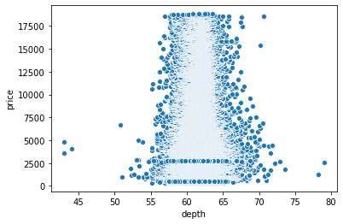
Visualizing and Cleaning the Data
As mentioned before, the most ideal table percentages are between 54 and 60 percent and the most ideal depth is between 59.5 and 62.9 percent. There are also some outliers that need to be removed.

Slide 22
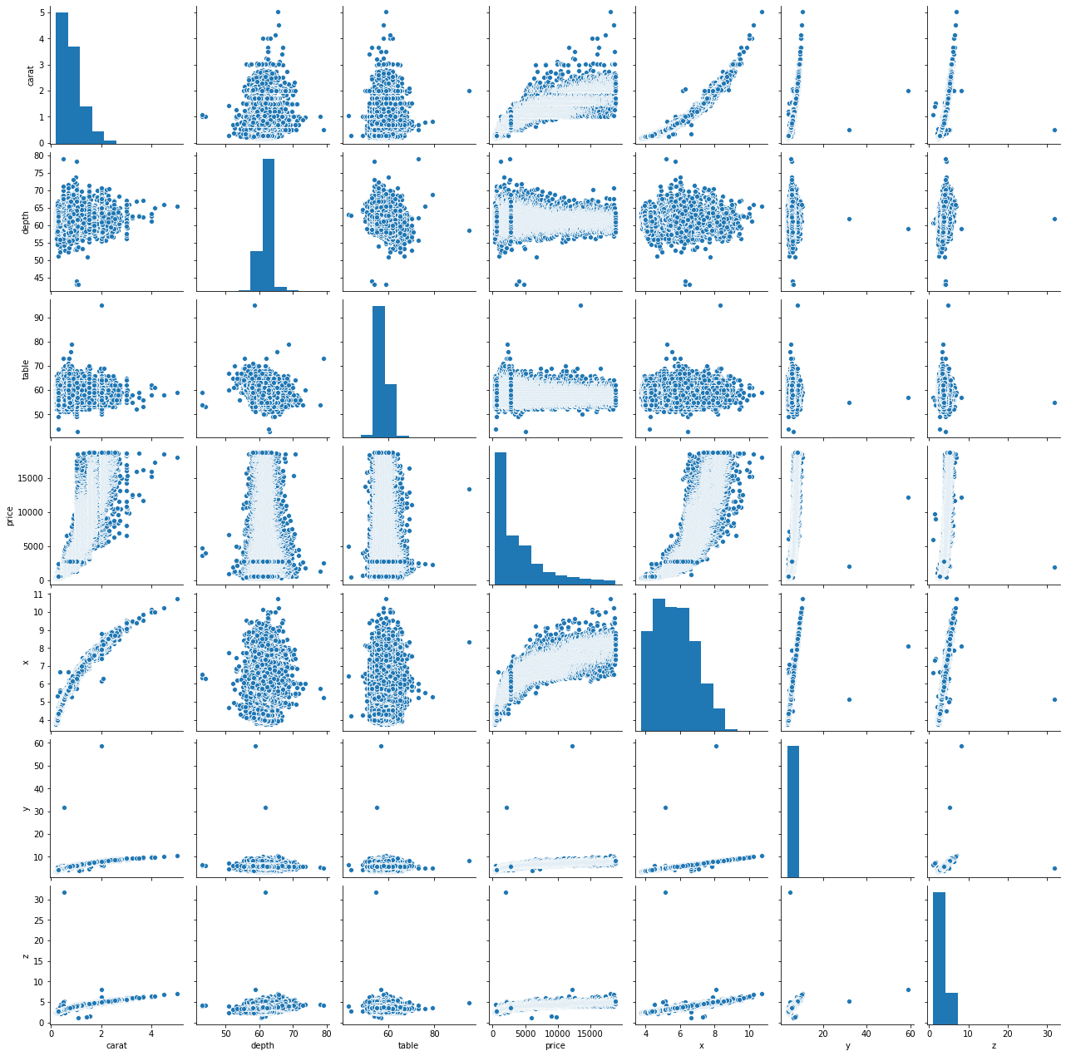
Visualizing and Cleaning the Data
This pair plot substantiates what we have claimed in our earlier exploratory data analysis.

Slide 23
Visualizing and Cleaning the Data
The table to the left shows how the categorical features were encoded. The higher the score (starting from 1), the better the category is as a predictor for higher price. This was done because machine learning algorithms can’t deal with non-numerical features.
Using the standard score, data that existed above 3 standard deviations above the mean was removed to get rid of outliers for all 10 columns.
The values of the 9 features were also scaled because machine learning algorithms don’t perform well when the features have very different scales (the gradient descent algorithm for example converges slower with non-uniform contour plots). The features will now be standard normally distributed (e.g. Gaussian with 0 mean and unit variance).
J | I | H | G | F | E | D
1 | 2 | 3 | 4 | 5 | 6 | 7
I1 | SI2 | SI1 | VS2 | VS1 | VVS2 | VVS1 | IF
1 | 2 | 3 | 4 | 5 | 6 | 7 | 8
Fair | Good | Very Good | Premium | Ideal
1 | 2 | 3 | 4 | 5

Slide 24
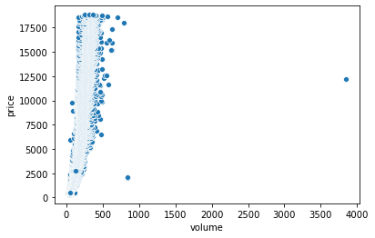
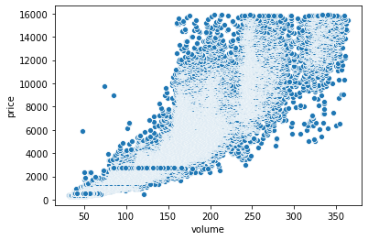
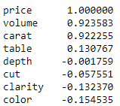
Visualizing and Cleaning the Data
Here, we can see how the outliers were removed from the new volume feature (as is the case for all other columns). We can also see that the volume feature has a higher correlation to price than the carat weight.

Slide 25
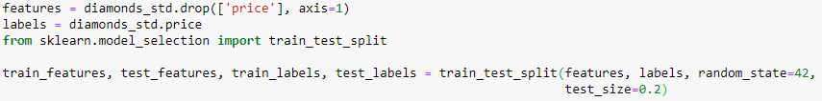
Splitting the Data and Testing the Models
The data was split into train and test sets using the train_test_split() function with an 80/20 split, respectively.
We chose 3 different models to train. Cross-validation was employed to check if overfitting is occurring. We also used the R-squared score as a sanity check. The RMSE (Root Mean Square Error) scores we got are shown below:

Slide 26
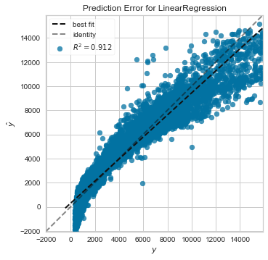
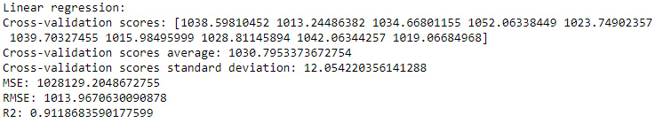
Testing the Models
Our first model is Linear Regression. The value of R-squared is close to 1 which is an indicator that the model fits the data fairly well.
The plot to the left shows the actual targets from the dataset plotted against the predicted values generated by our model. The closer the best fit line is to the identity line, the better.

Slide 27
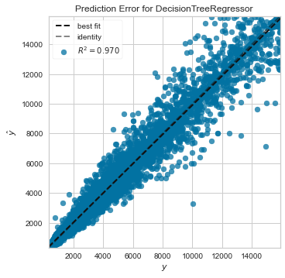
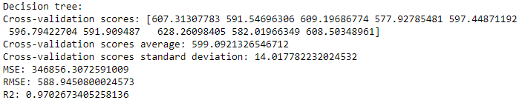
Testing the Models
Our second model is Decision Tree Regressor, which is capable of finding complex nonlinear relationships in the data.
The actual targets and the predicted values using the Decision Tree Regressor are closer than in the case of Linear Regression and the value of R-squared is even higher.

Slide 28
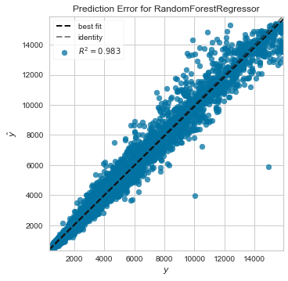
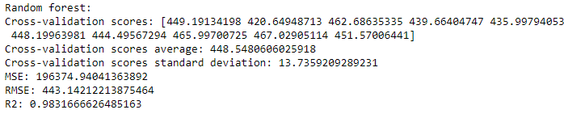
Testing the Models
Our final model is Random Forest Regressor, which works by training many Decision Trees on random subsets of the features, then averaging out their predictions. The lowest average RMSE and highest R-squared values were obtained by using this model.
It is good to note as well that the averages of the cross-validation scores in the 3 models are close to the RMSE scores without cross-validation. This proves that the models are in fact not overfitting.

Slide 29
Thank you!

