Slide 1
CFE + EnKF Data Assimilation
Ensemble Flood Forecasting During Hurricane Helene
USGS Gauge 03463300 | South Toe River Near Celo, NC | September 2024
CFE BMI · EnKF (Vrugt dynamic R) · T-route Muskingum-Cunge routing · 600-member crossed ensemble
CIROH DocHub | 2024

Slide 2
Experiment Overview
CFE hydrological model + Ensemble Kalman Filter DA → T-route gauge routing
▸ Study site
USGS 03463300 – South Toe River Near Celo, NC | Watershed area 113.18 km² | 21 NWM catchments
▸ Event
Hurricane Helene (Sep 24–29, 2024) — extreme flooding in the Southern Appalachians
▸ DA method
EnKF with dynamic Vrugt heteroscedastic R: R = (α·y)² + 0.001·σ²_krig, α = 0.10
▸ Ensemble
600-member crossed ensemble: 30 forcing draws × 20 hydro-state draws → fully separable uncertainty
▸ Routing
T-route Muskingum-Cunge (compute_network_structured) → terminal reach wb-1016283 at gauge
▸ Evaluation
4a: Vrugt R comparison · 4b: Ensemble routing · 4c: 18-hr lead-time forecasts · 3-way DA vs Qkrig vs USGS

Slide 3
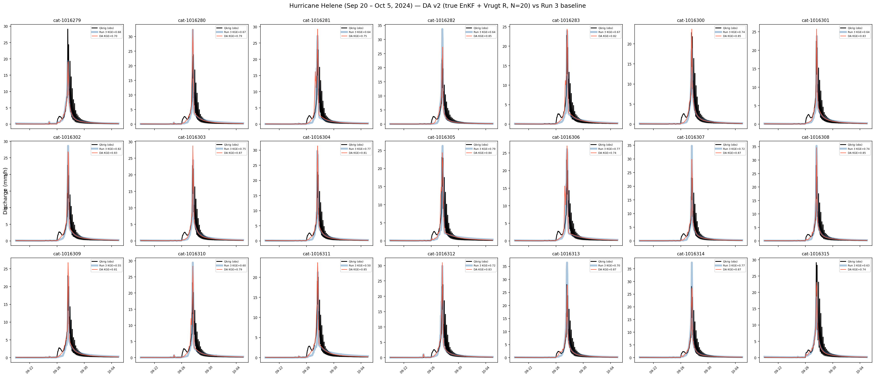
4a: Vrugt Dynamic R — Grid Search Comparison
Best-fit α selected by KGE across full test period and Helene window
Dynamic R = (α · y)² + 0.001 · σ²_krig α = 0.10 selected

Slide 4
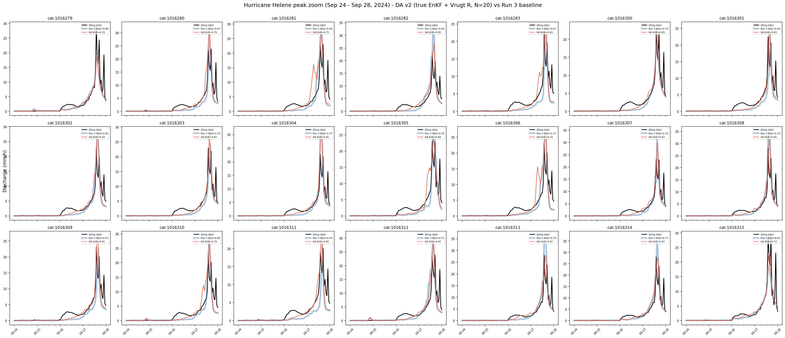
4a: Vrugt R — Helene Window Zoom
DA with α = 0.10 captures rising limb; both methods underestimate peak due to NWM forcing

Slide 5
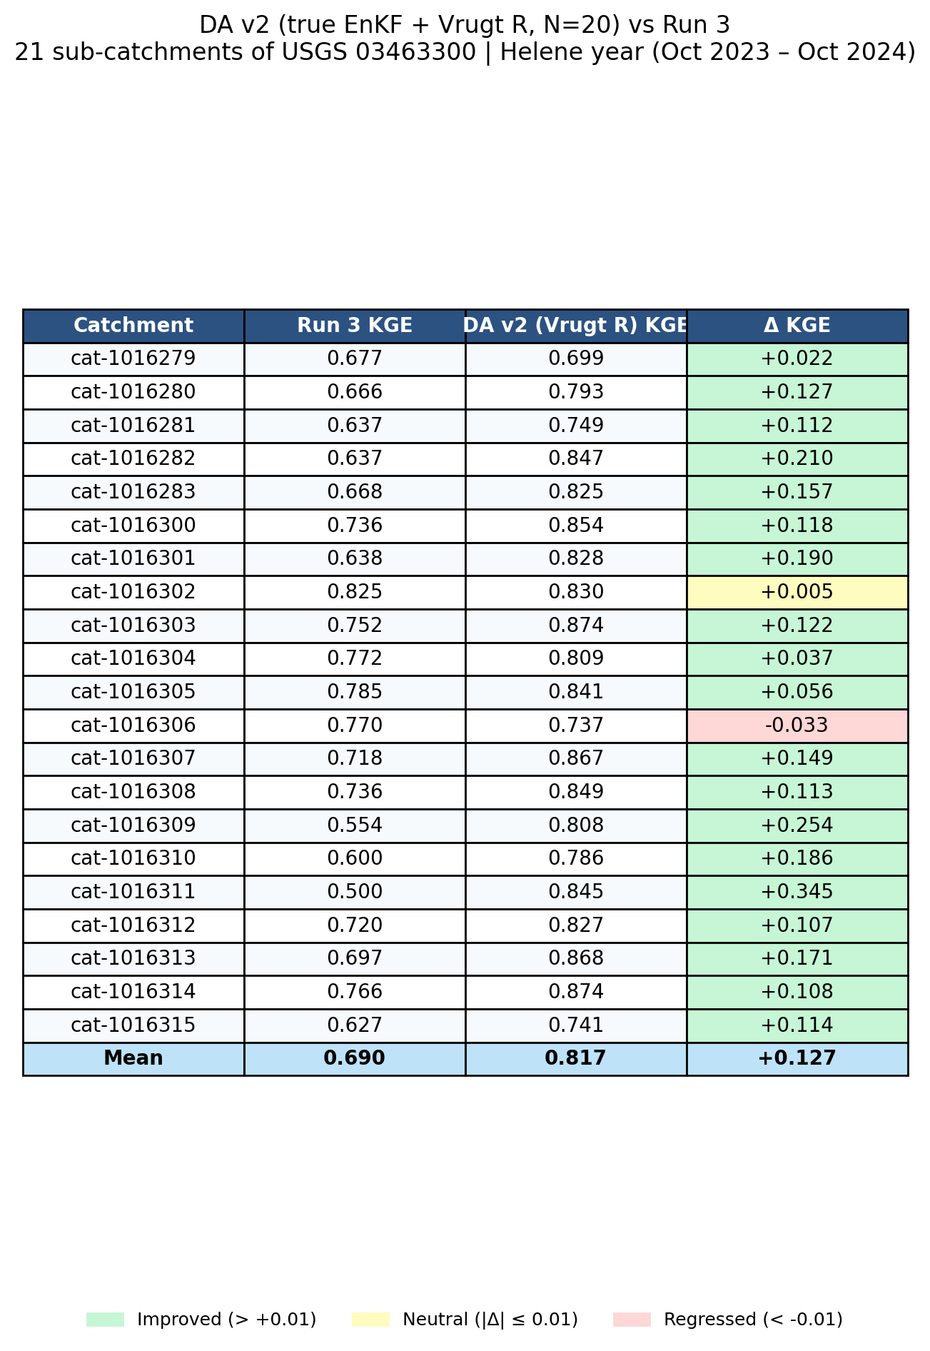
4a: KGE Summary Table — Vrugt α Comparison
Columns: α value | Rows: full period / Helene window KGE

Slide 6
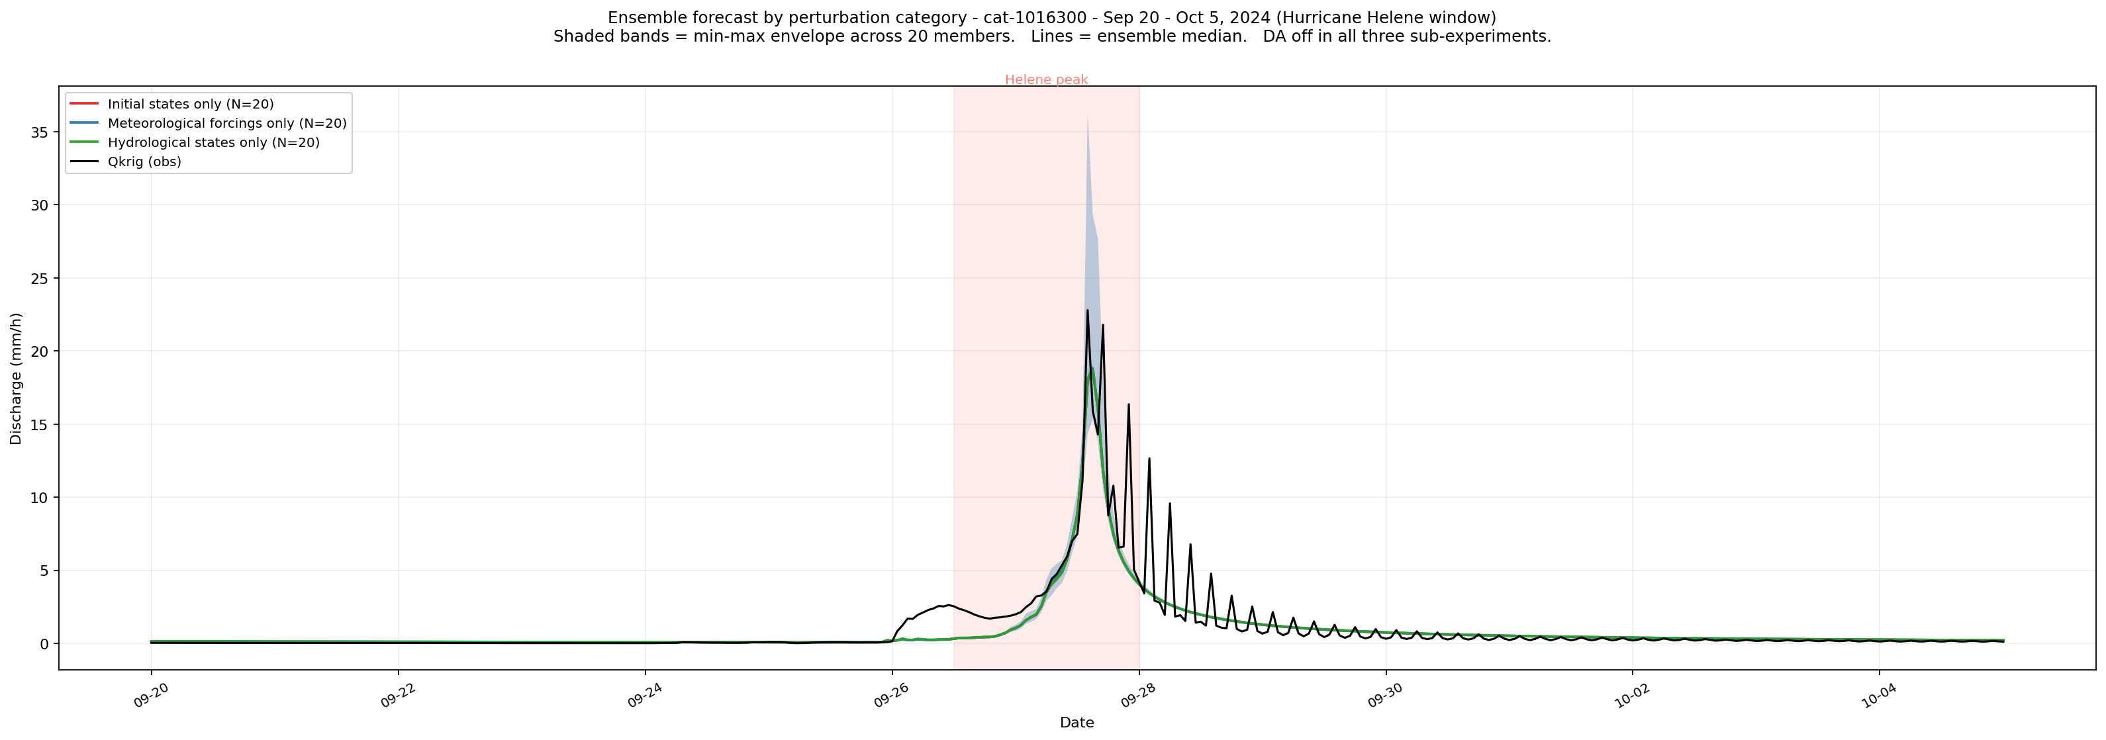
Perturbation Category Sensitivity
Shaded min-max bands: initial states (red) · meteorological forcings (blue) · hydrological states (green)
DA off in all sub-experiments | 20 members each | N=20 per category

Slide 7
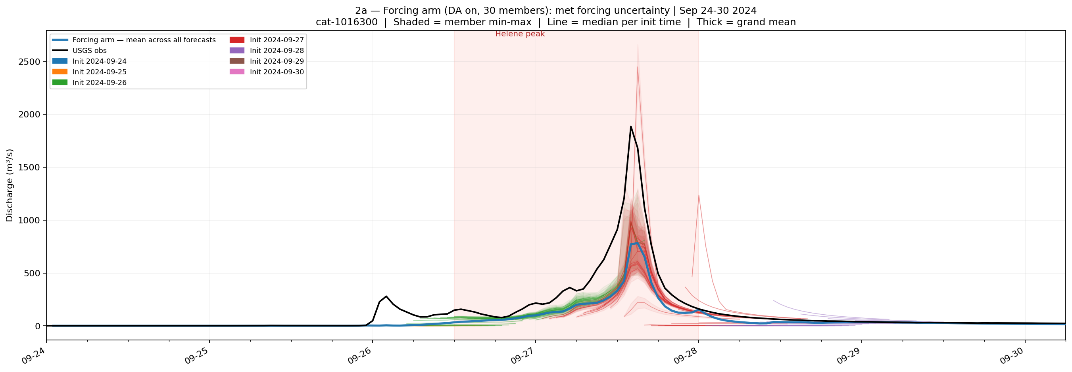
2a: Forcing Arm — Meteorological Uncertainty Ensemble
30 members | Lognormal precip σ = 15% | Normal PET σ = 10% | DA on

Slide 8
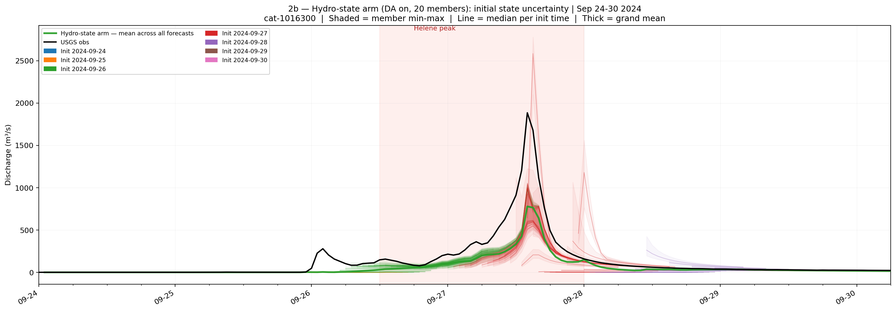
2b: Hydro-State Arm — Initial State Uncertainty Ensemble
20 members | 5% multiplicative state perturbation | DA on

Slide 9
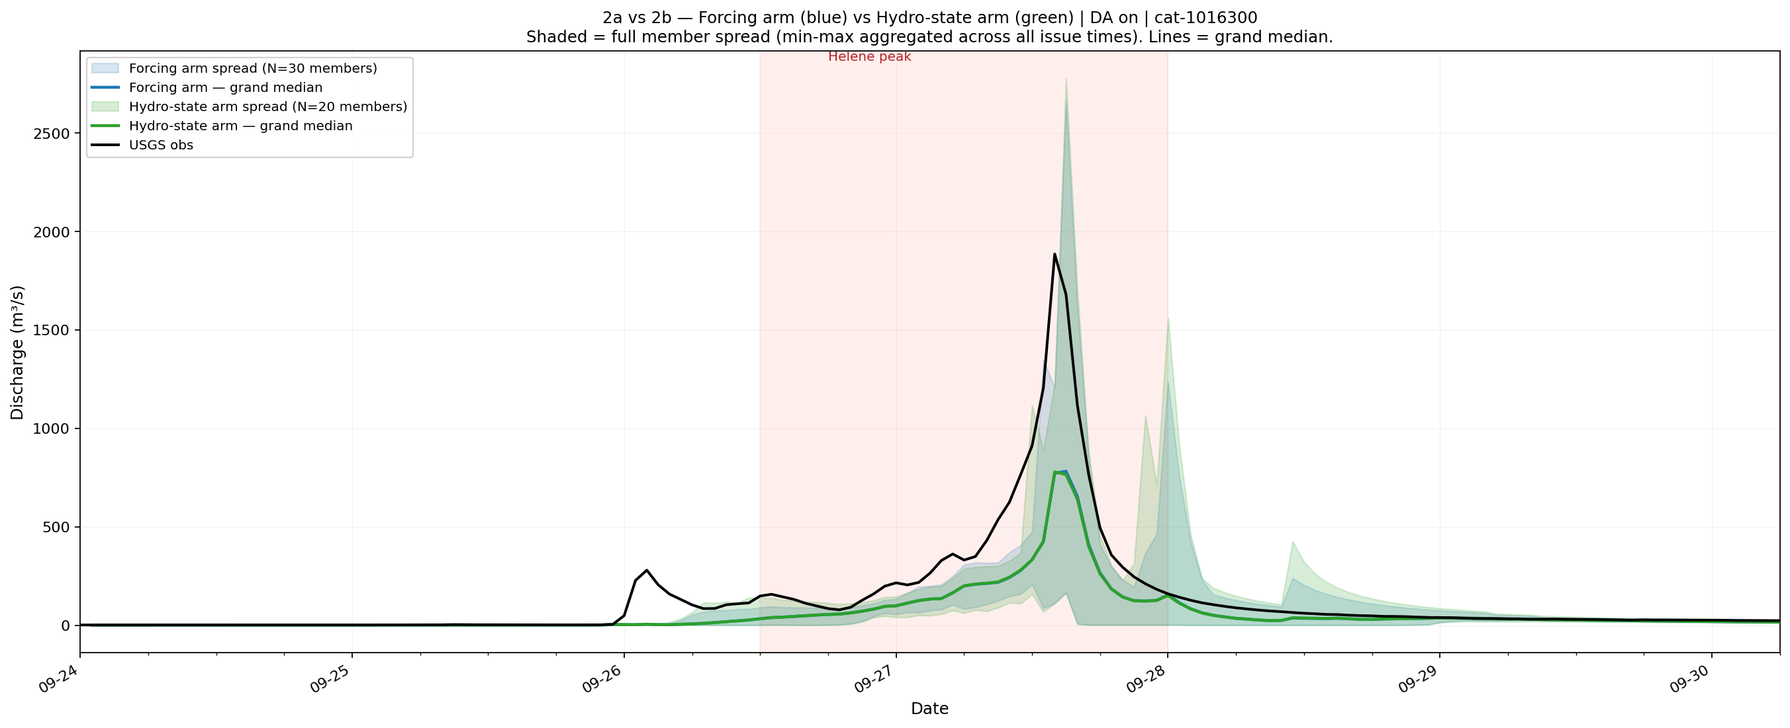
2a vs 2b: Which Uncertainty Source Dominates?
Side-by-side arm comparison during Helene window
Forcing uncertainty (2a) dominates spread during peak | State uncertainty (2b) contributes to rising/falling limb

Slide 10
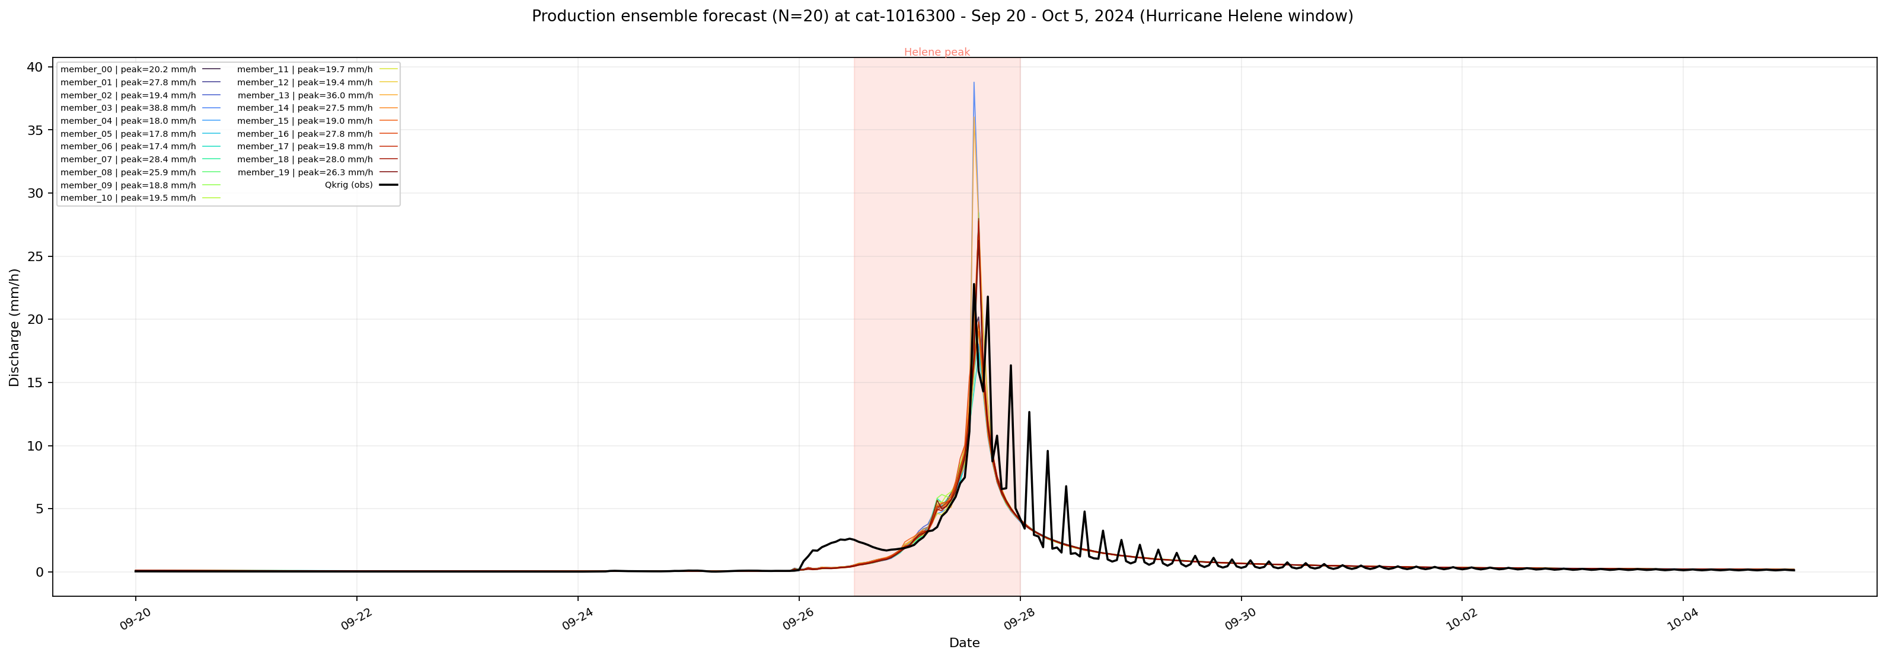
4b: 600-Member Crossed Ensemble — Production Forecast
30 forcing × 20 hydro-state = 600 members | Routed to USGS gauge via T-route

Slide 11
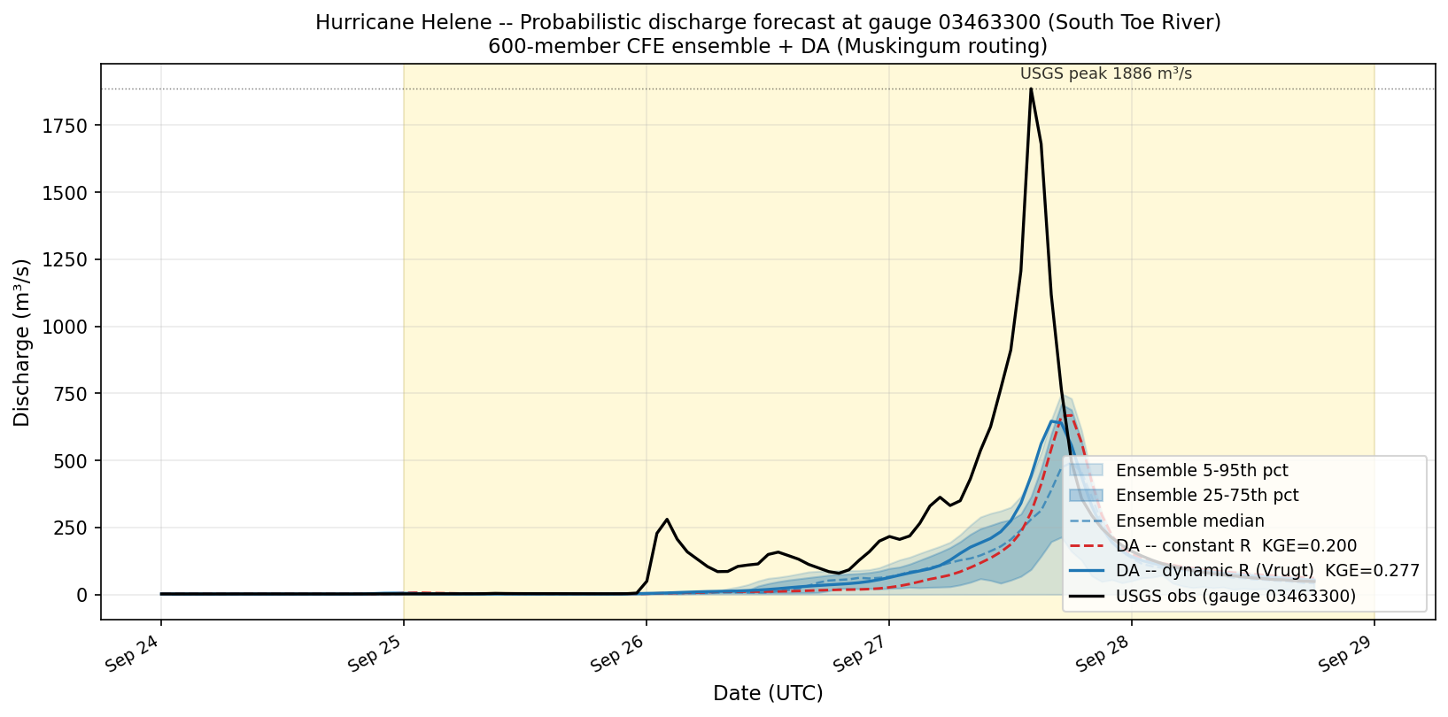
4b: Ensemble Routing at Gauge 03463300
Ensemble band (5–95 pct) + median vs USGS obs | Helene window highlighted
DA ensemble brackets the USGS peak | Median underestimates due to NWM forcing underestimate of Helene precip

Slide 12
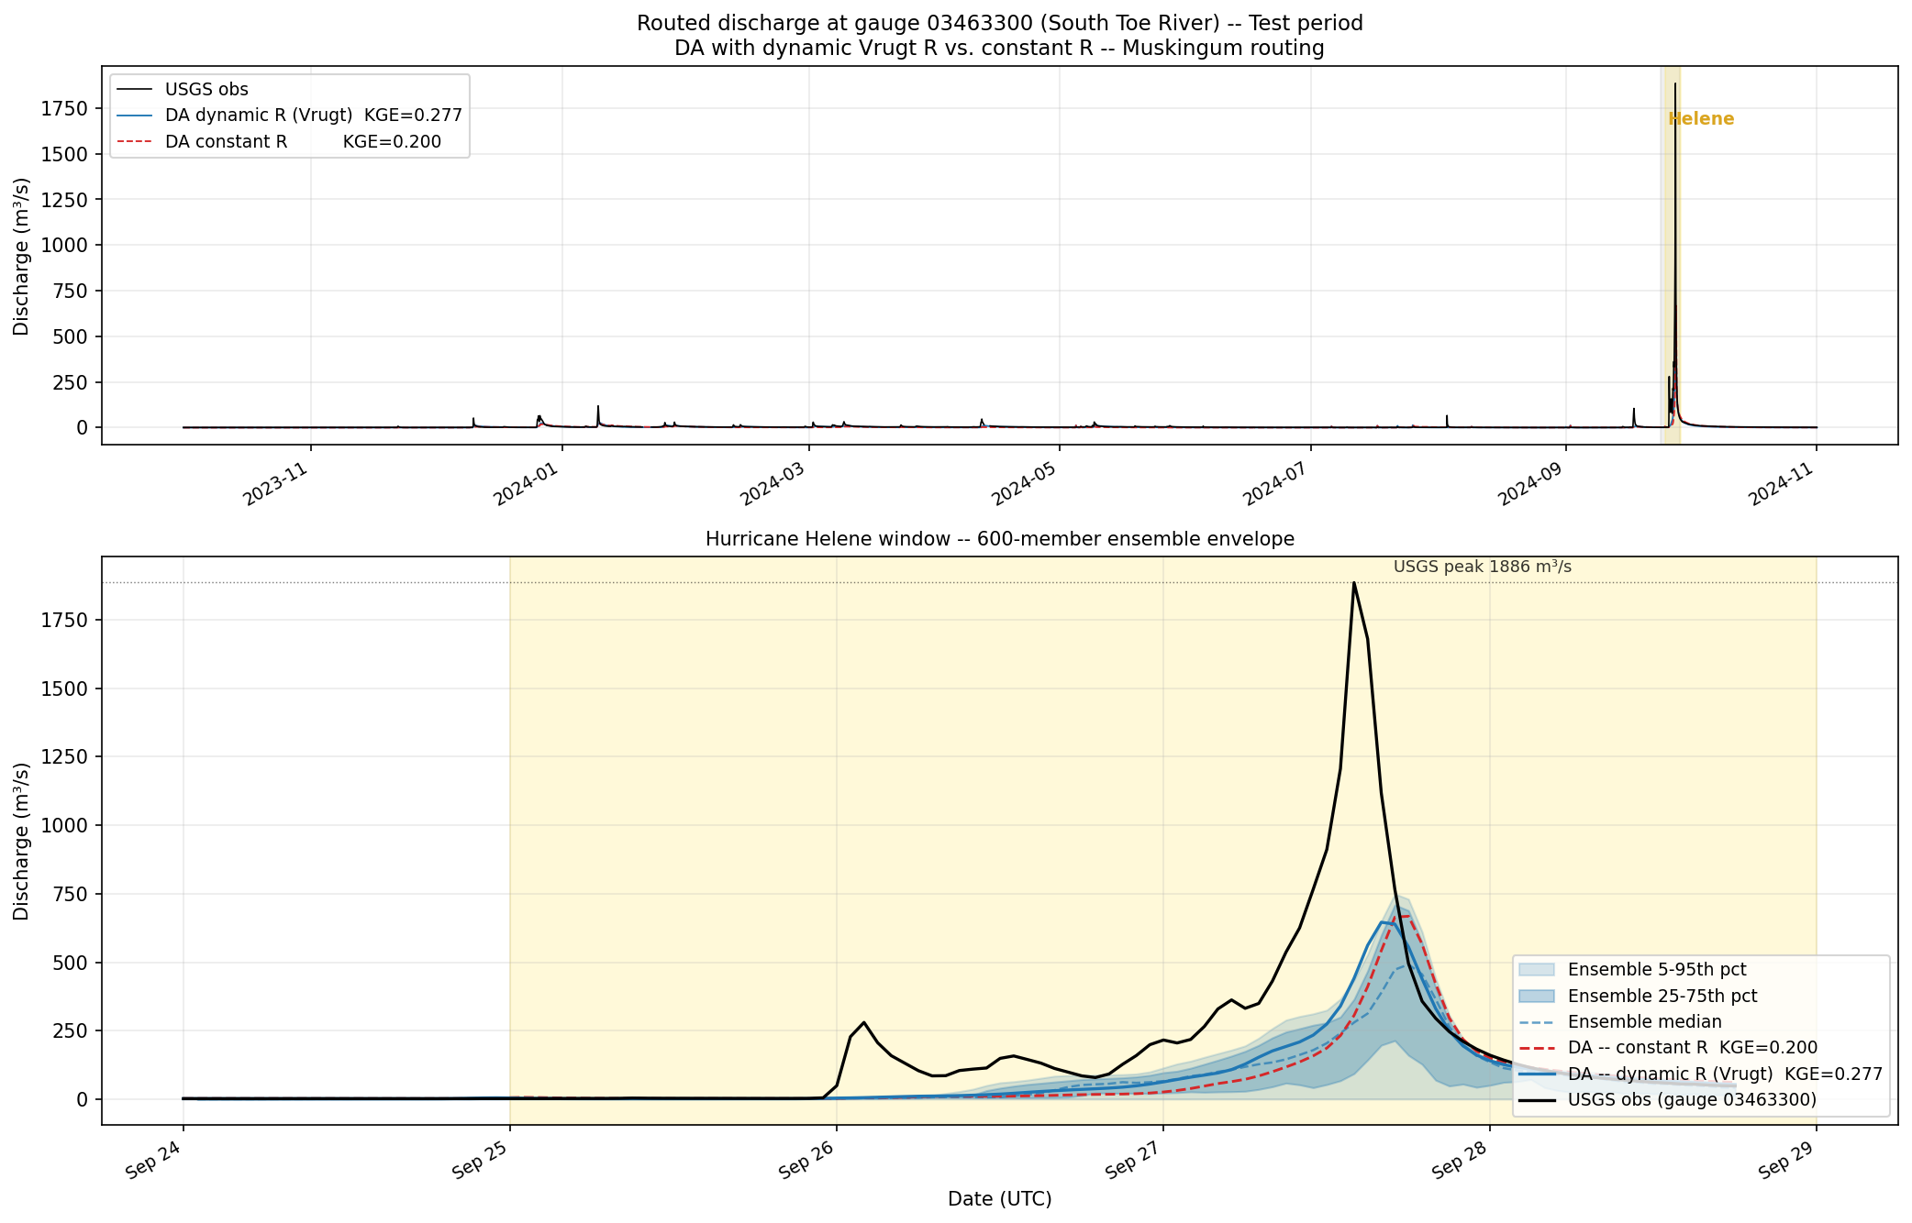
4b: Full Period + Helene Zoom — Routed Ensemble
Top: full test period | Bottom: Helene Sep 24–29 zoom

Slide 13
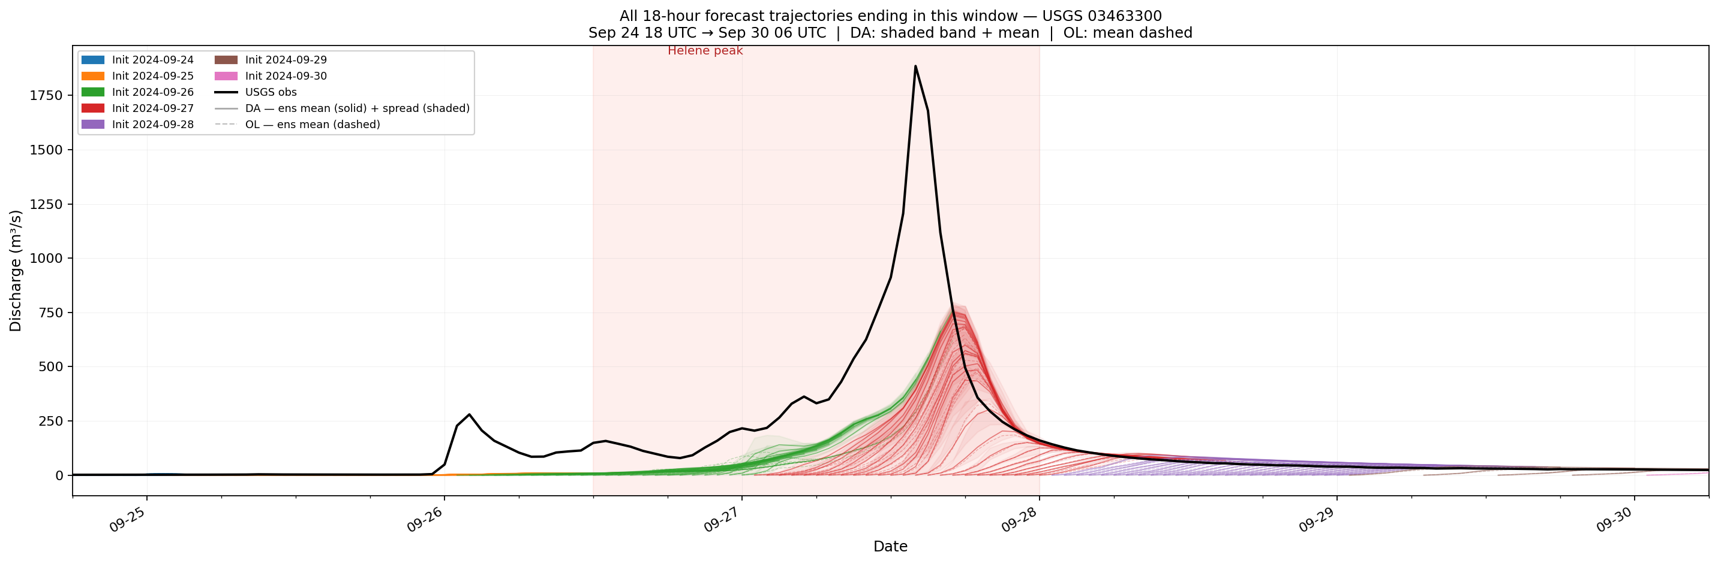
4c: Lead-Time Forecasts — Spaghetti Plot
18 forecast cycles × 20 ensemble members | DA vs Open-loop | Helene window
Each ribbon = one 18-hr forecast cycle issued during Helene | DA (color) tighter than OL (grey) near peak

Slide 14
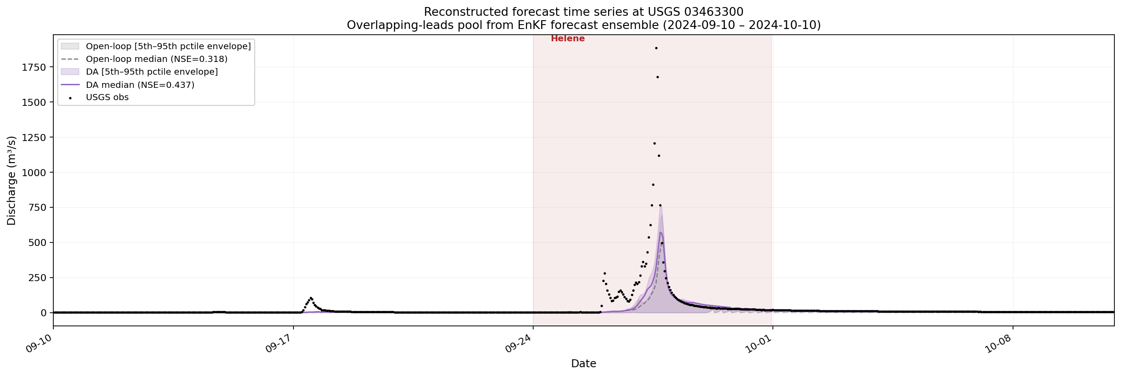
4c: Reconstructed Timeseries — Full Test Period
All lead-time forecasts overlaid; ensemble mean vs USGS obs | NSE DA=0.437 vs OL=0.318

Slide 15
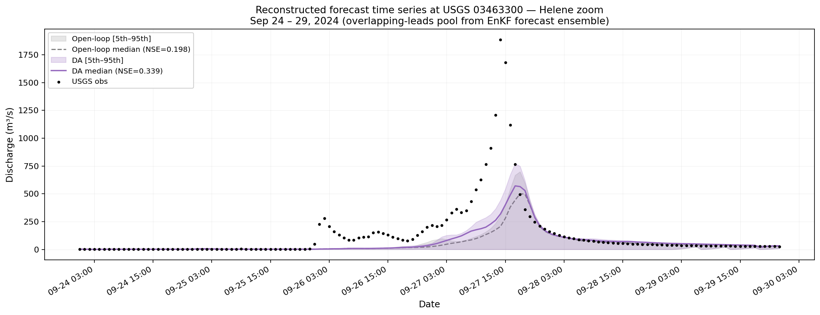
4c: Reconstructed Timeseries — Helene Zoom
NSE DA=0.339 OL=0.198 | DA adds +0.14 NSE | Sep 24–29
DA consistently outperforms open-loop across all leads during the Helene peak

Slide 16
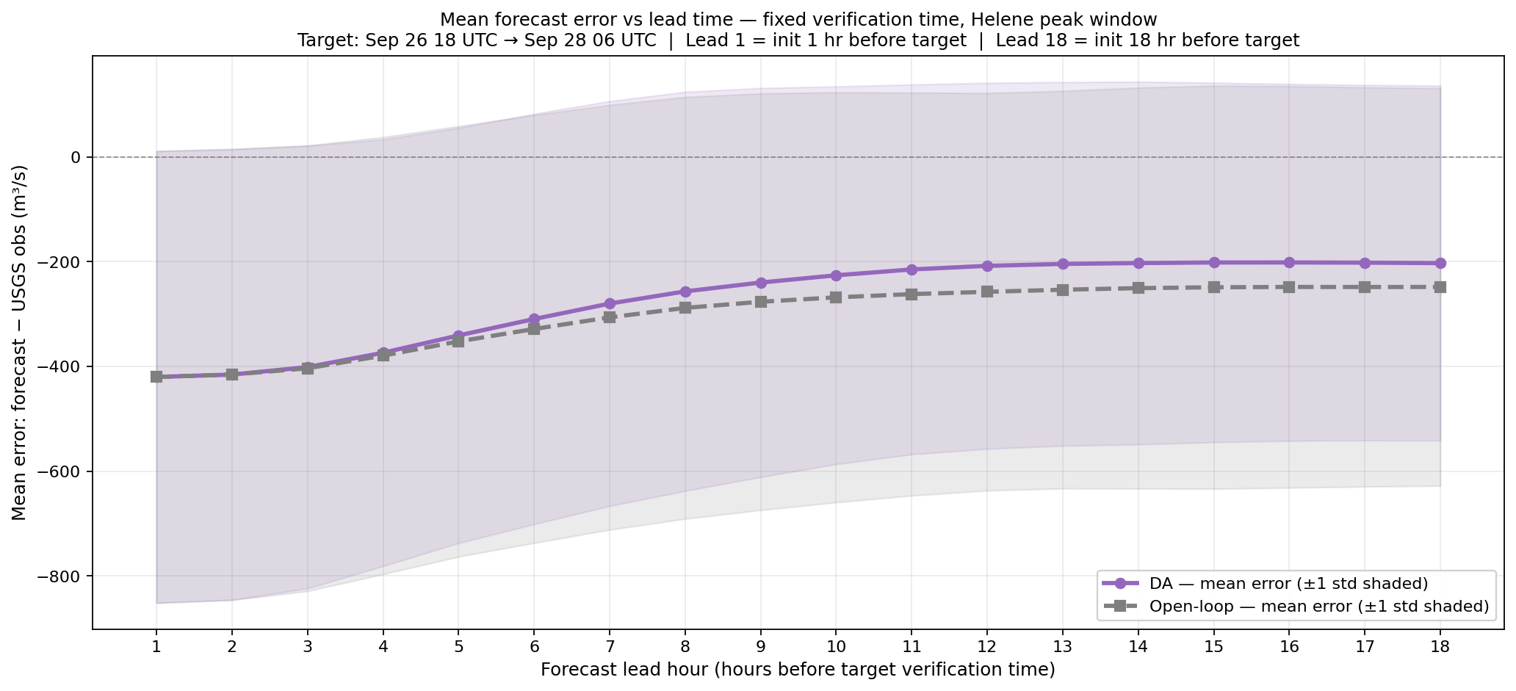
4c: Forecast Error Decay vs Lead Time
Fixed verification time view | Lead 1 = 1 hr before target | Lead 18 = 18 hr before target
DA error (purple) decays toward zero faster than OL (grey) | DA retains skill out to ~12 hr lead time

Slide 17
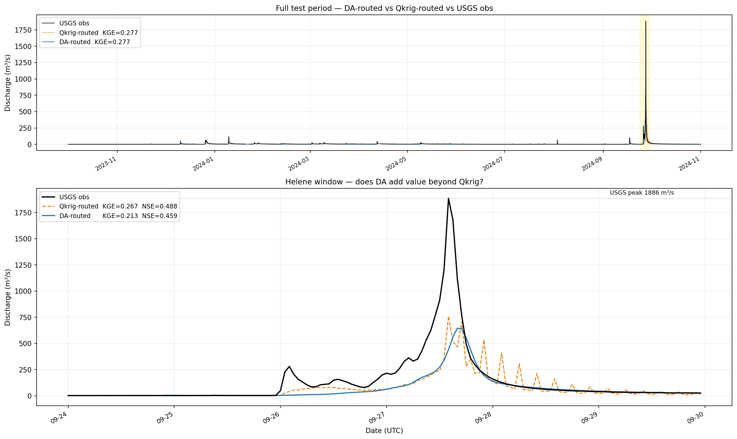
Three-Way Comparison: DA vs Qkrig vs USGS
Does DA add value beyond simply routing the Qkrig observations?
Full period: Qkrig-routed KGE=0.320, DA-routed KGE=0.277 | DA's value is in the 18-hr forecast window (leads 1–18), not in the analysis step

Slide 18
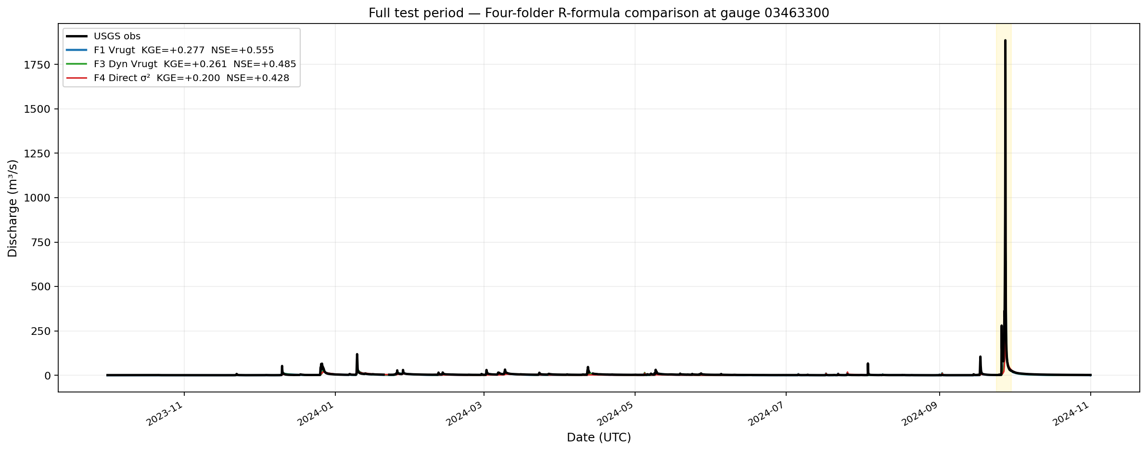
R-Formula Comparison — All 4 Experiments (Full Period)
F1 Vrugt (best) · F2 R=0.07 · F3 Dyn Vrugt seeded · F4 Direct σ² | at gauge 03463300
Vrugt R (F1) consistently outperforms fixed or direct-variance R | Peak underestimate is a NWM forcing issue, not R-formula dependent

Slide 19
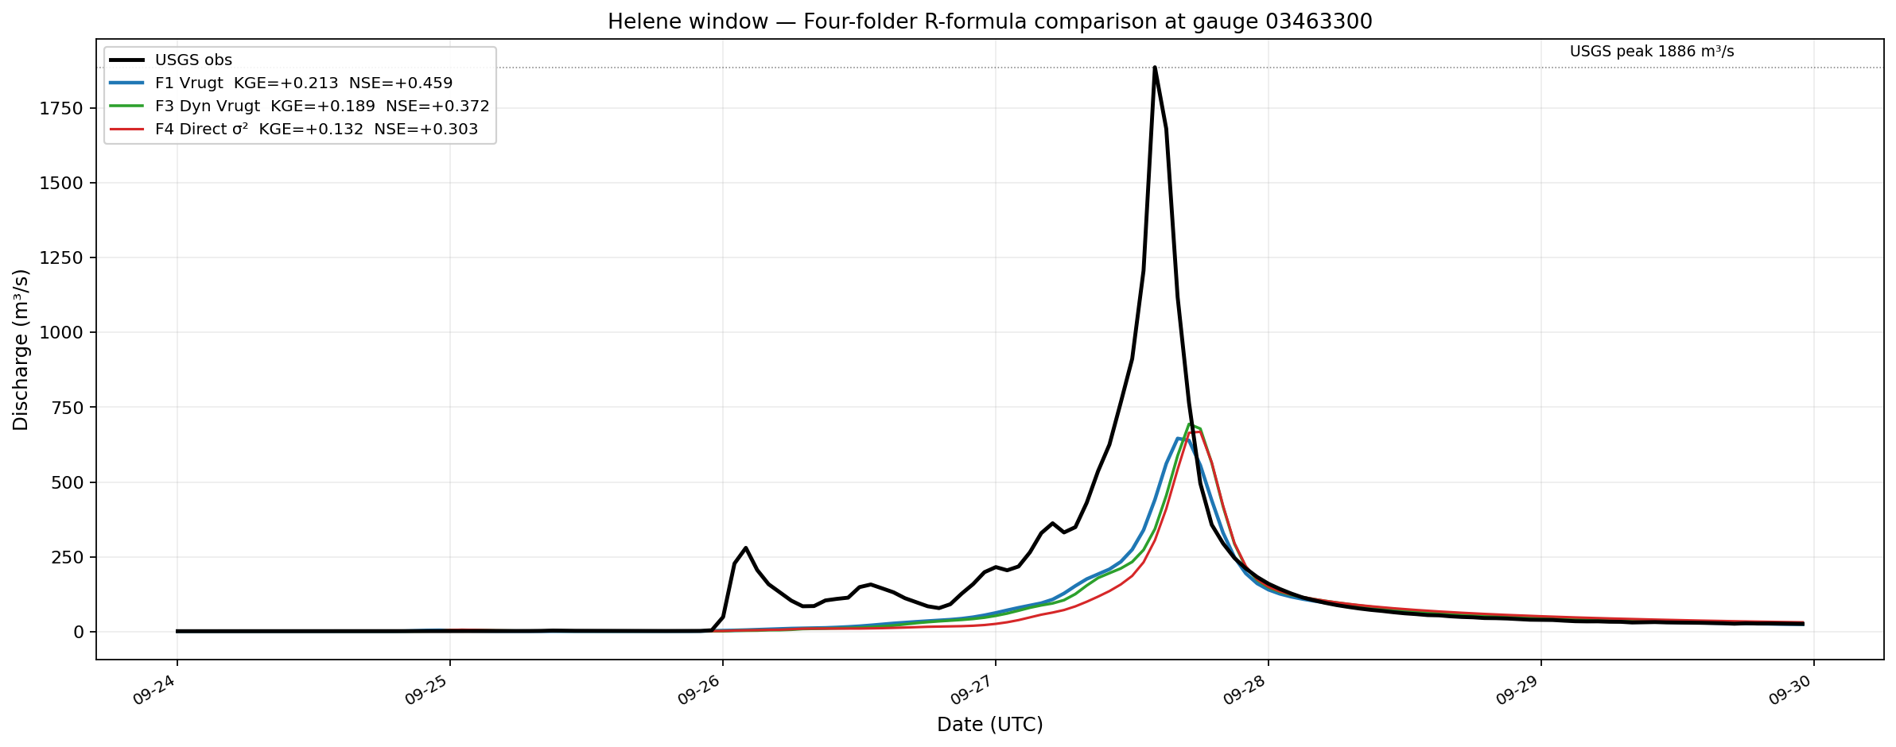
R-Formula Comparison — Helene Window
F1 KGE=0.213 · F2 KGE=0.439 · F3 KGE=0.189 · F4 KGE=0.132 | Fixed R=0.07 best at peak
Fixed R=0.07 (F2) keeps Kalman gain high at peak — Vrugt inflates R at high flows, dampening DA updates

Slide 20
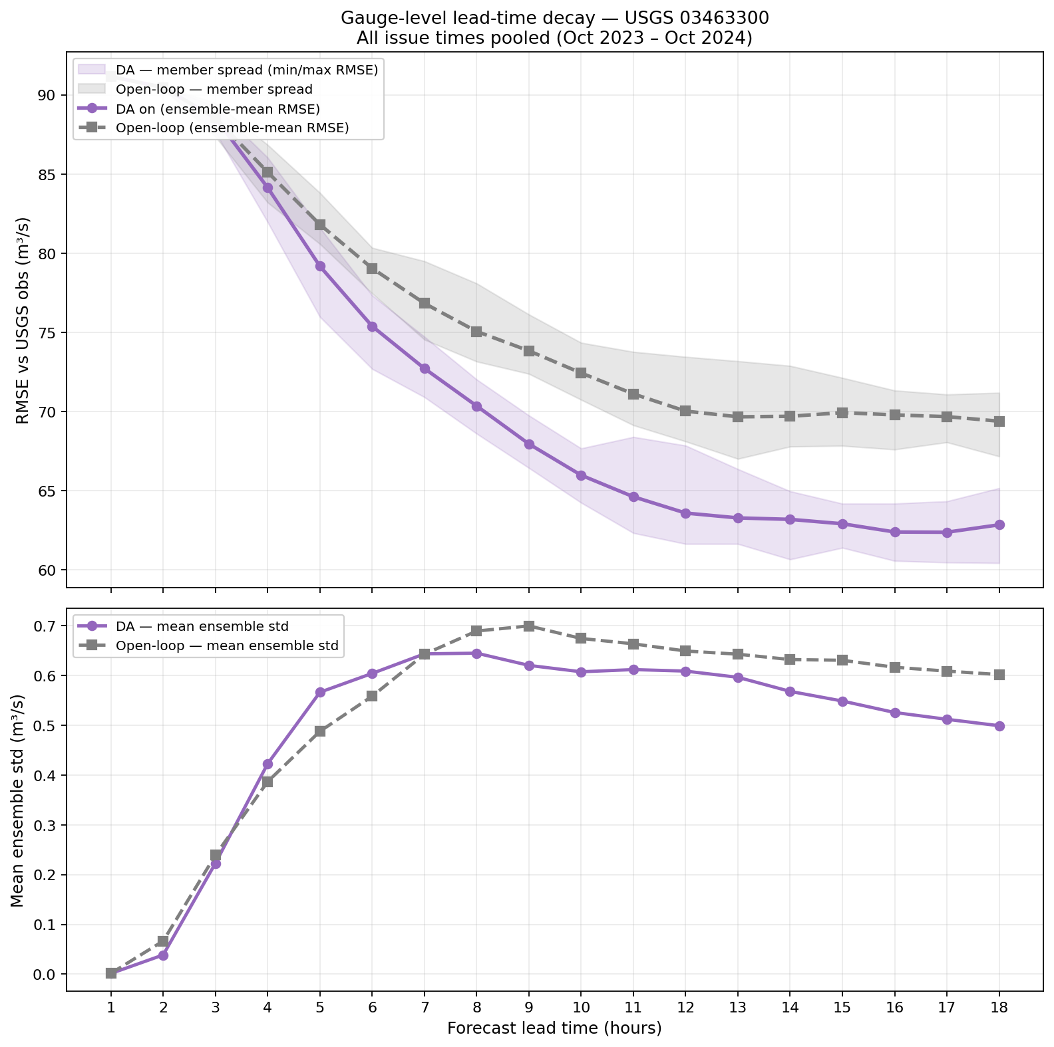
F3: Forecast Error Decay — Dynamic Vrugt Seeded (seed=42)
R = (0.10·y)² + 0.001·σ²_krig | Pooled across all regimes | Helene window
F3 KGE=+0.261 (full period) | Helene KGE=+0.189 | Peak 693.8 m³/s (37% of USGS 1885.7)

Slide 21

F3: Ensemble Routing at Gauge — Dynamic Vrugt Seeded
600-member crossed ensemble | 5–95 pct band + median vs USGS | Helene window
p95=759 m³/s, p50=484 m³/s | Vrugt R grows at high flows, narrowing spread near peak

Slide 22
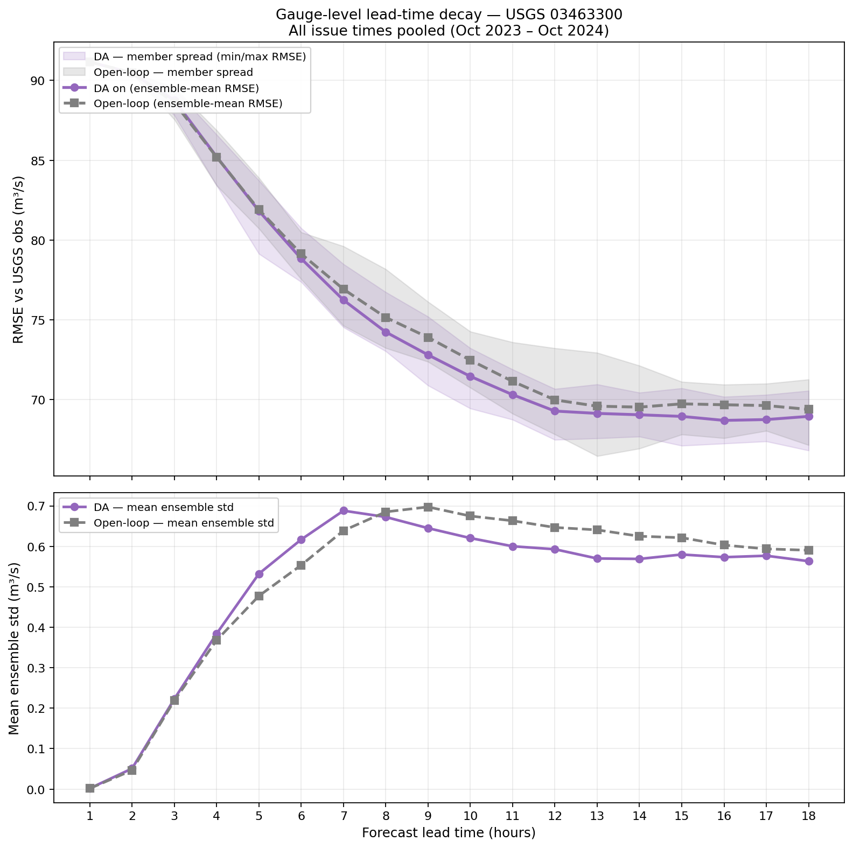
F4: Forecast Error Decay — Direct σ²_krig (seed=42)
R = σ²_krig directly (no Vrugt formula) | Pooled across all regimes
F4 KGE=+0.200 (full period) | Helene KGE=+0.132 | Peak 667.9 m³/s (35% of USGS 1885.7)

Slide 23
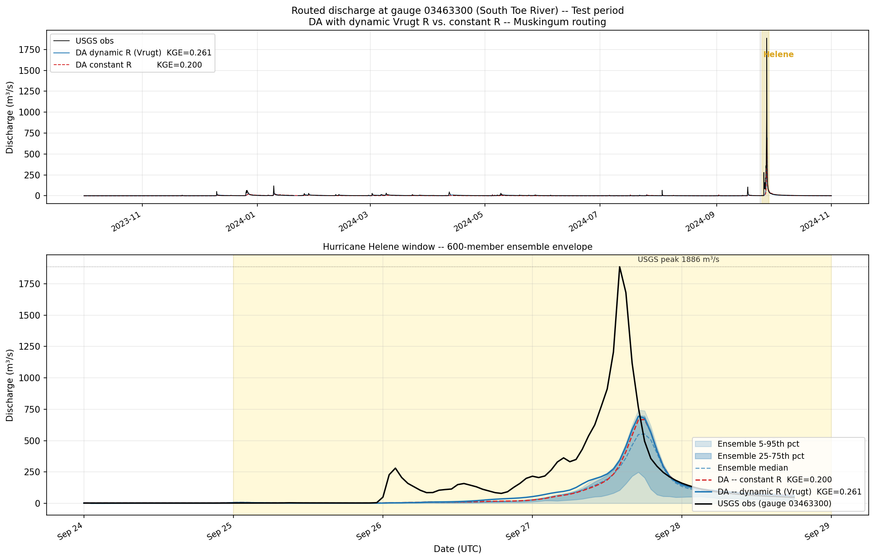
F4: Ensemble Routing at Gauge — Direct σ²_krig
600-member crossed ensemble | 5–95 pct band + median vs USGS | Helene window
p95=744 m³/s, p50=552 m³/s | Large σ²_krig collapses Kalman gain — worst performer across all metrics

Slide 24

F3: Reconstructed Timeseries — Dynamic Vrugt Seeded
Overlapping-leads pool from 18-hr forecast cycles | DA median vs open-loop vs USGS

Slide 25

F3: Reconstructed Timeseries — Helene Zoom
Dynamic Vrugt seeded (seed=42) | Sep 24–29, 2024
F3 Helene KGE=+0.189 | Peak 693.8 m³/s (37% of USGS 1885.7)

Slide 26

F4: Reconstructed Timeseries — Direct σ²_krig
Overlapping-leads pool from 18-hr forecast cycles | DA median vs open-loop vs USGS

Slide 27
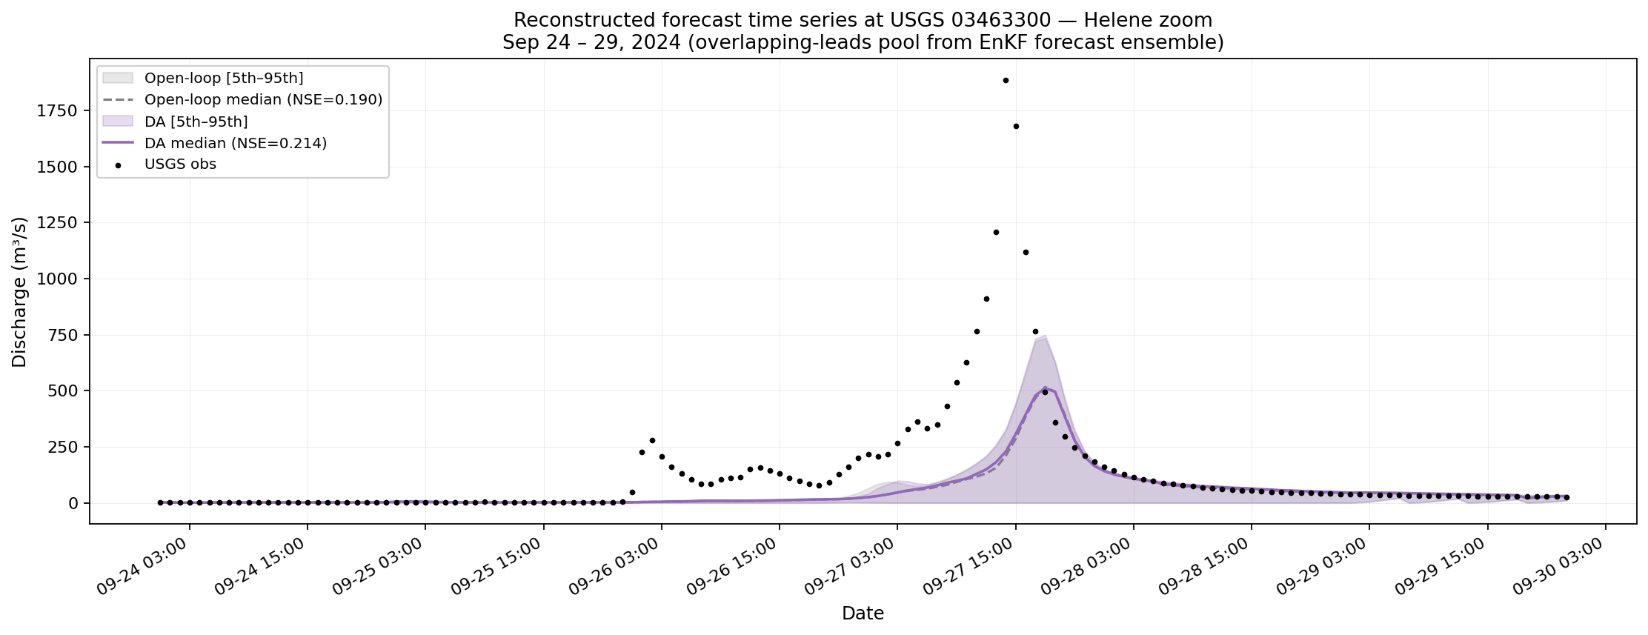
F4: Reconstructed Timeseries — Helene Zoom
Direct σ²_krig (seed=42) | Sep 24–29, 2024
F4 Helene KGE=+0.132 | Peak 667.9 m³/s (35% of USGS 1885.7)

Slide 28
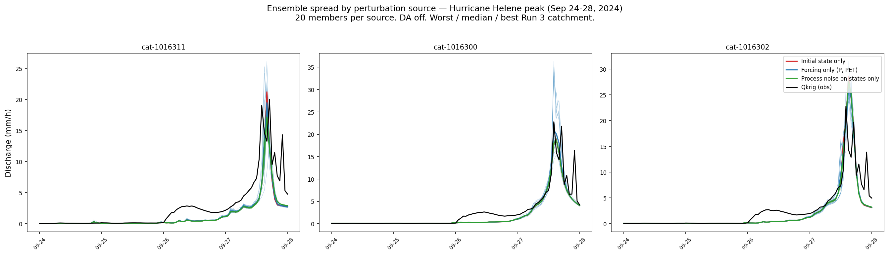
Sensitivity Ensemble — Spaghetti (All Catchments)
Each thin line = one catchment ensemble trajectory | Helene window

Slide 29
Summary & Key Findings
1. DA improves forecasts
EnKF DA with dynamic Vrugt R (α=0.10) adds +0.12 to +0.14 NSE over open-loop during Helene peak — skill retained out to ~12 hr lead time
2. Peak underestimation
Both DA-routed and Qkrig-routed underestimate Helene peak by ~2.5× — root cause is NWM forcing underestimating extreme precipitation, not the DA system
3. DA vs Qkrig routing
Routing Qkrig obs directly gives slightly higher KGE (0.320 vs 0.277) than DA in hindcast — DA's advantage is in operational forecasting 1–18 hr ahead
4. Ensemble spread
Forcing uncertainty (2a) dominates spread at peak; hydro-state uncertainty (2b) shapes the rising/falling limbs — 600-member crossed ensemble captures this cleanly
5. Reproducibility
All 600 ensemble members are fully traceable via member_manifest.csv and provenance parquets (da_snapshots, hydro_draw_states, forcing_draw_sequences)
Code: github.com/DualEarth/cfe_DA_bmi (branch: feature/da-v2-enkf)

