Slide 1
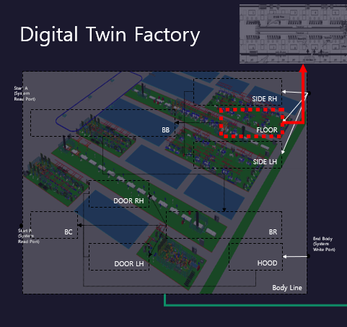
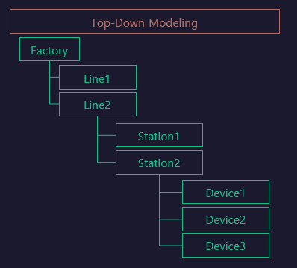
Line

Slide 2
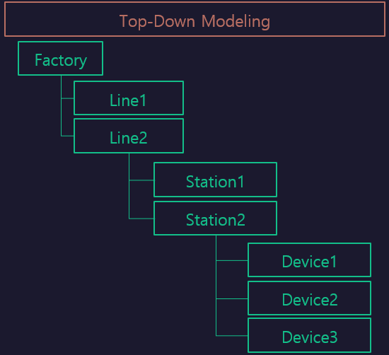

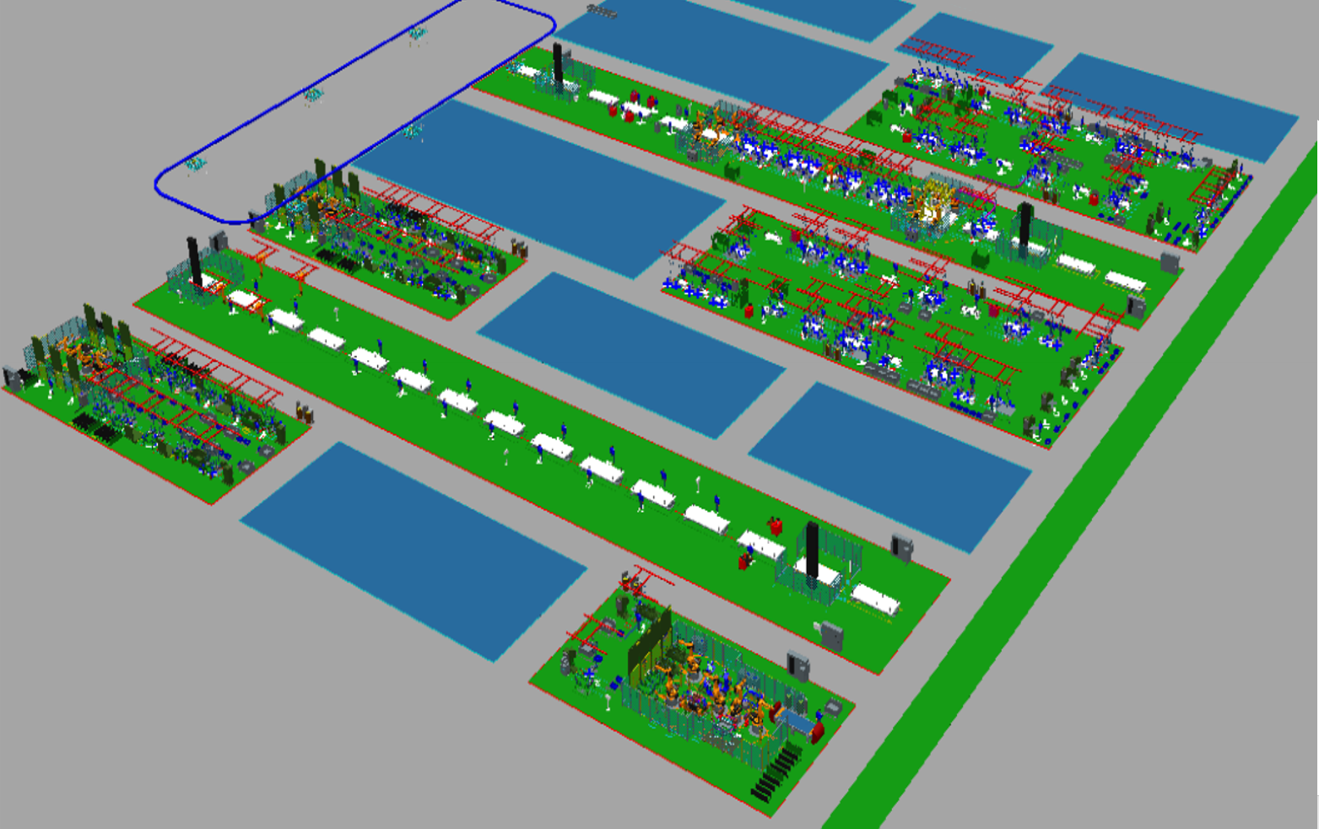
LineFlow
Func1
[RUN ~ BC]
SIDE RH
BB
FLOOR
Station $Func2
Station $Func1
Func2
[REMOVE~]
SIDE LH
Sub/Station
[Station]
DOOR RH
RUN
BC
BR
DOOR LH
MOVING
REMOVE

