Slide 1
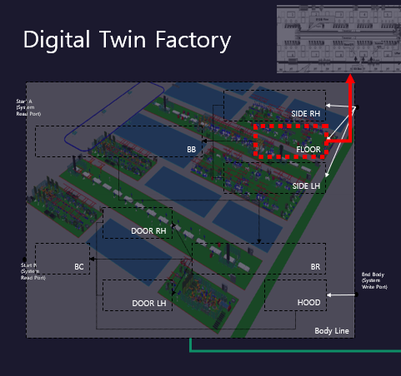
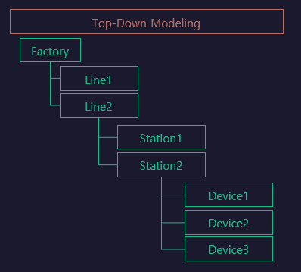
Station

Slide 2
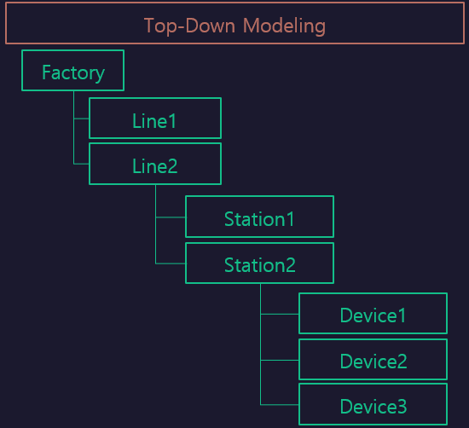

StationFlow
LH_WORK
LH$
Func1
LH$
Func2
Func1
[START
~FINISH]
START
FINISH
Func2
[RESET
~]
RH_WORK
RH$
Func1
RH$
Func2
Sub/LH
[LH]
Sub/RH
[RH]
RESET

