Slide 1
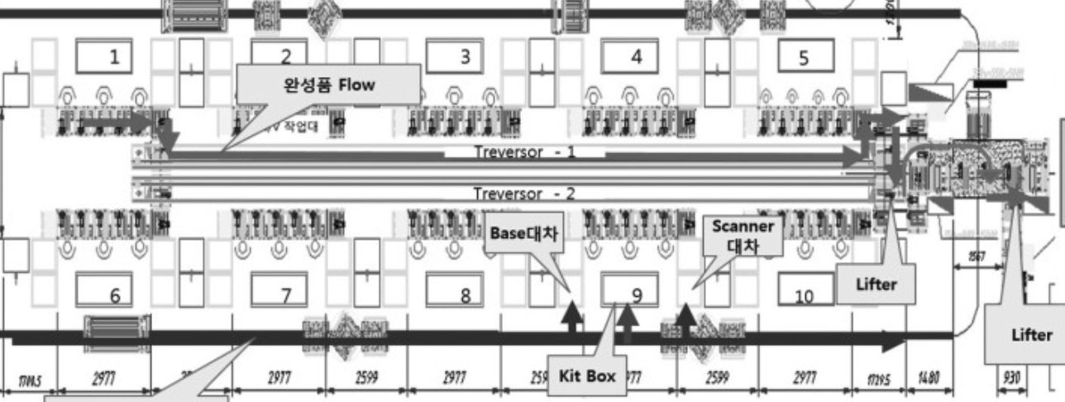
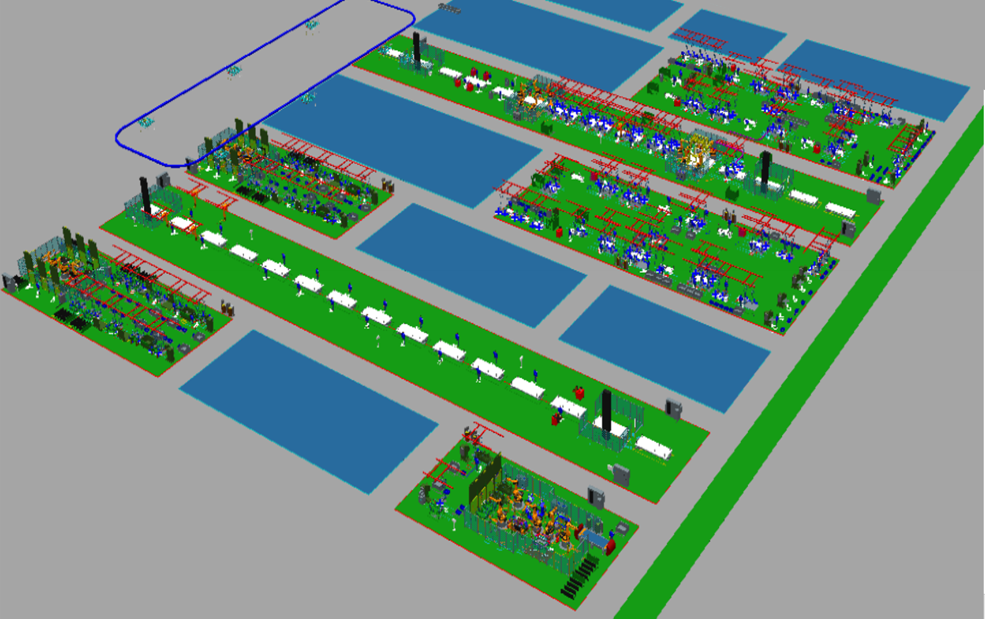
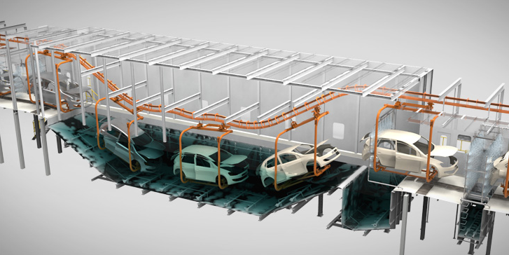
Digital Twin Factory
Top-Down Modeling
Factory
Line1
Line2
Body Line
Start A
(System Read Port)
SIDE RH
Station1
Station2
FLOOR
BB
Device1
Device2
SIDE LH
Device3
DOOR RH
Paint Line
P1
P2
BR
BC
Start Paint
(System Read Port)
Start B
(System Read Port)
P3
End Body
(System Write Port)
P4
HOOD
DOOR LH
P5
P6
End Paint
(System Write Port)

Slide 2
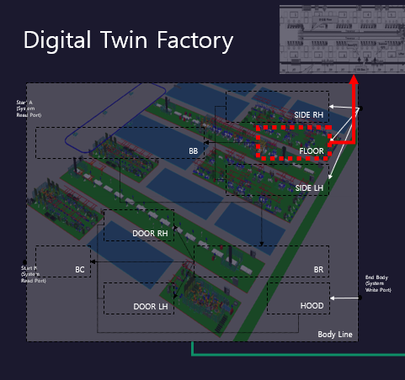
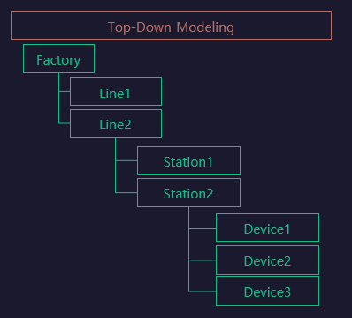
StationLH

Slide 3
StationFlow_LH
../../../lib/Cylinder/Double
[1stClamp01]
../../../lib/Cylinder/Double
[1stClamp02]
../../../lib/Cylinder/Double
[2ndClamp01]
../../../lib/Cylinder/Double
[2ndClamp02]
S131
S132
RbtHand01
$LOAD
RbtHand02
$LOAD
1stClamp01
$ADV
1stClamp02
$ADV
../../../lib/Cylinder/Single
[Pin01]
../../../lib/Cylinder/Single
[Pin02]
2ndClamp01
$ADV
PART01
$MOVE
2ndClamp02
$ADV
PART02
$ MOVE
../../../lib/Robot/Weld
[RbtWeld01]2
../../../lib/Robot/Weld
[RbtWeld02]2
2ndClamp01
$RET
2ndClamp02
$RET
RbtWeld01
$WELD
RbtWeld02
$WELD
../../../lib/Robot/Handling
[RbtHand01]
../../../lib/Robot/Handling
[RbtHand02]
1stClamp01
$RET
RbtWeld01
$HOME
1stClamp02
$RET
RbtWeld02
$HOME
RbtHand01
$UNLOAD
RbtHand02
$UNLOAD
Pin01
$RET
PART01
$REMOVE
Pin02
$RET
PART02
$ REMOVE
../../../lib/Part/Sensor
[PART01]
../../../lib/Part/Sensor
[PART02]
Pin01
$ADV
RbtHand01
$HOME
Pin02
$ADV
RbtHand02
$HOME
RH[RH_EXT]
Func1
[S131~S132]
CLEAR
Func2
[CLEAR~]

