Slide 1
Cylinder
복동 Air 실린더

Slide 2
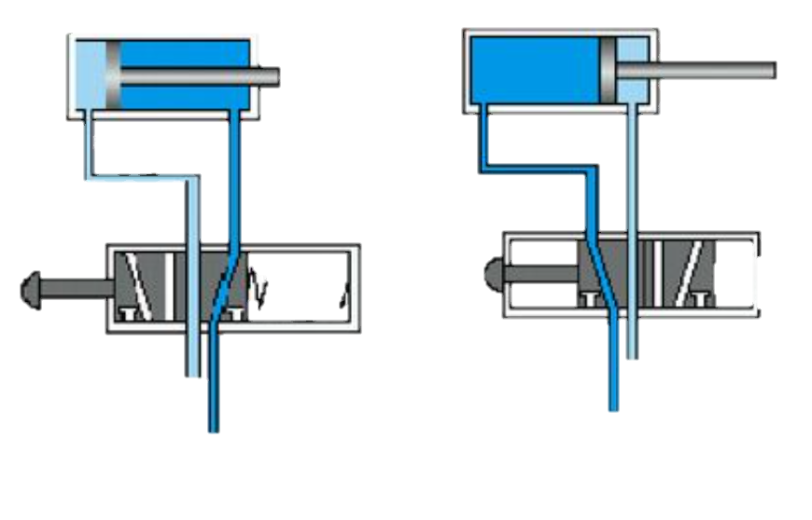
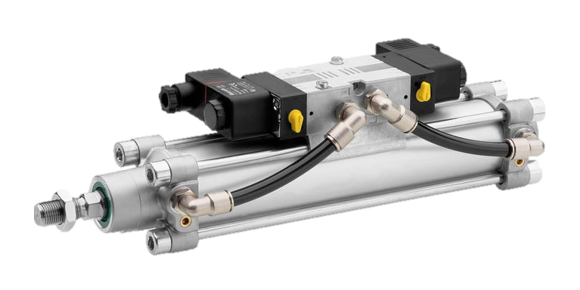
Flow
ADV
[ValveADV ~ SensorADV]
Valve
ADV
Piston
ADV
Sensor
ADV
RET
[ValveRET ~ SensorRET]
Valve
RET
Piston
RET
Sensor
RET

Slide 3
Flow
ADV
[ValveADV ~ ValveADV]
Valve
ADV
RET
[ValveRET ~ ValveRET]
Valve
RET

