Slide 1
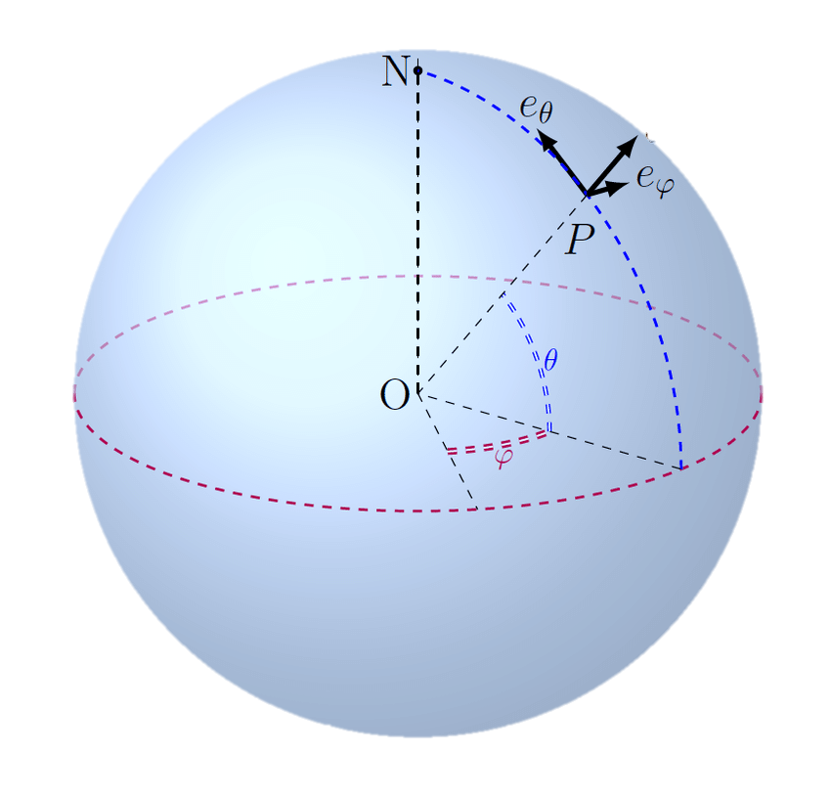




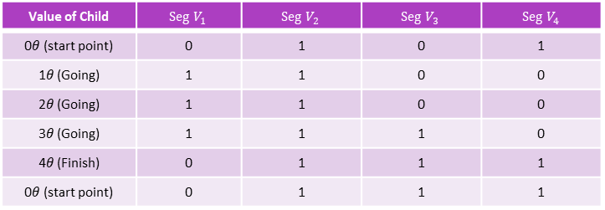


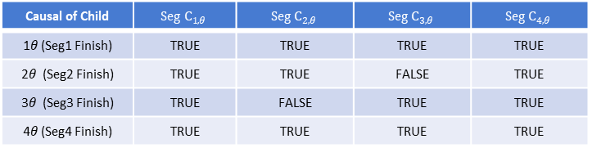
행위는 복수개의 시작점을 가질 수 있다. ${\text{Segment}}^{\text{φ}}$ = {${\text{φ}}_{1}$, ${\text{φ}}_{2}$, …, ${\text{φ}}_{k}$}
1. 시작 가능 경우의 수: Number of start point = $2^{n−r}$
(n = number of children , r = number of value fixed children)
$\text{시작점} 값 구하기 (각도법){\text{φ}}_{k}$ $°$ = ${\text{(}01010111…\text{n}\text{)}}_{2}$ / $2^{n}$ x $360°$
$\text{시작점} 값 구하기 (호도법){\text{φ}}_{k}\text{rad}\text{= }{\text{(}01010111…\text{n}\text{)}}_{2} \text{/ }2^{n} \text{x} \text{radian}$
2. ${\text{Segment}}^{\text{φ}} 값 \text{Start} \text{Point} 공식 :{\text{φ}}_{k}$= $\sum_{i=1}^{n}{(2^{i−1}V_{i})}$/ $2^{n}$ x $2π$
($V_{i}$ = The value of the i-th child (1 or 0))
3. ${\text{Segment}}^{\text{φ}} 값$ Causal 공식 : ${\text{φ}}_{θ}$= $\sum_{i=1}^{n}{(2^{i−1}V_{i}C_{(i,θ)})}$/ $2^{n}$ x $2π$
($θ$= $2π$/n, $C_{(i,θ)}$ = The Causal of the i-th child when $θ$(1=causal or 0=noncausal))
$θ$= $2π$/n
${\text{φ}}_{θ}$= $\sum_{i=1}^{n}{(2^{i−1}V_{i}C_{(i,θ)})}$/ $2^{n}$ x $2π$
Value of Child | $$Seg V_{1}$$ | $$Seg V_{2}$$ | $$Seg V_{3}$$ | $$Seg V_{4}$$
0$θ$(start point) | 0 | 1 | 0 | 1
1$θ$ (Going) | 1 | 1 | 0 | 0
2$θ$ (Going) | 1 | 1 | 0 | 0
3$θ$ (Going) | 1 | 1 | 1 | 0
4$θ$ (Finish) | 0 | 1 | 1 | 1
0$θ$(start point) | 0 | 1 | 1 | 1
Segment A
$V_{i}$ : $θ$ 시점에 모든 Node별로 Value 관찰 (On :1 , Off: 0)
Ex) Segment A = {
Seg1 > Seg2 ; Seg1 > Seg3
Seg2 > Seg4 ; Seg3 > Seg4
Seg1 <|> Seg4
}
Causal of Child | $$Seg C_{1, θ}$$ | $$Seg C_{2, θ}$$ | $$Seg C_{3, θ}$$ | $$Seg C_{4, θ}$$
1$θ$ (Seg1 Finish) | TRUE | TRUE | TRUE | TRUE
2$θ$ (Seg2 Finish) | TRUE | TRUE | FALSE | TRUE
3$θ$ (Seg3 Finish) | TRUE | FALSE | TRUE | TRUE
4$θ$ (Seg4 Finish) | TRUE | TRUE | TRUE | TRUE
Seg2
Seg1
Seg4
Seg3
$C_{(i,θ)}$ : $θ$ 시점에 모든 Node별로 Causal 계산 (병렬 Start/Reset Edge 존재시에 noncausal 판정)

