Slide 1
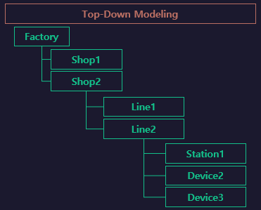

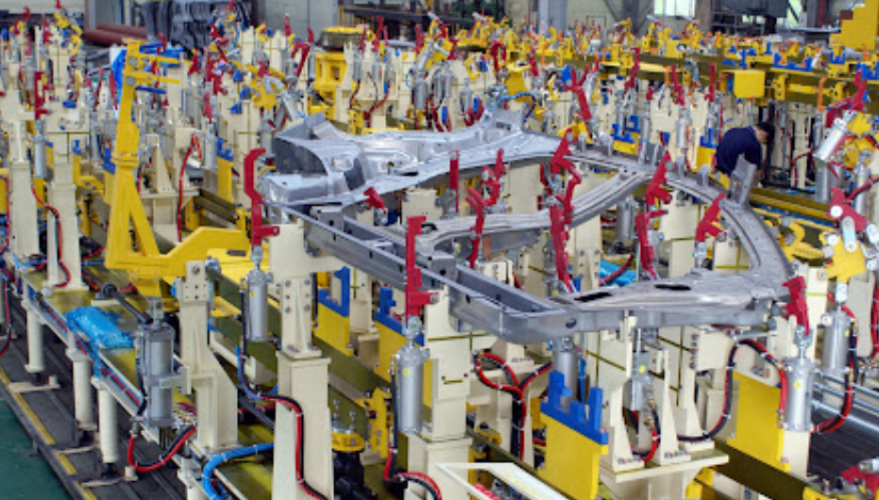

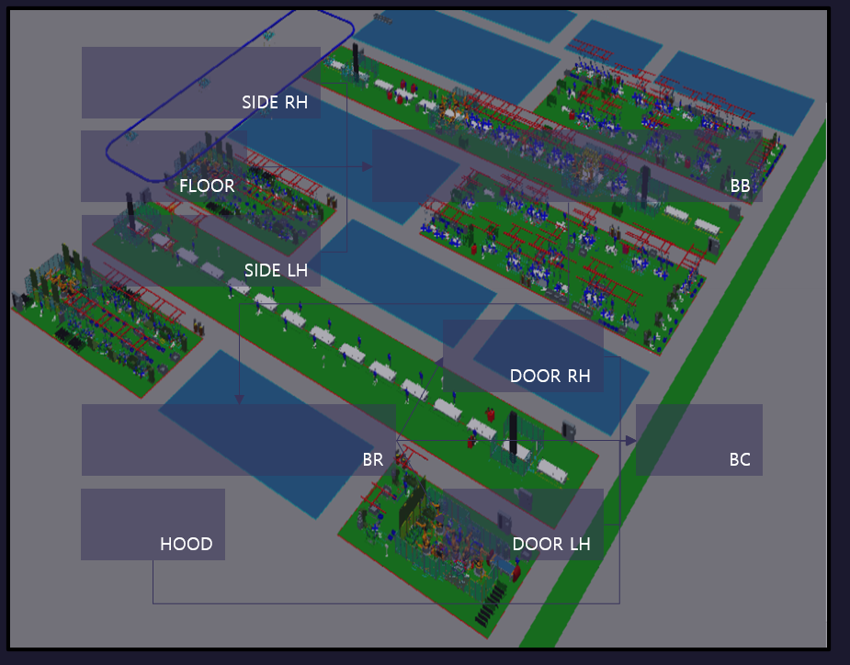
tt
S771
S712
S713
S714
S715
S716

Slide 2
LineFlow
Buffer
Buffer1
Buffer2
Buffer3
START
[Buffer
~ Buffer]
END
[Unload
~ Unload]
S711
.Work
S712
.Work
S714
.Work
Unload
RBT717.
IN_OK_1ST_A
S713
.Work
RBT717.
IN_OK_2nd
UNLOAD
[UnloadClear
~ UnloadClear]
RBT717.
WORK_COMP_RST
UnloadClear
sub/Robot
[RBT717]
Clear

Slide 3
S711
Work
RbtHand01
.LOAD
1stClamp01
.ADV
2ndClamp01
.ADV
PART01
.MOVE
2ndClamp01
.RET
RbtWeld01
.WELD
1stClamp01
.RET
RbtWeld01
.HOME
RbtHand01
.UNLOAD
Pin01
.RET
PART01
.REMOVE
Pin01
.ADV
RbtHand01
.HOME

Slide 4
S712
Work
RbtHand01
.LOAD
1stClamp01
.ADV
2ndClamp01
.ADV
PART01
.MOVE
2ndClamp01
.RET
RbtWeld01
.WELD
1stClamp01
.RET
RbtWeld01
.HOME
RbtHand01
.UNLOAD
Pin01
.RET
PART01
.REMOVE
Pin01
.ADV
RbtHand01
.HOME

Slide 5
S713
Work
RbtHand01
.LOAD
1stClamp01
.ADV
2ndClamp01
.ADV
PART01
.MOVE
2ndClamp01
.RET
RbtWeld01
.WELD
1stClamp01
.RET
RbtWeld01
.HOME
RbtHand01
.UNLOAD
Pin01
.RET
PART01
.REMOVE
Pin01
.ADV
RbtHand01
.HOME

Slide 6
S714
Work
RbtHand01
.LOAD
1stClamp01
.ADV
2ndClamp01
.ADV
PART01
.MOVE
2ndClamp01
.RET
RbtWeld01
.WELD
1stClamp01
.RET
RbtWeld01
.HOME
RbtHand01
.UNLOAD
Pin01
.RET
PART01
.REMOVE
Pin01
.ADV
RbtHand01
.HOME

