Slide 1
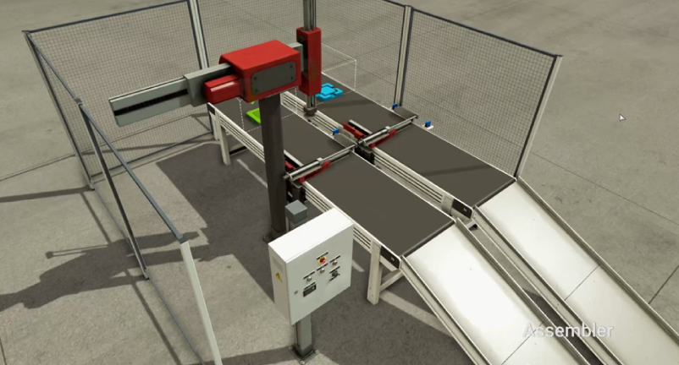
CV
GO
[CV+ ~ Part]
PARTOFF
[Part Remove ~ _]
Robot X-
Sub
Robot X+
Robot Z-
CV+
Part
MAIN
Assy
Robot Z+
Part Remove

