Slide 1
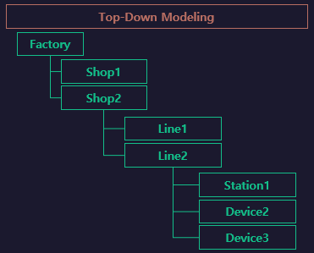

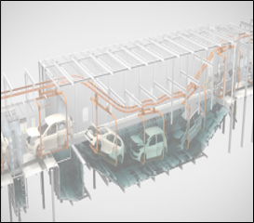
PaintShop
Paint Lines

Slide 2
Flow
START
[start ~ start]
start
END
[end ~ end]
UNLOAD
[UnloadClear
~ UnloadClear]
end
UnloadClear
UnloadClear
Clear

