Slide 1
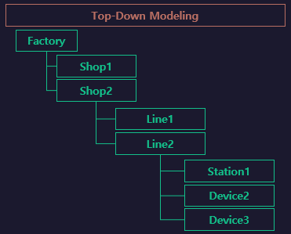
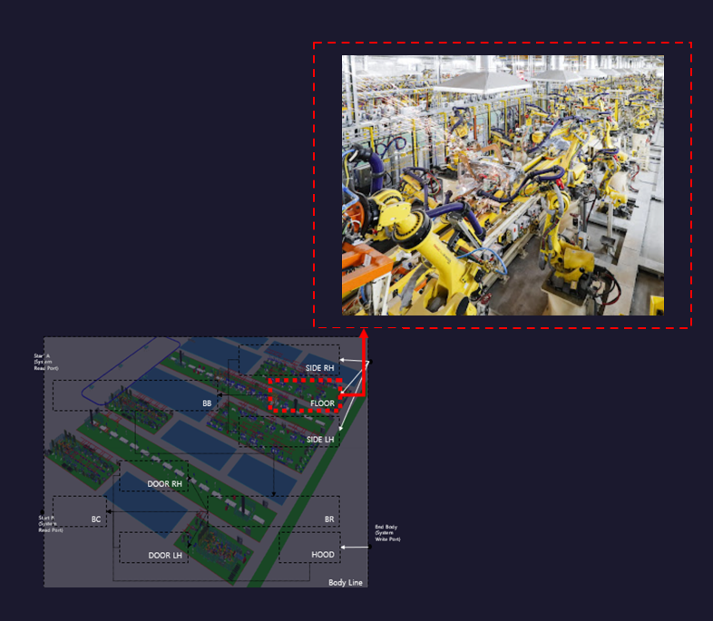

Floor
S111
S112
S113
S114
S115
S116

Slide 2
LineFlow
Buffer
Buffer1
Buffer2
Buffer3
START
[Buffer
~ Buffer]
END
[Unload
~ Unload]
S111
.Work
S112
.Work
S113
.Work
S114
.Work
Unload
RBT117.
LOAD
RBT117.
UNLOAD
UNLOAD
[UnloadClear
~ UnloadClear]
RBT117.
HOME
UnloadClear
../../lib/Robot/Handling
[RBT117]
Clear

Slide 3
S111
../../lib/Cylinder/Single
[Pin01]
../../lib/Cylinder/Single
[Pin02]
Work
../../lib/Robot/Weld
[RbtWeld01]
../../lib/Robot/Weld
[RbtWeld02]
RbtHand01
.LOAD
1stClamp01
.ADV
../../lib/Robot/Handling
[RbtHand01]
../../lib/Robot/Handling
[RbtHand02]
2ndClamp01
.ADV
PART01
.MOVE
../../lib/Part/Sensor
[PART01]
../../lib/Part/Sensor
[PART02]
2ndClamp01
.RET
RbtWeld01
.WELD
1stClamp01
.RET
RbtWeld01
.HOME
RbtHand01
.UNLOAD
Pin01
.RET
PART01
.REMOVE
Pin01
.ADV
RbtHand01
.HOME

Slide 4
S112
../../lib/Cylinder/Single
[Pin01]
../../lib/Cylinder/Single
[Pin02]
Work
../../lib/Robot/Weld
[RbtWeld01]
../../lib/Robot/Weld
[RbtWeld02]
RbtHand01
.LOAD
1stClamp01
.ADV
../../lib/Robot/Handling
[RbtHand01]
../../lib/Robot/Handling
[RbtHand02]
2ndClamp01
.ADV
PART01
.MOVE
../../lib/Part/Sensor
[PART01]
../../lib/Part/Sensor
[PART02]
2ndClamp01
.RET
RbtWeld01
.WELD
1stClamp01
.RET
RbtWeld01
.HOME
RbtHand01
.UNLOAD
Pin01
.RET
PART01
.REMOVE
Pin01
.ADV
RbtHand01
.HOME

Slide 5
S113
../../lib/Cylinder/Single
[Pin01]
../../lib/Cylinder/Single
[Pin02]
Work
../../lib/Robot/Weld
[RbtWeld01]
../../lib/Robot/Weld
[RbtWeld02]
RbtHand01
.LOAD
1stClamp01
.ADV
../../lib/Robot/Handling
[RbtHand01]
../../lib/Robot/Handling
[RbtHand02]
2ndClamp01
.ADV
PART01
.MOVE
../../lib/Part/Sensor
[PART01]
../../lib/Part/Sensor
[PART02]
2ndClamp01
.RET
RbtWeld01
.WELD
1stClamp01
.RET
RbtWeld01
.HOME
RbtHand01
.UNLOAD
Pin01
.RET
PART01
.REMOVE
Pin01
.ADV
RbtHand01
.HOME

Slide 6
S114
../../lib/Cylinder/Single
[Pin01]
../../lib/Cylinder/Single
[Pin02]
Work
../../lib/Robot/Weld
[RbtWeld01]
../../lib/Robot/Weld
[RbtWeld02]
RbtHand01
.LOAD
1stClamp01
.ADV
../../lib/Robot/Handling
[RbtHand01]
../../lib/Robot/Handling
[RbtHand02]
2ndClamp01
.ADV
PART01
.MOVE
../../lib/Part/Sensor
[PART01]
../../lib/Part/Sensor
[PART02]
2ndClamp01
.RET
RbtWeld01
.WELD
1stClamp01
.RET
RbtWeld01
.HOME
RbtHand01
.UNLOAD
Pin01
.RET
PART01
.REMOVE
Pin01
.ADV
RbtHand01
.HOME

