Slide 1
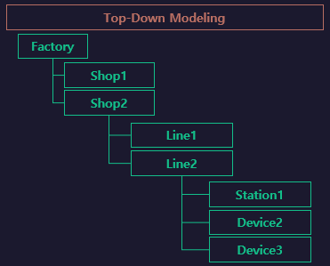

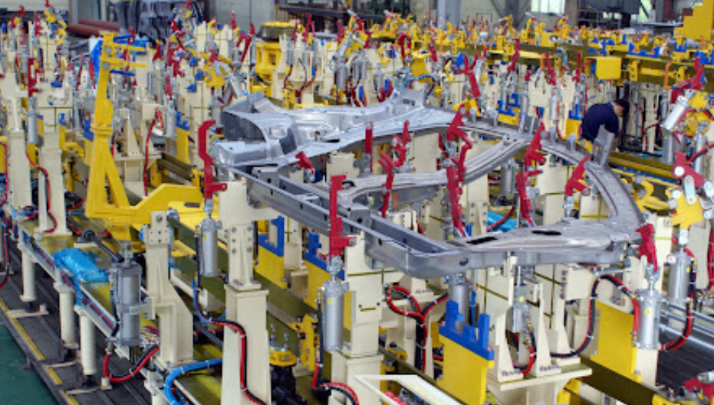

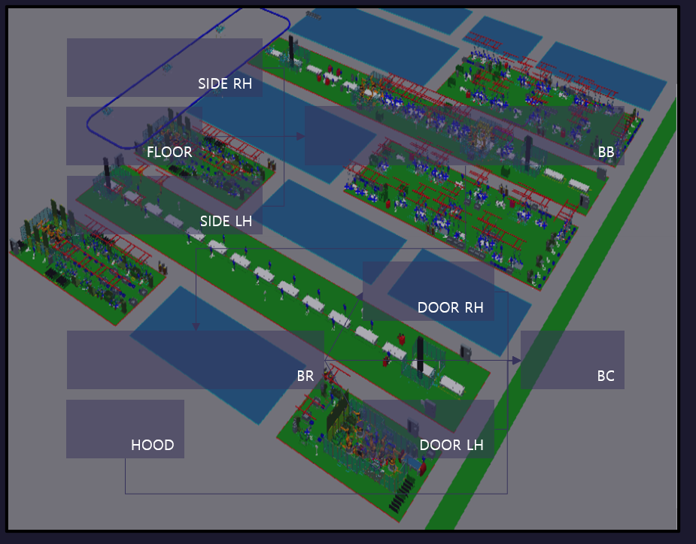
Side
S771
S712
S713
S714
S715
S716

Slide 2
LineFlow
Buffer
Buffer1
Buffer2
Buffer3
START
[Buffer
~ Buffer]
END
[Unload
~ Unload]
S711
.Work
S712
.Work
S714
.Work
Unload
RBT717.
LOAD
S713
.Work
RBT717.
UNLOAD
UNLOAD
[UnloadClear
~ UnloadClear]
RBT717.
HOME
UnloadClear
../../lib/Robot/Handling
[RBT717]
Clear

Slide 3
S711
../../lib/Cylinder/Single
[Pin01]
../../lib/Cylinder/Single
[Pin02]
Work
../../lib/Robot/Weld
[RbtWeld01]
../../lib/Robot/Weld
[RbtWeld02]
RbtHand01
.LOAD
1stClamp01
.ADV
../../lib/Robot/Handling
[RbtHand01]
../../lib/Robot/Handling
[RbtHand02]
2ndClamp01
.ADV
PART01
.MOVE
../../lib/Part/Sensor
[PART01]
../../lib/Part/Sensor
[PART02]
2ndClamp01
.RET
RbtWeld01
.WELD
1stClamp01
.RET
RbtWeld01
.HOME
RbtHand01
.UNLOAD
Pin01
.RET
PART01
.REMOVE
Pin01
.ADV
RbtHand01
.HOME

Slide 4
S712
../../lib/Cylinder/Single
[Pin01]
../../lib/Cylinder/Single
[Pin02]
Work
../../lib/Robot/Weld
[RbtWeld01]
../../lib/Robot/Weld
[RbtWeld02]
RbtHand01
.LOAD
1stClamp01
.ADV
../../lib/Robot/Handling
[RbtHand01]
../../lib/Robot/Handling
[RbtHand02]
2ndClamp01
.ADV
PART01
.MOVE
../../lib/Part/Sensor
[PART01]
../../lib/Part/Sensor
[PART02]
2ndClamp01
.RET
RbtWeld01
.WELD
1stClamp01
.RET
RbtWeld01
.HOME
RbtHand01
.UNLOAD
Pin01
.RET
PART01
.REMOVE
Pin01
.ADV
RbtHand01
.HOME

Slide 5
S713
../../lib/Cylinder/Single
[Pin01]
../../lib/Cylinder/Single
[Pin02]
Work
../../lib/Robot/Weld
[RbtWeld01]
../../lib/Robot/Weld
[RbtWeld02]
RbtHand01
.LOAD
1stClamp01
.ADV
../../lib/Robot/Handling
[RbtHand01]
../../lib/Robot/Handling
[RbtHand02]
2ndClamp01
.ADV
PART01
.MOVE
../../lib/Part/Sensor
[PART01]
../../lib/Part/Sensor
[PART02]
2ndClamp01
.RET
RbtWeld01
.WELD
1stClamp01
.RET
RbtWeld01
.HOME
RbtHand01
.UNLOAD
Pin01
.RET
PART01
.REMOVE
Pin01
.ADV
RbtHand01
.HOME

Slide 6
S714
../../lib/Cylinder/Single
[Pin01]
../../lib/Cylinder/Single
[Pin02]
Work
../../lib/Robot/Weld
[RbtWeld01]
../../lib/Robot/Weld
[RbtWeld02]
RbtHand01
.LOAD
1stClamp01
.ADV
../../lib/Robot/Handling
[RbtHand01]
../../lib/Robot/Handling
[RbtHand02]
2ndClamp01
.ADV
PART01
.MOVE
../../lib/Part/Sensor
[PART01]
../../lib/Part/Sensor
[PART02]
2ndClamp01
.RET
RbtWeld01
.WELD
1stClamp01
.RET
RbtWeld01
.HOME
RbtHand01
.UNLOAD
Pin01
.RET
PART01
.REMOVE
Pin01
.ADV
RbtHand01
.HOME

