Slide 1
my

Slide 2
STN01_UsingLIB1
WORK2
3.+
4.+
WORK1
3.-
1.+
1.-
4.-
2.+
2.-

Slide 3
STN01_UsingLIB2
[A] autoLamp
[M] manualLamp
[D] driveLamp
[S] stopLamp
[E] emgLamp
[T] testrunLamp
[R] readyLamp
[I] idleLamp
WORK1
1.FWD[P]
1.-
2.+
2.-

Slide 4
STN01
WORK2
WORK1
Pin.+
../lib/dev
[Pin]
Pin.-
WORK3

Slide 5
STN02
WORK2
WORK1
Pin.+
../lib/dev
[Pin]
Pin.-
WORK3

Slide 6
STN03
WORK2
WORK1
Pin.+
../lib/dev
[Pin]
Pin.-
WORK3

Slide 7
KIT1
0IN
Cv_RR
.MOVE
../lib/Double
[In]
In
.RET
In
.ADV
../lib/Double
[1st_stp]
1Work
1st_usb
.ADV
1st_usb
.RET
1st_stp
.RET
1st_stp
.ADV
Cv_RR .REMOVE
../lib/Double
[1st_usb]
../lib/Double
[2nd_stp]
2nd_usb
.ADV
2nd_usb
.RET
2nd_stp
.RET
2nd_stp
.ADV
../lib/Double
[2nd_usb]
Cv_Frt
.MOVE
Cv_Frt
.REMOVE
3rd_usb
.ADV
3rd_usb
.RET
3rd_stp
.RET
../lib/Double
[3rd_stp]
3rd_stp
.ADV
../lib/Double
[3rd_usb]
4th_usb
.ADV
4th_usb
.RET
4th_stp
.RET
4th_stp
.ADV
../lib/Double
[4th_stp]
../lib/Double
[4th_usb]
5OUT
Part
.MOVE
../lib/Double
[Out]
Out.ADV
0IN
../lib/CV
[Cv_RR]
Cv_Frt
.MOVE
Cv_Frt
.REMOVE
../lib/CVRemove[Cv_Frt]
Out.RET
1Work
../lib/CVRemove[Part]
Part
.REMOVE
5OUT PASS

Slide 8
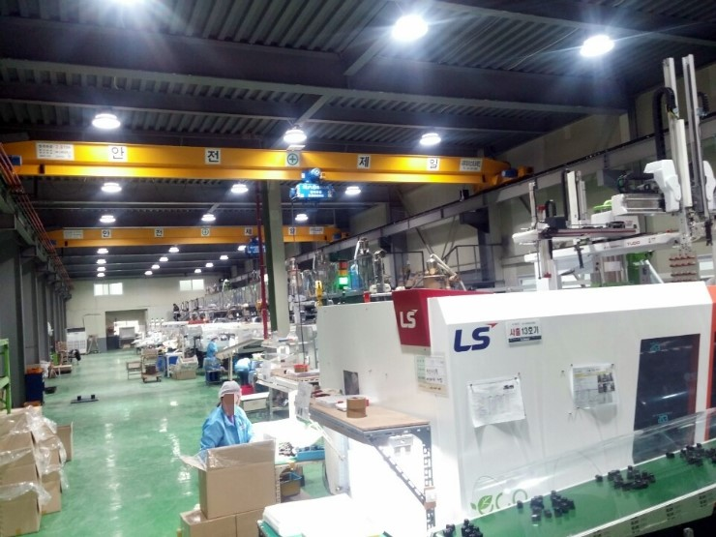
[Layout]KIT1
KIT1_Cv_RR
[Path]rtsp://210.99.70.120:1935/live/cctv002.stream
KIT1_In
KIT1_1st_usb
KIT1_1st_stp
KIT1_2nd_stp
KIT1_2nd_usb
KIT1_3rd_usb
KIT1_3rd_stp
KIT1_4th_usb
KIT1_4th_stp
KIT1_Out
KIT1_Cv_Frt
KIT1_Part

Slide 9
[Layout]KIT2
[Path]rtsp://210.99.70.120:1935/live/cctv012.stream
KIT1_Cv_RR
KIT1_In
KIT1_1st_stp
KIT1_1st_usb
KIT1_2nd_stp
KIT1_2nd_usb
KIT1_3rd_stp
KIT1_3rd_usb
KIT1_4th_stp
KIT1_4th_usb
KIT1_Out
KIT1_Cv_Frt
KIT1_Part

Slide 10
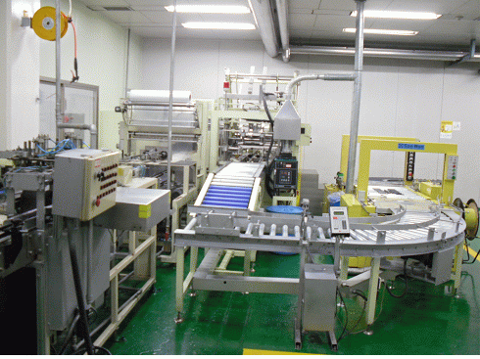
[Layout]STN02, STN03, KIT1, KIT2
KIT1_Cv_RR
KIT2_Cv_RR
[Path]SlideImage
KIT1_In
KIT2_In
KIT1_1st_stp
KIT1_1st_usb
KIT2_1st_stp
STN02_Pin
KIT2_1st_usb
KIT1_2nd_usb
KIT2_2nd_usb
KIT1_2nd_stp
KIT2_2nd_stp
KIT1_Cv_Frt
KIT2_Cv_Frt
KIT1_3rd_usb
KIT2_3rd_usb
KIT1_3rd_stp
KIT2_3rd_stp
KIT1_4th_stp
KIT1_4th_usb
KIT2_4th_stp
KIT2_4th_usb
STN03_Pin
KIT1_Part
KIT2_Part
KIT1_Out
KIT2_Out

Slide 11
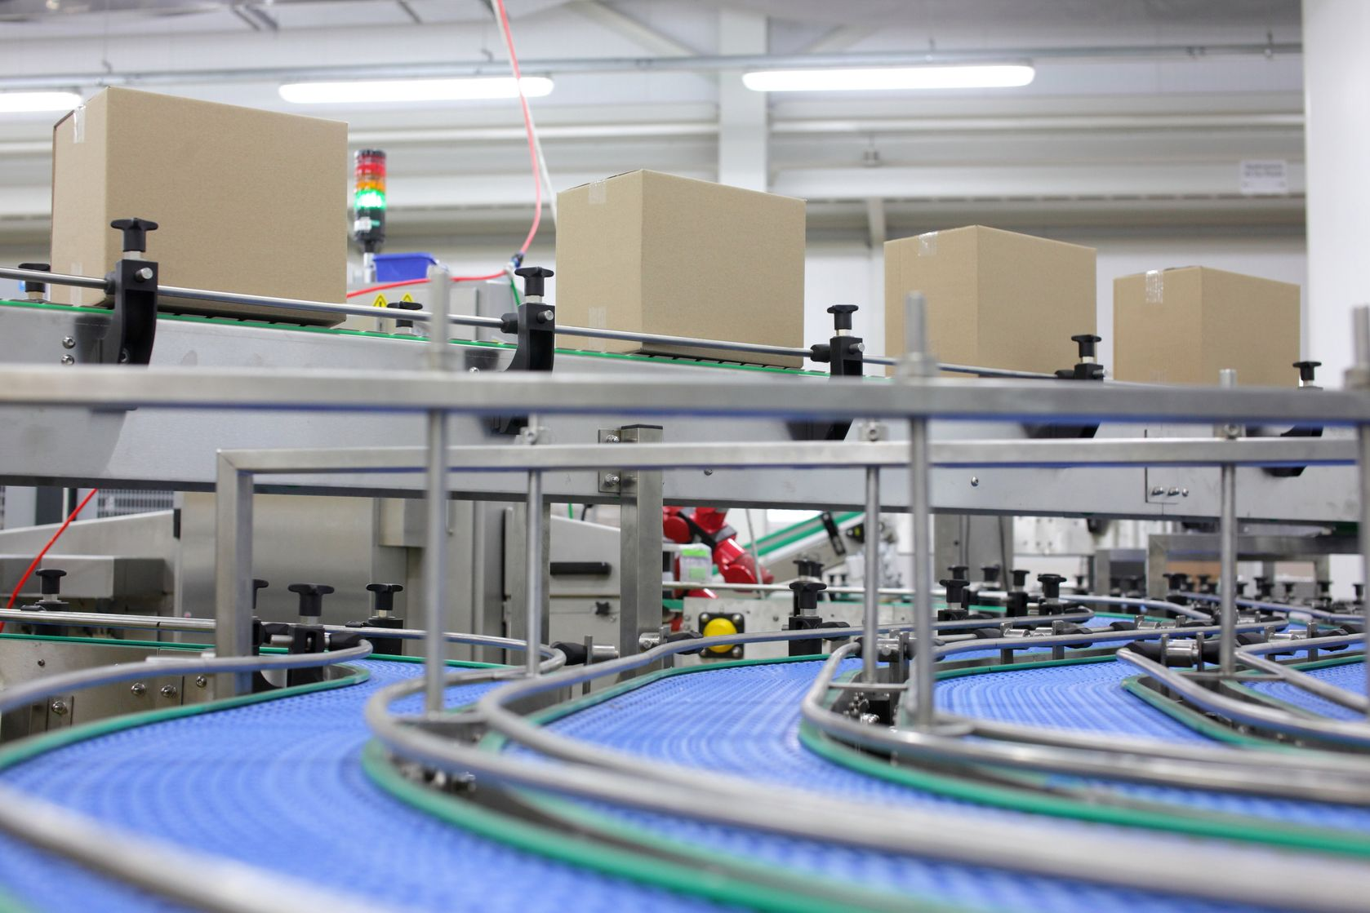
[Layout]STN55
[Path]SlideImage
KIT1_1st_stp
KIT1_2nd_stp
KIT1_3rd_stp
KIT1_4th_stp
KIT1_4th_usb
KIT1_2nd_usb
KIT1_3rd_usb
KIT1_1st_usb

Slide 12
KIT2
0IN
Cv_RR
.MOVE
../lib/Double
[In]
In
.RET
In
.ADV
../lib/Double
[1st_stp]
1Work
1st_usb
.ADV
1st_usb
.RET
1st_stp
.RET
1st_stp
.ADV
Cv_RR .REMOVE
../lib/Double
[1st_usb]
../lib/Double
[2nd_stp]
2nd_usb
.ADV
2nd_usb
.RET
2nd_stp
.RET
2nd_stp
.ADV
../lib/Double
[2nd_usb]
Cv_Frt
.MOVE
Cv_Frt
.REMOVE
3rd_usb
.ADV
3rd_usb
.RET
3rd_stp
.RET
../lib/Double
[3rd_stp]
3rd_stp
.ADV
../lib/Double
[3rd_usb]
4th_usb
.ADV
4th_usb
.RET
4th_stp
.RET
4th_stp
.ADV
../lib/Double
[4th_stp]
../lib/Double
[4th_usb]
5OUT
Part
.MOVE
../lib/Double
[Out]
Out.ADV
0IN
../lib/CV
[Cv_RR]
Cv_Frt
.MOVE
Cv_Frt
.REMOVE
../lib/CVRemove[Cv_Frt]
Out.RET
1Work
../lib/CVRemove[Part]
Part
.REMOVE
5OUT PASS

Slide 13
Time Chart Flow KIT1 (Work : 1Work)
Device 일반 표시
Device 원위치 표시
Cv_Frt.MOVE
Cv_Frt MOVE
Cv_Frt.REMOVE
Cv_Frt REMOVE
1st_usb.ADV
1st_usb ADV
1st_usb.RET
1st_usb RET
2nd_usb.ADV
2nd_usb ADV
2nd_usb.RET
2nd_usb RET
3rd_usb.ADV
3rd_usb ADV
3rd_usb.RET
3rd_usb RET
4th_usb.ADV
4th_usb ADV
4th_usb.RET
4th_usb RET
3rd_stp.RET
3rd_stp RET
3rd_stp.ADV
3rd_stp ADV
4th_stp.RET
4th_stp RET
4th_stp.ADV
4th_stp ADV
2nd_stp.RET
2nd_stp RET
2nd_stp.ADV
2nd_stp ADV
1st_stp.RET
1st_stp RET
1st_stp.ADV
1st_stp ADV

