Slide 1
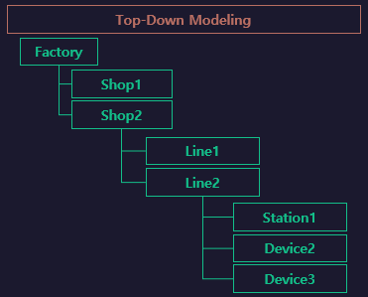

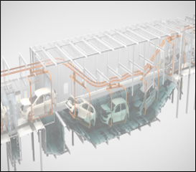
PaintShop
Paint Lines

Slide 2
Flow
START
[start ~ end]
start
END
[end ~ end]
UNLOAD
[ UNLOAD ~
UNLOAD ]
end
UNLOAD
AUTO
CLEAR

