Slide 1
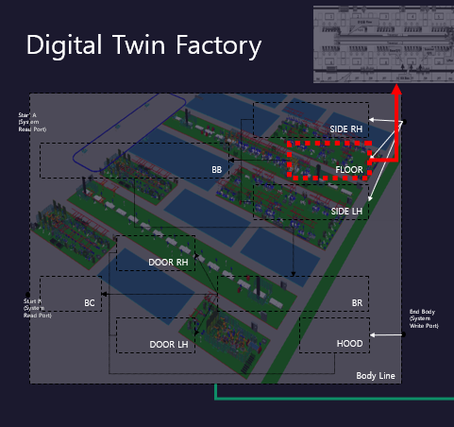
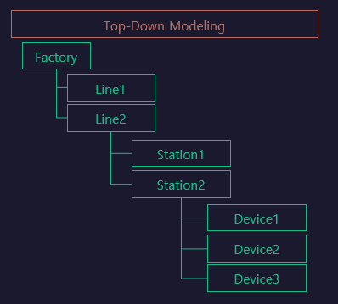
Line

Slide 2
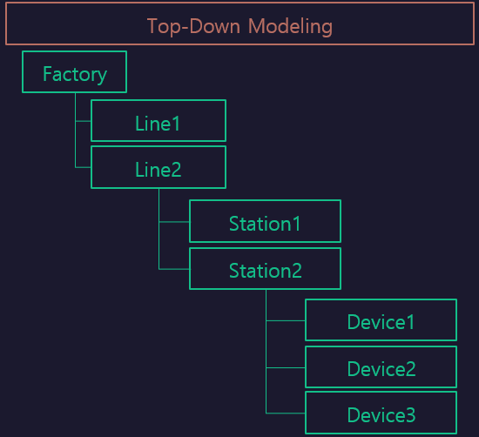

StationFlow
RUN
[START
~ FINISH]
LH_WORK
LH.
Func1
LH.
Func2
Sub/LH
[LH]
START
FINISH
Sub/RH
[RH]
RH_WORK
RH.
Func1
RH.
Func2

