Slide 1
Cylinder
복동 Air 실린더

Slide 2
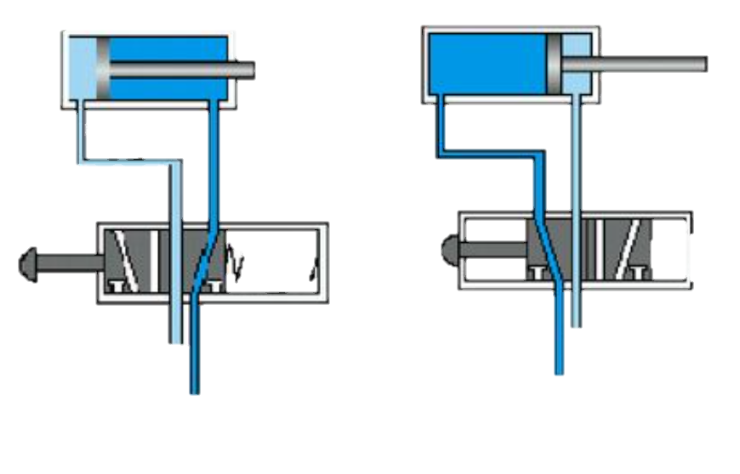
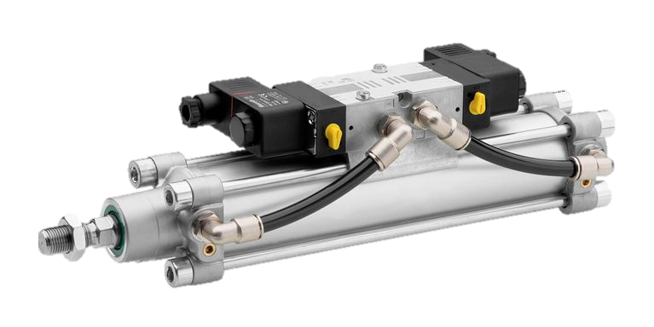
Flow
ADV
[ValveADV ~ PositionADV]
Valve
ADV
Piston
ADV
Position
ADV
RET
[ValveRET ~ PositionRET]
Valve
RET
Piston
RET
Position
RET

