Slide 1
CV_JobClear

Slide 2
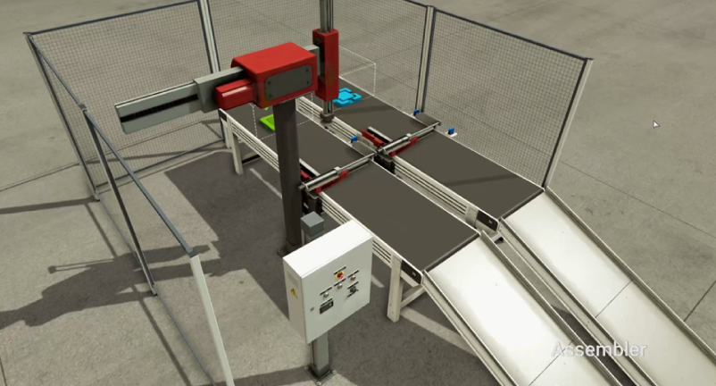
CV
Robot X-
Sub
Robot X+
Robot Z-
MAIN
Assy
Robot Z+
UpCV+
PartIn
MOVE1
[UpCV+ ~ PartIn]
MOVE2
[DownCV+ ~ PartOut]
DownCV+
PartOut
JOBCLEAR
[work end ~ _]
work end

