Slide 1
Axis2

Slide 2
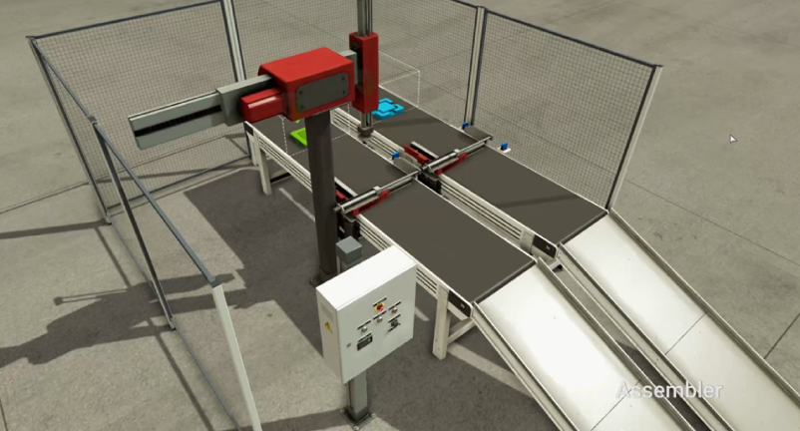
Robot
ZP
[zm+~zs+]
ZM
[zm-~zs-]
RobotX-
Sub
RobotX+
RobotZ-
XP
[xm+~xs+]
zm+
zs+
MAIN
Assy
RobotZ+
XM
[xm-~xs-]
zm-
zs-
xm+
xs+
gm+
gs+
GRIBADV
[gm+~gs+]
xm-
xs-
gm-
gs-
GRIBRET
[gm-~gs-]

