Slide 1
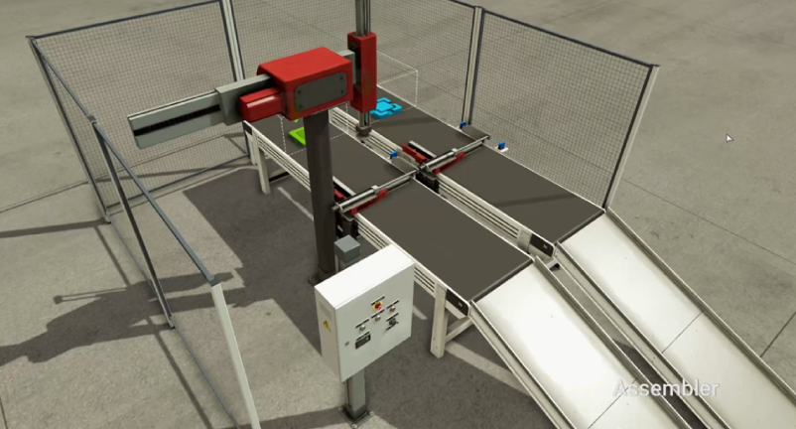
CV
GO
[MOTOR
~ MOVE
PART]
Robot X-
Sub
Robot X+
Robot Z-
MAIN
Assy
Robot Z+
REMOVE
PART
MOTOR
MOVE
PART

