Slide 1
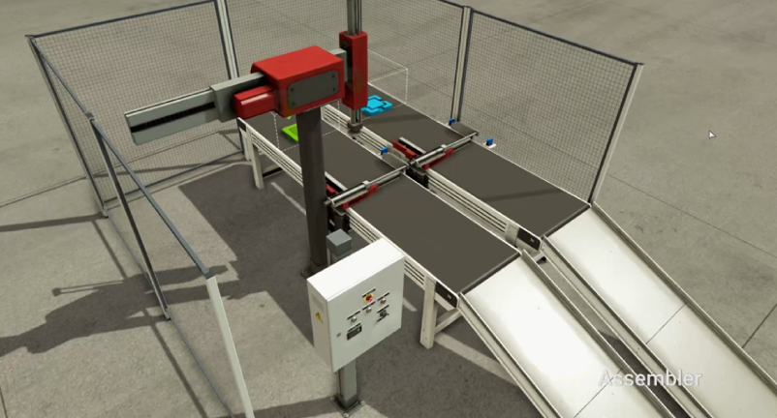
Robot
Z+
[zm+~zs+]
Z-
[zm-~zs-]
RobotX-
Sub
RobotX+
RobotZ-
X+
[xm+~xs+]
zm+
zs+
MAIN
Assy
RobotZ+
X-
[xm-~xs-]
zm-
zs-
xm+
xs+
gm+
gs+
Grab+
[gm+~gs+]
xm-
xs-
gm-
gs-
Grab-
[gm-~gs-]

