Slide 1
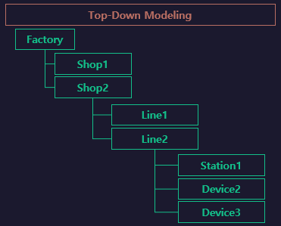
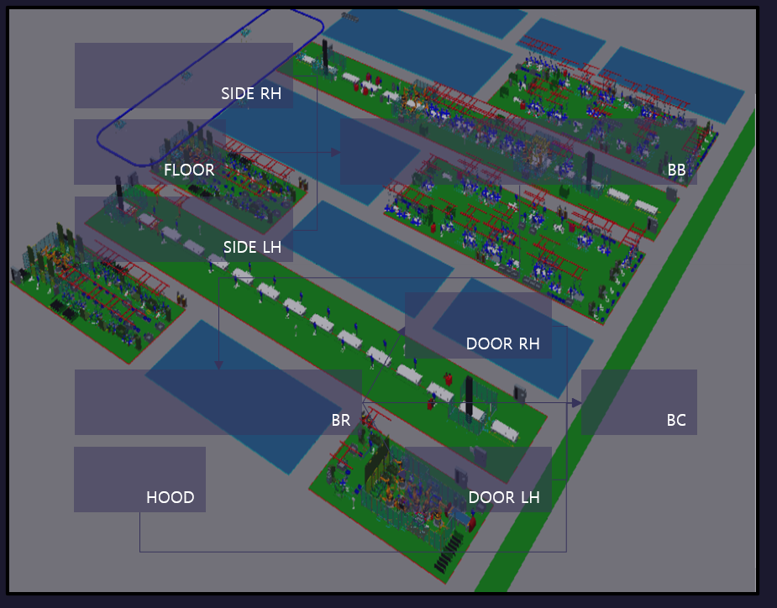

BodyShop
BB
SIDE
FLOOR
BC
MOVING

Slide 2
IO TABLE
Case | Flow | Name | DataType (In:Out) | Input | Output | Symbol In | Symbol Out
외부주소 | FlowA | Floor.CLEAR | bit | %IX0.0.0 | %QX0.1.0
외부주소 | FlowA | Floor.END | bit | %MX0 | -
외부주소 | FlowA | Floor.RUN | bit | %IX0.0.1 | %QX0.1.1
외부주소 | FlowA | SIDE_LH.CLEAR | bit | %IX0.0.2 | %QX0.1.2
외부주소 | FlowA | SIDE_LH.END | bit | %MX1 | -
외부주소 | FlowA | SIDE_LH.RUN | bit | %IX0.0.3 | %QX0.1.3
외부주소 | FlowA | SIDE_RH.CLEAR | bit | %IX0.0.4 | %QX0.1.4
외부주소 | FlowA | SIDE_RH.END | bit | %MX2 | -
외부주소 | FlowA | SIDE_RH.RUN | bit | %IX0.0.5 | %QX0.1.5

Slide 3
IO TABLE
Case | Flow | Name | DataType (In:Out) | Input | Output | Symbol In | Symbol Out
자동셀렉트 | ALL | AutoSelect | bit | %MX1000 | -
수동셀렉트 | ALL | ManualSelect | bit | %MX1001 | -
운전푸쉬버튼 | ALL | DrivePushBtn | bit | %MX1002 | -
정지푸쉬버튼 | ALL | PausePushBtn | bit | %MX1003 | -
해지푸쉬버튼 | ALL | ClearPushBtn | bit | %MX1004 | -
비상푸쉬버튼 | ALL | EmergencyBtn | bit | %MX1005 | -
자동모드램프 | ALL | AutoModeLamp | bit | - | %MX1006
수동모드램프 | ALL | ManualModeLamp | bit | - | %MX1007
대기모드램프 | ALL | IdleModeLamp | bit | - | %MX1008
이상모드램프 | ALL | ErrorLamp | bit | - | %MX1009
원위치중램프 | ALL | OriginStateLamp | bit | - | %MX1010
준비모드램프 | ALL | ReadyStateLamp | bit | - | %MX1011
운전모드램프 | ALL | DriveLamp | bit | - | %MX1012

Slide 4
IO TABLE
Case | Flow | Name | DataType (In:Out) | Input | Output | Symbol In | Symbol Out
연산 | - |  | - |  | - | - | -
명령 | - |  | - | - |  | - | -
변수 | - |  |  | - | - | - | -
상수 | - |  |  |  | - | - | -

Slide 5
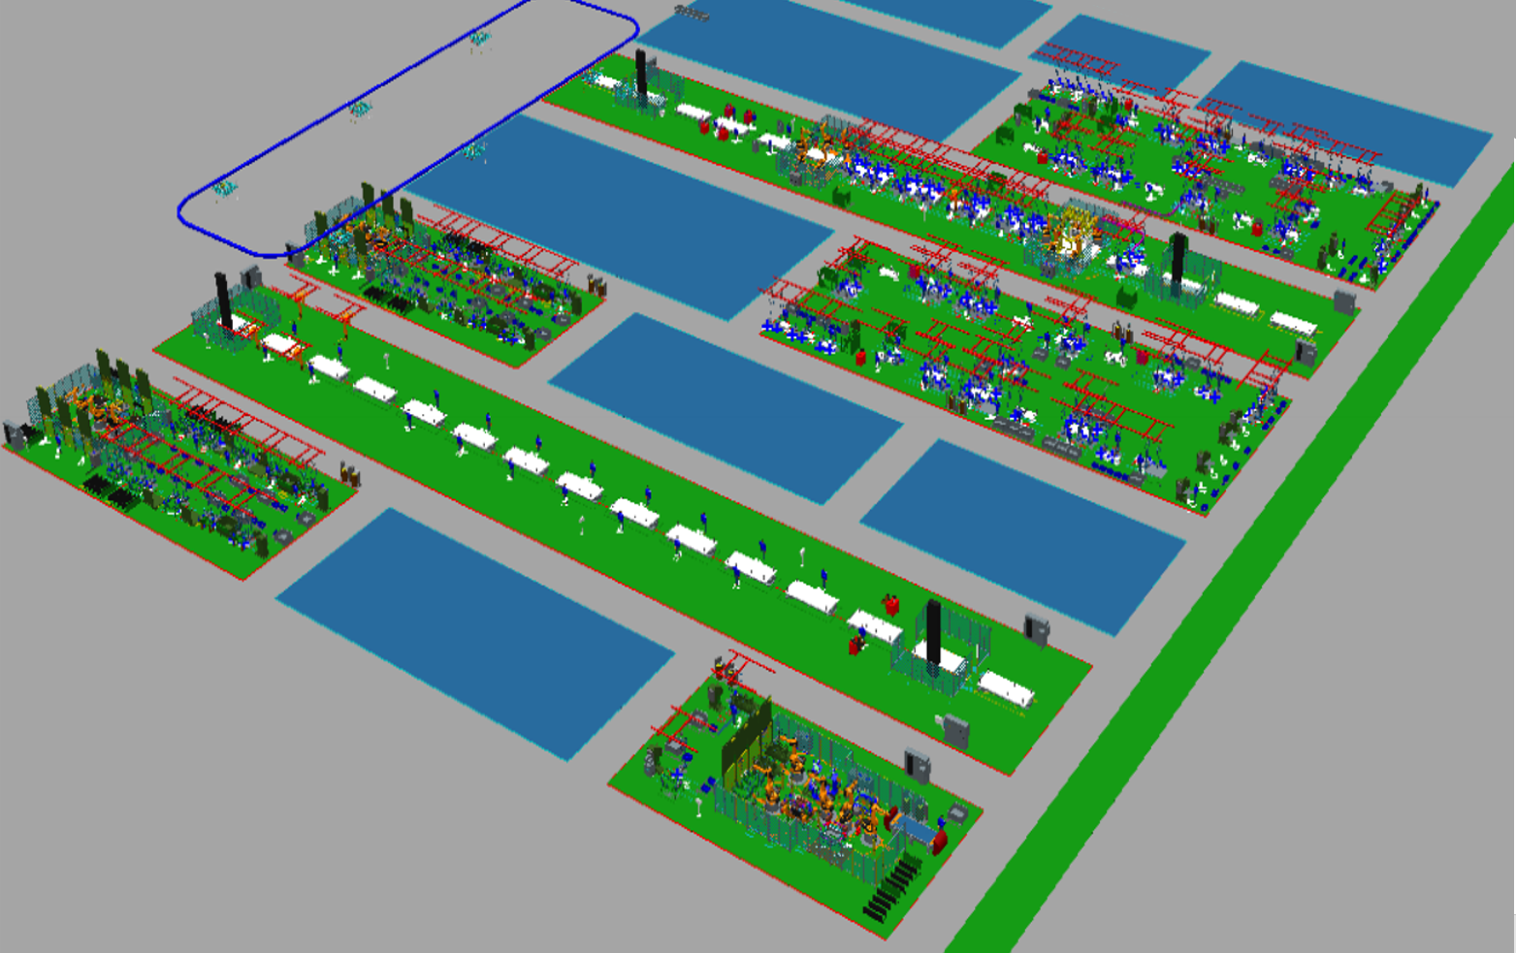
FlowA
RH_LOAD
SIDE RH
SIDE_RH.
RUN
SIDE_RH
.END
FLR
BB
START
RUN
Floor.
RUN
FLR _LOAD
Floor
.END
SIDE_RH.
CLEAR
Floor.
CLEAR
SIDE_LH
.END
SIDE_LH.
CLEAR
START
[START ~ RUN]
SIDE LH
SIDE_LH.
RUN
Sub/Side
[SIDE_LH]
LH_LOAD
Sub/Floor
[Floor]
Sub/Side
[SIDE_RH]

Slide 6
FlowB
./Sub/Sub/LH
[LH]
./Sub/Sub/RH
[RH]
FlowA.BB
DOOR RH
BR
BC1
BC2
BC3
BC4
UNLOAD
END
[BC4 ~ BC4]
DOOR LH
AUTO
CLEAR
UNLOAD
[ UNLOAD ~
UNLOAD ]
MOVING

