Slide 1
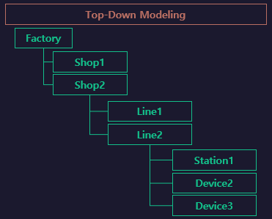
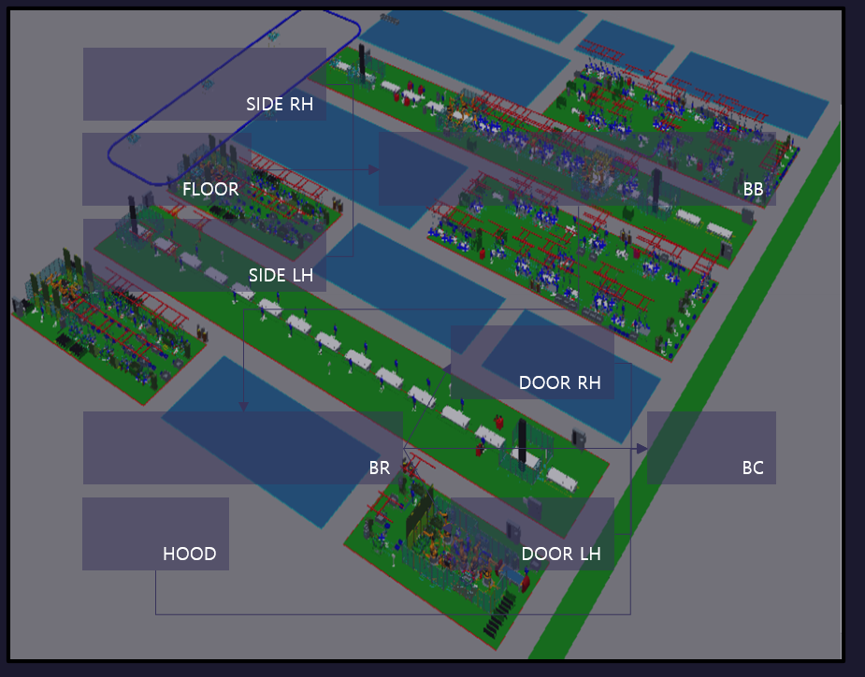

BodyShop
BB
SIDE
FLOOR
BC
MOVING

Slide 2
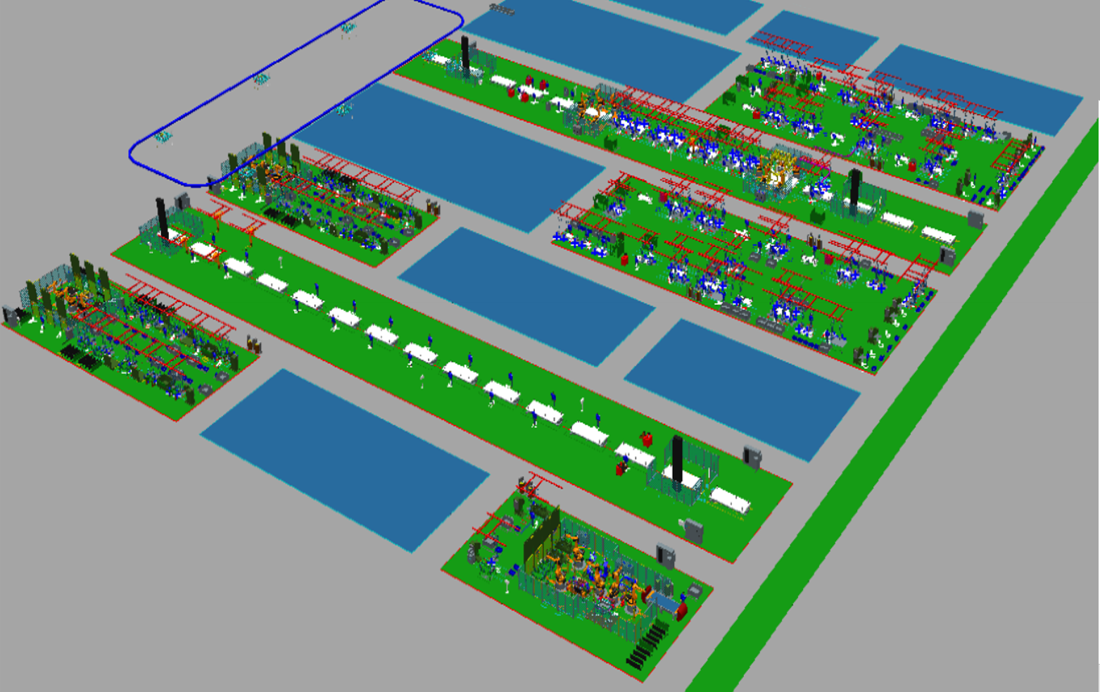
FlowA
SIDE RH
FLOOR
BB
START
RUN
FF.
START
FC.
START
SIDE LH
START
[START ~ RUN]
Sub/Line
[FF]
Sub/Line
[FC]

Slide 3
FlowB
FlowA.BB
DOOR RH
BR
BC1
BC2
BC3
BC4
UNLOAD
END
[BC4 ~ BC4]
DOOR LH
AUTO
CLEAR
UNLOAD
[ UNLOAD ~
AUTOCLEAR ]
MOVING

