Slide 1
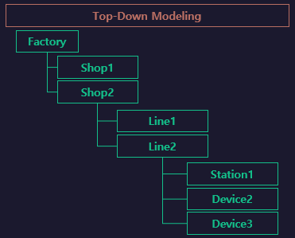

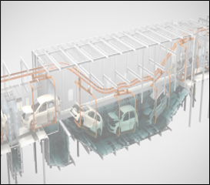
PaintShop
Paint Lines

Slide 2
Flow
START
[start ~ end]
start
END
[end ~ end]
end

