Slide 1
LS XGI Ladder

Slide 2
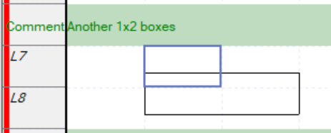
cursor at (1, 7)
Lx0
Lx1
Lx2
vLine 은 Ly 기준으로 center 에서 아래로 내려 옴
Ly7
Ly7 에서 Vline 그린 것
Lx1 의 우측 : coord (1, 7) + 2 = 7174
Lx2 의 좌측 : coord (2, 7) – 1 = 7174
Ly8
coord at (1, 7) = 7172
Ly7 에서 Vline 그린 것
Lx0 의 우측 : coord (0, 7) + 2 = 7171
Lx1 의 좌측 : coord (1, 7) – 1 = 7171
(1, 8) 에서의 hLine
coord (1, 8) = 8196

Slide 3
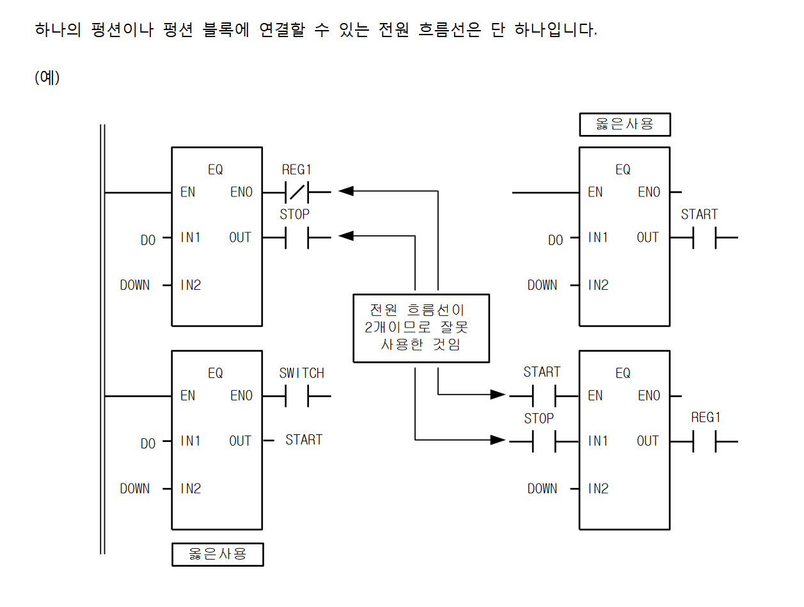
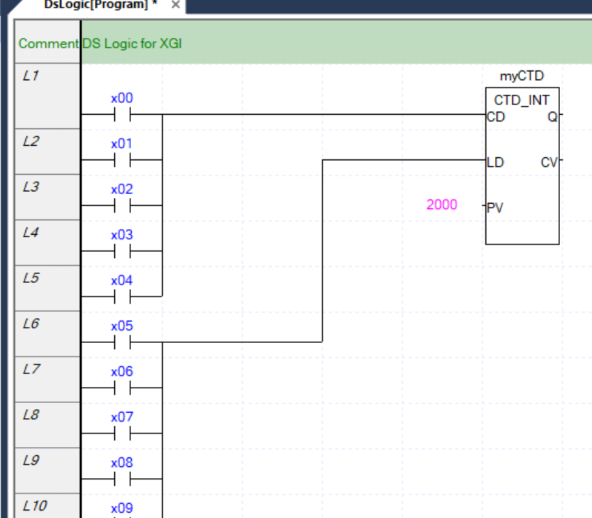
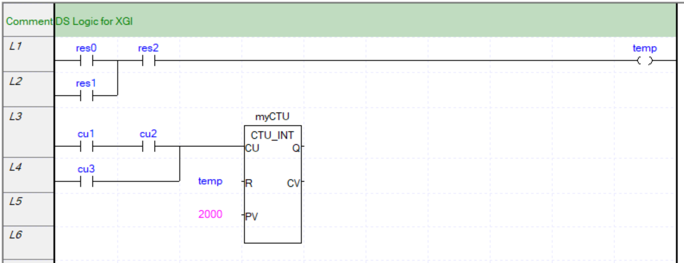
Input side 다릿발
http://duduji.iptime.org/gnuboard/data/file/du_board_study/XGI_%EC%B4%88%EA%B8%89(V18).pdf pp.43
OK
Input 쪽 bool 값은 복수개로 전원 연결 가능

Slide 4
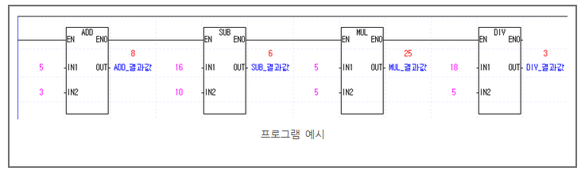
https://engineering-mino.tistory.com/22

Slide 5
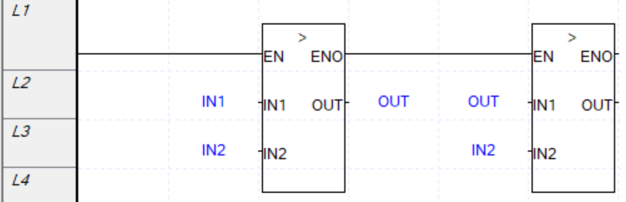
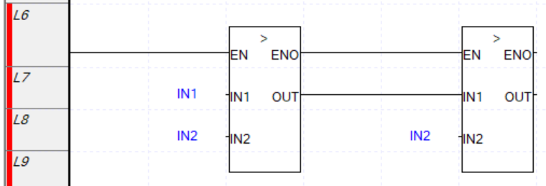
직접 연결 불가
Chaining 불가

Slide 6
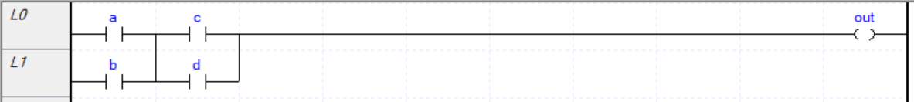
Drawing 순서
Coordinate 순으로 정렬되어야 한다.
a -> 세로선 -> c -> 세로선 -> 가로선 -> out
b -> d
<Rung BlockMask=“0”>
<Element ElementType=“6” Coordinate=“1”>a</Element>
<Element ElementType=“0” Coordinate="3"></Element>
<Element ElementType="6" Coordinate="4">c</Element>
<Element ElementType="0" Coordinate="6"></Element>
<Element ElementType="2" Coordinate="7" Param="84"></Element>
<Element ElementType="14" Coordinate="94">out</Element>
<Element ElementType="6" Coordinate="1025">b</Element>
<Element ElementType="6" Coordinate="1028">d</Element>
</Rung>

Slide 7
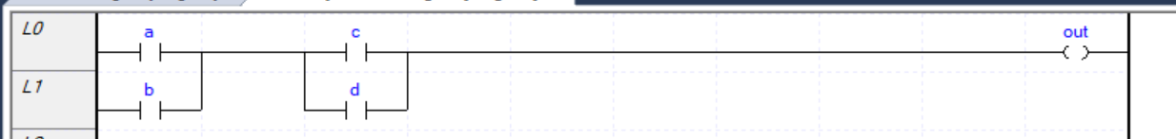
BinaryEncoded = 1
아래와 같이 저장하는 순간 binary encoding 되어 저장된다. (save as earliear version..
<Program Task="Scan Program" Version="256" LocalVariable="1" Kind="0" InstanceName="" Comment="" ObjectId="de8fdba9-c64f-48c6-9770-f3d61bd6a5a9" FindProgram="1" FindVar="1" Encrytption="">BinaryEncodedProgram<Body>
<LDRoutine BinaryEncoded="1">
<ProgramData Version="LD VER 1.1" ProjectType="2" Compressed="1" dt:dt="bin.base64" xmlns:dt="urn:schemas-microsoft-com:datatypes">QlpoOTFBWSZTWRYzCUEAAAHXgP/xQCAIAAAJPACGAAABsACtQSJNU9pI9QMh6gUAAAZMgSak
mhGINNA2zUKzCPPEUprbGb+B1es43d0EtBFnBLy+9/JjvnvkaKgChFIsPTwho/EhTIKgbKaN
a1qUL80waIiK9uCWTblM44nckl0MgZKYU3KLWhiHFGEO/8FsUl1B5F3JFOFCQFjMJQQ=</ProgramData>
<OnlineUploadData Compressed="1" dt:dt="bin.base64" xmlns:dt="urn:schemas-microsoft-com:datatypes">QlpoOTFBWSZTWY5iHkIAAA3eAOAQQAEwAAYEEQAAAaAAMQAACvKMj1MnqSRSSVXekyB44y38
XckU4UJCOYh5CA==</OnlineUploadData>
</LDRoutine>
</Body>

Slide 8
OLD VERSION
generateXml
type XmlOutput = string
type EncodedXYCoordinate = int
type CoordinatedRungXml = {
Coordinate: EncodedXYCoordinate // int
Xml: XmlOutput // string
}
type CoordinatedRungXmlsForCommand = {
SpanY: int
PositionedRungXmls: CoordinatedRungXml list
}
type RungInfosWithSpan = {
RungInfos:CoordinatedRungXml list
X: int
Y: int
SpanX: int
SpanY: int
}
type RungGenerationInfo = {
Xmls: XmlOutput list
Y: int }
generateXGIXmlFromStatement
generateRungs
xmlRung: RungGenerationInfo
rung: CoordinatedRungXml
rng: RungInfoWithScan
drawCommand: int*[CoordinatedRungXml]
drawCmdCounter: : CoordinatedRungXmlsForCommand
drawCoil: int*[CoordinatedRungXml]

Slide 9
OLD VERSION
generateXml
type CoordinatedXmlElement = {
/// Xgi 출력시 순서 결정하기 위한 coordinate.
Coordinate: EncodedXYCoordinate // int
/// Xml element 문자열
Xml: XmlOutput // string
SpanX: int
SpanY: int
}
type BlockSummarizedXmlElements = {
X: int
Y: int
TotalSpanX: int
TotalSpanY: int
XmlElements: CoordinatedXmlElement list
}
type RungInfosWithSpan = {
RungInfos:CoordinatedXmlElement list
X: int
Y: int
SpanX: int
SpanY: int
}
type RungGenerationInfo = {
Xmls: XmlOutput list // Rung 별 누적 xml. 역순으로 추가. 꺼낼 때 뒤집어야..
Y: int }
generateXGIXmlFromStatement
generateRungs
xmlRung: RungGenerationInfo
rung: CoordinatedXmlElement
drawLadderBlock: BlockSummarizedXmlElements
drawCommand: [CoordinatedXmlElement]
drawCmdCounter: : [CoordinatedXmlElement]
drawCoil: int*[CoordinatedXmlElement]
generateRungs
generateRungs
RungGenerationInfo
generateRungs
generateRungs

Slide 10
Call Hierarchy
XgiProjectParams.GenerateXmlString
XgiPOUParams.GenerateXmlNode
type CoordinatedXmlElement = {
/// Xgi 출력시 순서 결정하기 위한 coordinate.
Coordinate: EncodedXYCoordinate // int
/// Xml element 문자열
Xml: XmlOutput // string
SpanX: int
SpanY: int
}
type BlockSummarizedXmlElements = {
X: int
Y: int
TotalSpanX: int
TotalSpanY: int
XmlElements: CoordinatedXmlElement list
}
type RungInfosWithSpan = {
RungInfos:CoordinatedXmlElement list
X: int
Y: int
SpanX: int
SpanY: int
}
type RungGenerationInfo = {
// Rung 별 누적 xml. 역순으로 추가. 꺼낼 때 뒤집어야..
Xmls: XmlOutput list
Y: int }
commentedStatement2CommentedXgiStatements
generateXGIXmlFromStatement
generateRungs
xmlRung: RungGenerationInfo
rung: CoordinatedXmlElement
drawLadderBlock: BlockSummarizedXmlElements
drawCommand: BlockSummarizedXmlElements
drawPredicate : BlockSummarizedXmlElements
drawFunction
drawAction
drawFunctionBlockTimer
drawFunctionBlockCoutner
createFunctionBlockInstanceXmls : BlockSummarizedXmlElements
createBoxXmls : BlockSummarizedXmlElements
drawCoil: BlockSummarizedXmlElements

Slide 11
commentedStatement2CommentedXgiStatements: CommentedXgiStatements
commentedStatement2CommentedXgiStatements
statement2XgiStatements: Statement list
mergeArithmaticOperator: IExpression

Slide 12
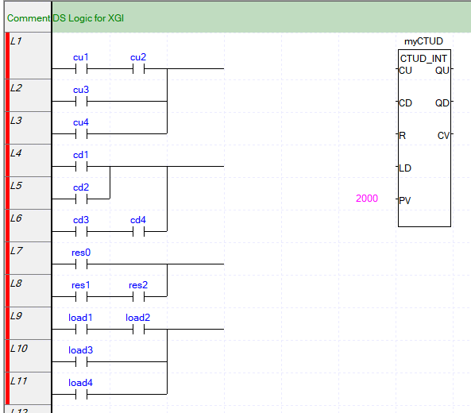

Slide 13
Literal
DINT#-100
T#1S
TIME#1000MS

Slide 14
TODO list

Slide 15
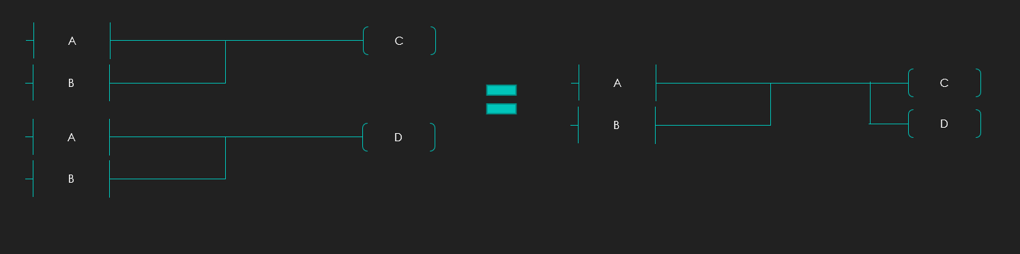
최적화

Slide 16
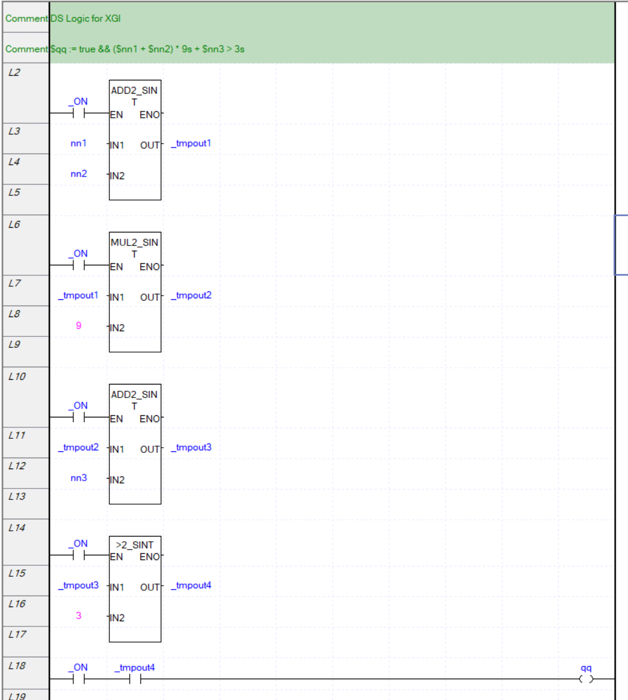
최적화

