Slide 1
CVRemove

Slide 2
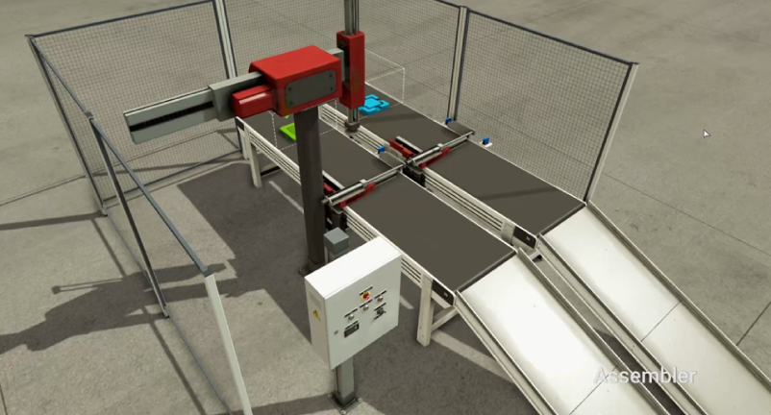
CV
Robot X-
Sub
Robot X+
Robot Z-
MAIN
Assy
Robot Z+
MOVE
[MOVE~ MOVE]
REMOVE
REMOVE
[REMOVE ~ REMOVE]
MOVE

