Slide 1
kit

Slide 2
KIT
0IN
Cv_RR
.MOVE
lib/Cylinder/Double
[In]
In
.RET
In
.ADV
lib/Cylinder/Double
[1st_stp]
1Work
1st_usb
.ADV
1st_usb
.RET
1st_stp
.RET
1st_stp
.ADV
Cv_RR .REMOVE
lib/Cylinder/Double
[1st_usb]
lib/Cylinder/Double
[2nd_stp]
2nd_usb
.ADV
2nd_usb
.RET
2nd_stp
.RET
2nd_stp
.ADV
lib/Cylinder/Double
[2nd_usb]
Cv_Frt
.MOVE
Cv_Frt
.REMOVE
3rd_usb
.ADV
3rd_usb
.RET
3rd_stp
.RET
lib/Cylinder/Double
[3rd_stp]
3rd_stp
.ADV
lib/Cylinder/Double
[3rd_usb]
4th_usb
.ADV
4th_usb
.RET
4th_stp
.RET
4th_stp
.ADV
lib/Cylinder/Double
[4th_stp]
lib/Cylinder/Double
[4th_usb]
5OUT
Part
.MOVE
lib/Cylinder/Double
[Out]
Out.ADV
0IN
lib/Conveyor/CV
[Cv_RR]
Cv_Frt
.MOVE
Cv_Frt
.REMOVE
lib/Conveyor/CVRemove[Cv_Frt]
Out.RET
1Work
lib/Conveyor/CVRemove[Part]
Part
.REMOVE
5OUT PASS

Slide 3
Layout : KIT
KIT_Cv_RR
[Path] rtsp://210.99.70.120:1935/live/cctv012.stream
KIT_In
KIT_1st_usb
KIT_1st_stp
KIT_2nd_usb
KIT_2nd_stp
KIT_3rd_usb
KIT_3rd_stp
KIT_4th_usb
KIT_4th_stp
KIT_Out
KIT_Cv_Frt
KIT_Part

Slide 4
IO TABLE KIT
Case | Name | DataType | Input | Output | Job | Func
외부주소 | KIT_1st_stp.ADV | bool | %IX0.0.5 | %QX0.1.3 | KIT_1st_stp_ADV
외부주소 | KIT_1st_stp.RET | bool | %IX0.0.4 | %QX0.1.2 | KIT_1st_stp_RET
외부주소 | KIT_1st_usb.ADV | bool | %IX0.0.7 | %QX0.1.5 | KIT_1st_usb_ADV
외부주소 | KIT_1st_usb.RET | bool | %IX0.0.6 | %QX0.1.4 | KIT_1st_usb_RET
외부주소 | KIT_2nd_stp.ADV | bool | %IX0.0.9 | %QX0.1.7 | KIT_2nd_stp_ADV
외부주소 | KIT_2nd_stp.RET | bool | %IX0.0.8 | %QX0.1.6 | KIT_2nd_stp_RET
외부주소 | KIT_2nd_usb.ADV | bool | %IX0.0.11 | %QX0.1.9 | KIT_2nd_usb_ADV
외부주소 | KIT_2nd_usb.RET | bool | %IX0.0.10 | %QX0.1.8 | KIT_2nd_usb_RET
외부주소 | KIT_3rd_stp.ADV | bool | %IX0.0.13 | %QX0.1.11 | KIT_3rd_stp_ADV
외부주소 | KIT_3rd_stp.RET | bool | %IX0.0.12 | %QX0.1.10 | KIT_3rd_stp_RET
외부주소 | KIT_3rd_usb.ADV | bool | %IX0.0.15 | %QX0.1.13 | KIT_3rd_usb_ADV
외부주소 | KIT_3rd_usb.RET | bool | %IX0.0.14 | %QX0.1.12 | KIT_3rd_usb_RET
외부주소 | KIT_4th_stp.ADV | bool | %IX0.0.17 | %QX0.1.15 | KIT_4th_stp_ADV
외부주소 | KIT_4th_stp.RET | bool | %IX0.0.16 | %QX0.1.14 | KIT_4th_stp_RET
외부주소 | KIT_4th_usb.ADV | bool | %IX0.0.19 | %QX0.1.17 | KIT_4th_usb_ADV
외부주소 | KIT_4th_usb.RET | bool | %IX0.0.18 | %QX0.1.16 | KIT_4th_usb_RET
외부주소 | KIT_Cv_Frt.MOVE | bool | %IX0.0.32 | %MX5 | KIT_Cv_Frt_MOVE
외부주소 | KIT_Cv_Frt.REMOVE | bool | - | %MX5 | KIT_Cv_Frt_REMOVE
외부주소 | KIT_Cv_RR.MOVE | bool | %IX0.0.0 | %QX0.1.28 | KIT_Cv_RR_MOVE
외부주소 | KIT_Cv_RR.REMOVE | bool | %IX0.0.0 | %QW625.3 | KIT_Cv_RR_REMOVE
외부주소 | KIT_In.ADV | bool | %IX0.0.3 | %QX0.1.1 | KIT_In_ADV
외부주소 | KIT_In.RET | bool | %IX0.0.2 | %QX0.1.0 | KIT_In_RET
외부주소 | KIT_Out.ADV | bool | %IX0.0.23 | %QX0.1.19 | KIT_Out_ADV
외부주소 | KIT_Out.RET | bool | %IX0.0.22 | %QX0.1.18 | KIT_Out_RET
외부주소 | KIT_Part.MOVE | bool | %IX0.0.53 | %QW625.1 | KIT_Part_MOVE
외부주소 | KIT_Part.REMOVE | bool | - | %QW625.2 | KIT_Part_REMOVE
내부변수

Slide 5
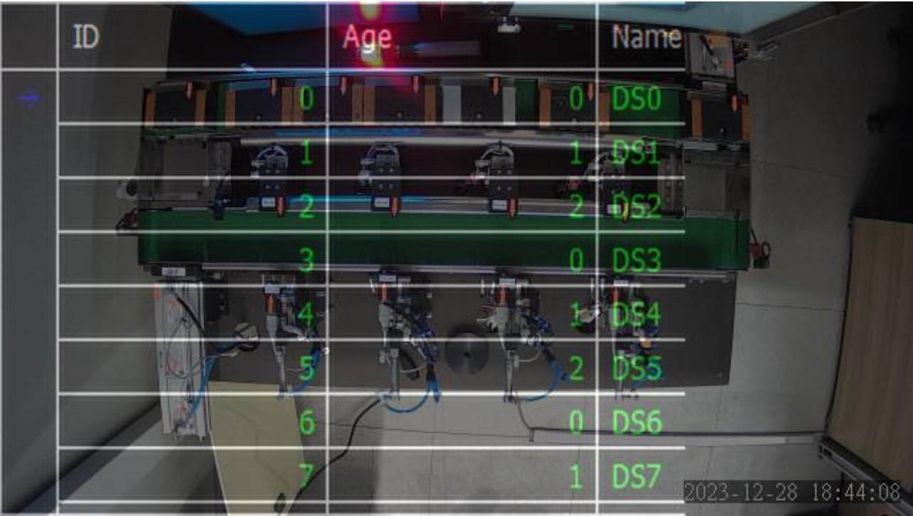
Layout : KIT
[Path]http://192.168.9.44:42039/videostream.cgi?user=admin&pwd=888888
KIT_In
KIT_Cv_RR
KIT_4th_stp
KIT_3rd_stp
KIT_2nd_stp
KIT_1st_stp
KIT_Cv_Frt
KIT_Out
KIT_4th_usb
KIT_3rd_usb
KIT_2nd_usb
KIT_1st_usb

Slide 6
Layout : KIT
[Path]rtsp://210.99.70.120:1935/live/cctv002.stream
KIT_In
KIT_Cv_RR
KIT_4th_stp
KIT_3rd_stp
KIT_2nd_stp
KIT_1st_stp
KIT_Cv_Frt
KIT_Out
KIT_4th_usb
KIT_3rd_usb
KIT_2nd_usb
KIT_1st_usb

