Slide 1
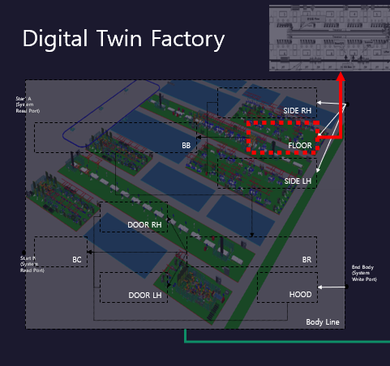
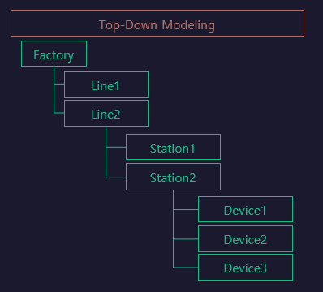
Station

Slide 2
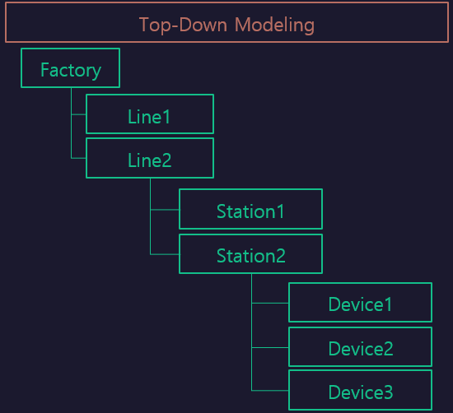

StationFlow
LH_WORK
LH.
Func1
LH.
Func2
Func1
[START
~FINISH]
START
FINISH
Func2
[RESET
~ RESET]
RH_WORK
RH.
Func1
RH.
Func2
Sub/LH
[LH]
Sub/RH
[RH]
RESET

