Slide 1
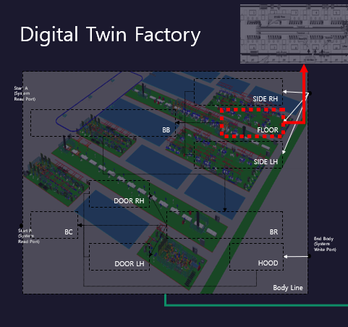
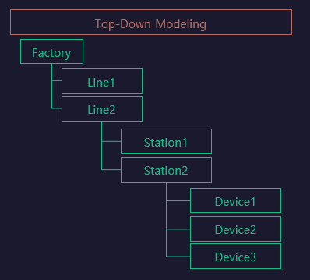
LH

Slide 2
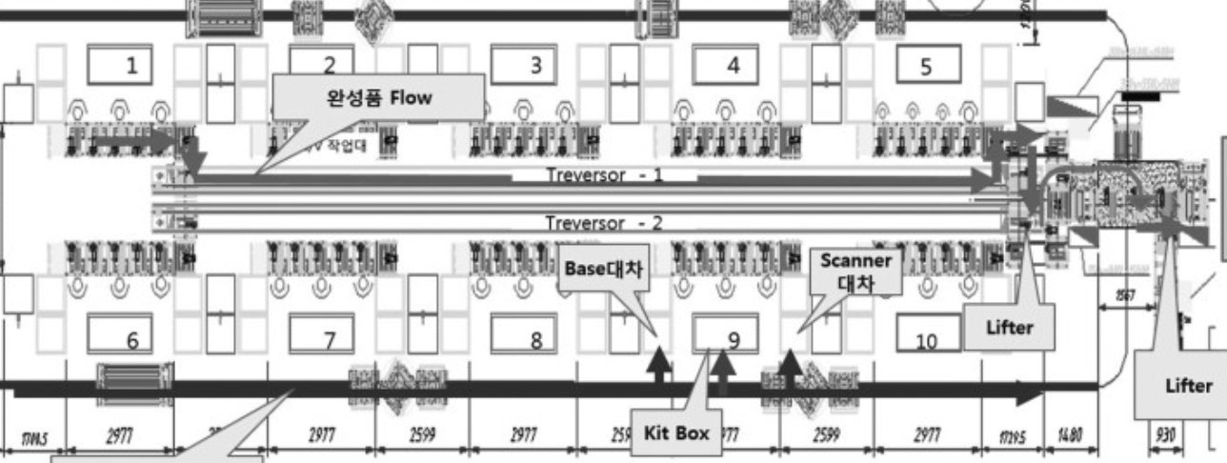
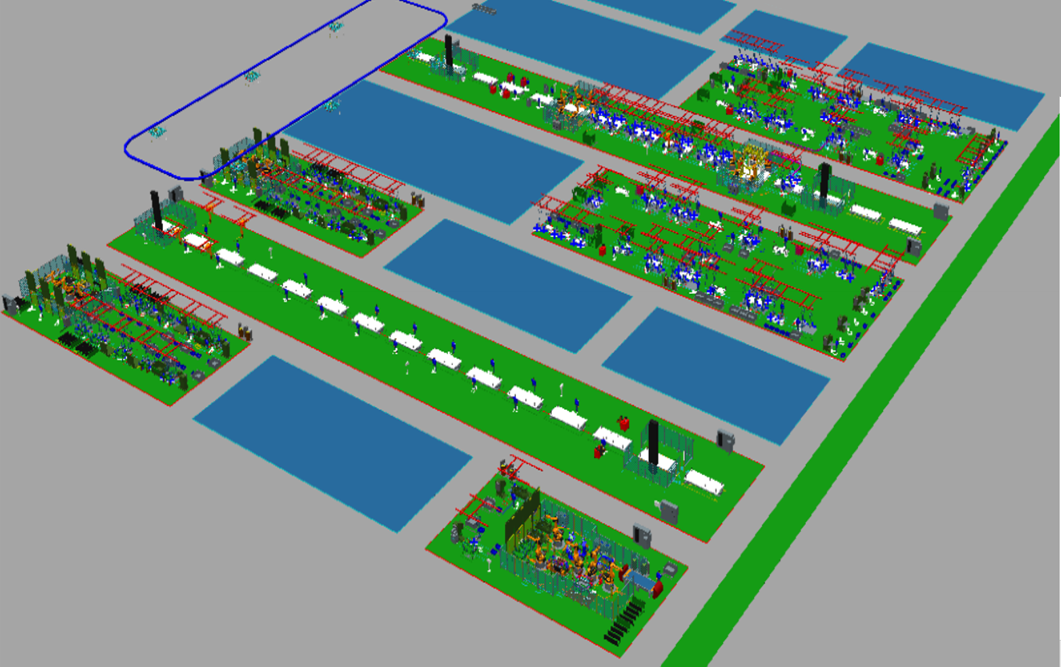
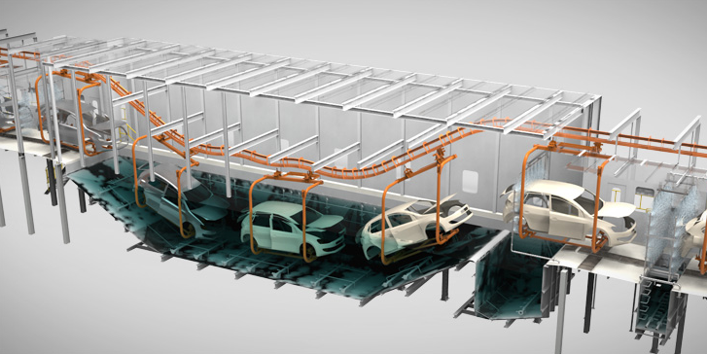
Digital Twin Factory
Top-Down Modeling
Factory
Line1
Line2
Body Line
Start A
(System Read Port)
SIDE RH
Station1
Station2
FLOOR
BB
Device1
Device2
SIDE LH
Device3
DOOR RH
Paint Line
P1
P2
BR
BC
Start Paint
(System Read Port)
Start B
(System Read Port)
P3
End Body
(System Write Port)
P4
HOOD
DOOR LH
P5
P6
End Paint
(System Write Port)

Slide 3
StationFlow_LH
../../../lib/Cylinder/Double
[1stClamp01]
../../../lib/Cylinder/Double
[1stClamp02]
../../../lib/Cylinder/Double
[2ndClamp01]
../../../lib/Cylinder/Double
[2ndClamp02]
S131
S132
RbtHand01
.LOAD
RbtHand02
.LOAD
1stClamp01
.ADV
1stClamp02
.ADV
../../../lib/Cylinder/Single
[Pin01]
../../../lib/Cylinder/Single
[Pin02]
2ndClamp01
.ADV
PART01
.MOVE
2ndClamp02
.ADV
PART02
. MOVE
../../../lib/Robot/Weld
[RbtWeld01]
../../../lib/Robot/Weld
[RbtWeld02]
2ndClamp01
.RET
2ndClamp02
.RET
RbtWeld01
.WELD
RbtWeld02
.WELD
../../../lib/Robot/Handling
[RbtHand01]
../../../lib/Robot/Handling
[RbtHand02]
1stClamp01
.RET
RbtWeld01
.HOME
1stClamp02
.RET
RbtWeld02
.HOME
RbtHand01
.UNLOAD
RbtHand02
.UNLOAD
Pin01
.RET
PART01
.REMOVE
Pin02
.RET
PART02
. REMOVE
../../../lib/Part/Sensor
[PART01]
../../../lib/Part/Sensor
[PART02]
Pin01
.ADV
RbtHand01
.HOME
Pin02
.ADV
RbtHand02
.HOME
RH[RH_EXT]
Func1
[S131~S132]
CLEAR
Func2
[CLEAR~ CLEAR]

