Slide 1
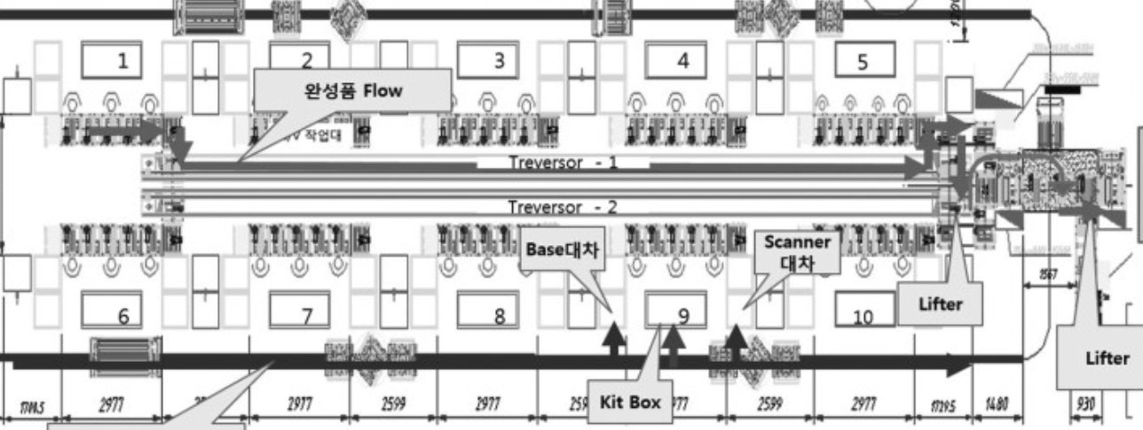
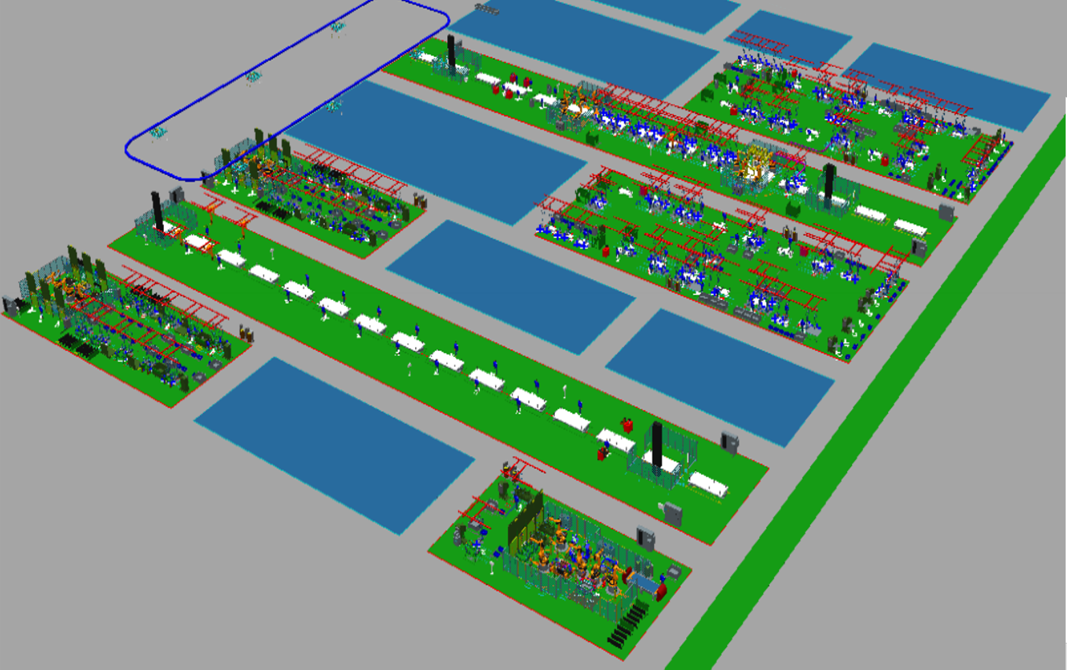
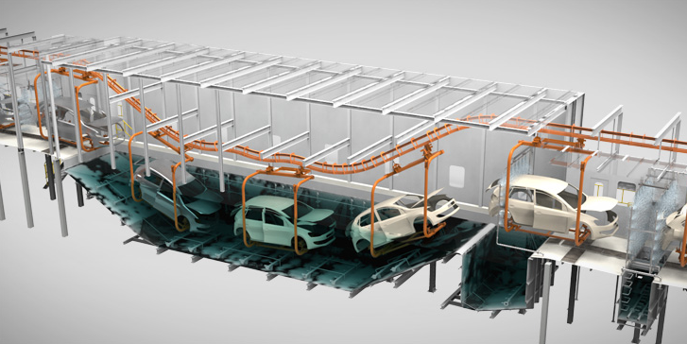
Digital Twin Factory
Top-Down Modeling
Factory
Line1
Line2
Body Line
Start A
(System Read Port)
SIDE RH
Station1
Station2
FLOOR
BB
Device1
Device2
SIDE LH
Device3
DOOR RH
Paint Line
P1
P2
BR
BC
Start Paint
(System Read Port)
Start B
(System Read Port)
P3
End Body
(System Write Port)
P4
HOOD
DOOR LH
P5
P6
End Paint
(System Write Port)

Slide 2
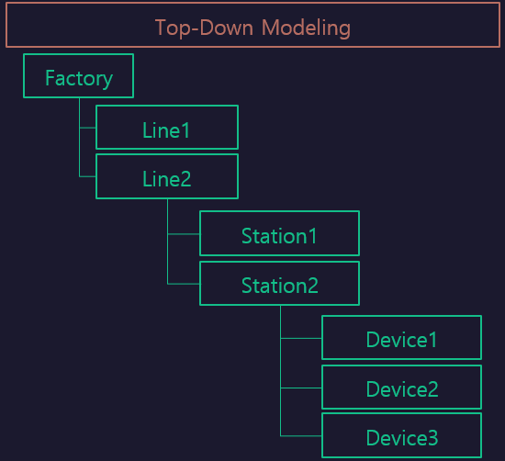

LineFlow
Func1
[RUN ~ BC]
SIDE RH
BB
FLOOR
Station $Func2
Station $Func1
Func2
[REMOVE~]
SIDE LH
Sub/Station
[Station]
DOOR RH
RUN
BC
BR
DOOR LH
MOVING
REMOVE

