Slide 1
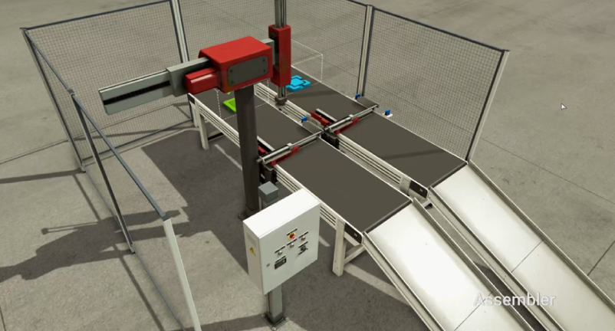
Line
RBTCOMPL
[_~로봇조립Sub]
Go
Main
Rbt XRET
Rbt XADV
RBTCLEAR
[로봇Clear ~_]
Rbt ZRET
SubAssy
Green공급및고정
MAIN
Conv $MOVE
Rbt ZADV
sys2$
SUBDONE
Clamp$ADV
../../lib/Robot/Axis2
[Rbt]
Clamp$RET
Rbt$
XM
Rbt$
XP
../../lib/Cylinder/Double
[Clamp]
Assy반출
로봇조립Main
로봇조립Sub
Rbt$
ZP
Rbt$
GRIBADV
../../lib/Conveyor/CV
[Conv]
Rbt$
ZP
Rbt$
GRIBRET
SubAssy
[sys2]
로봇Clear
Clear
Rbt$
ZM
Rbt$
XP
Conv$
REMOVE
Rbt$
XM
Rbt$
ZM

