Slide 1
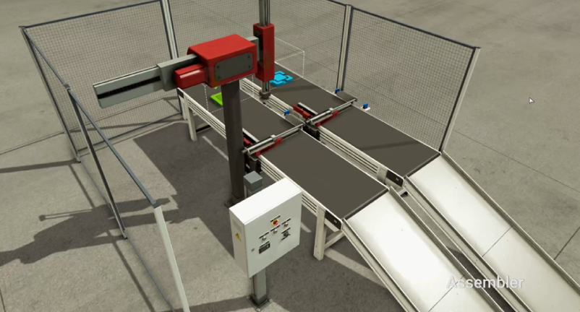
Line
SUBDONE
[_~Blue공급및고정]
Go
Sub
RBT XRET
Sub
ASSYGO
[Assy반출지시~_]
RBT XADV
Blue공급및고정
RBT ZRET
Conv$MOVE1
MAIN
Assy
RBT ZADV
Clamp$ADV
Clamp$RET
../../lib/Cylinder/Double
[Upper]
Assy반출지시
../../lib/Cylinder/Double
[Clamp]
Assy반출
Upper$ADV
../../lib/Conveyor/CV_JobClear
[Conv]
Conv$MOVE2
Conv $
JOBCLEAR
Main
[sys1]
Upper$ADV
sys1$
RBTCOMPL
Upper$RET

