Slide 1
XGK timer, counter 생성

Slide 2
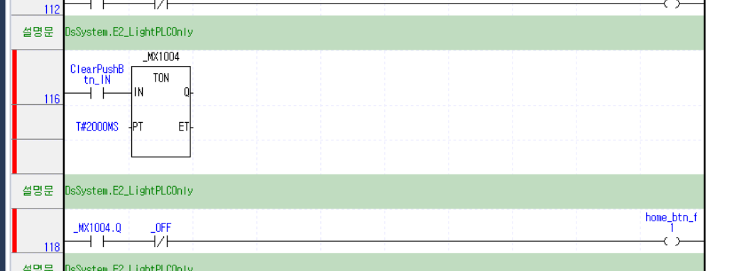
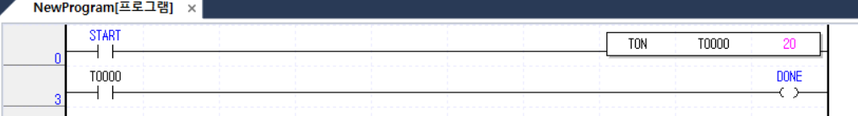
Timer
XGI
XGK

Slide 3
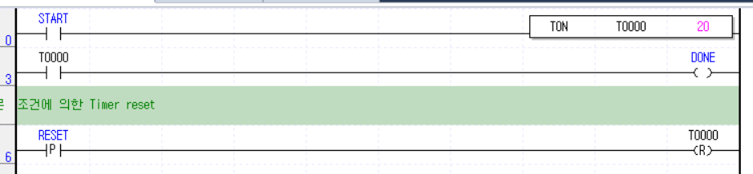
XGK
<LDRoutine>
<Rung BlockMask="0">
<Element ElementType="6" Coordinate="1">M00000</Element>
<Element ElementType="2" Coordinate="4" Param="81"></Element>
<Element ElementType="33" Coordinate="88" Param="TON,T0000,20">
TON</Element>
</Rung>
<Rung BlockMask="0">
<Element ElementType="6" Coordinate="1025">T0000</Element>
<Element ElementType="2" Coordinate="1028" Param="87"></Element>
<Element ElementType="14" Coordinate="1118">M00001</Element>
</Rung>
<Rung BlockMask="0"><Element ElementType="63" Coordinate="2049">조건에 의한 Timer reset</Element></Rung>
<Rung BlockMask="0"><Element ElementType="8" Coordinate="3073">M00000</Element>
<Element ElementType="2" Coordinate="3076" Param="87"></Element>
<Element ElementType="17" Coordinate="3166">T0000</Element>
</Rung>
<OnlineUploadData Compressed="1" dt:dt="bin.base64"
xmlns:dt="urn:schemas-microsoft-com:datatypes">
QlpoORdyRThQkAAAAAA=</OnlineUploadData>
</LDRoutine>
M00000 : START
M00001 : DONE
ElementType
PulseContactMode = 8
ResetCoilMode = 17
FBMode = 33

Slide 4
XGI
ElementType
6: ContactMode
7: ClosedContactMode
14: CoilType_Start
63: RungCommentMode
70 : VairiableMode
102: VertFBMode
<Rung BlockMask="0"><Element ElementType="6" Coordinate="56321">ClearPushBtn_IN</Element>
<Element ElementType="102" Coordinate="56324" Param="FNAME: TON&#xA;TYPE: function_block&#xA;INSTANCE: _MX1004,VAR&#xA;INDEX: 81&#xA;COL_PROP: 1&#xA;SAFETY: 0&#xA;VAR_IN: IN, 0x00200001, , 0&#xA;VAR_IN: PT, 0x00208000, , 0&#xA;VAR_OUT: Q, 0x00000001, &#xA;VAR_OUT: ET, 0x00008000, &#xA;">_MX1004</Element>
<Element ElementType="70" Coordinate="57345">T#2000MS</Element>
</Rung>
<Rung BlockMask="0"><Element ElementType="63" Coordinate="59393">DsSystem.E2_LightPLCOnly</Element>
</Rung>
<Rung BlockMask="0"><Element ElementType="6" Coordinate="60417">_MX1004.Q</Element>
<Element ElementType="7" Coordinate="60420">_OFF</Element>
<Element ElementType="2" Coordinate="60423" Param="84"></Element>
<Element ElementType="14" Coordinate="60510">home_btn_f1</Element>
</Rung>

