Slide 1
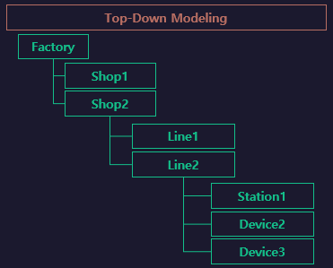
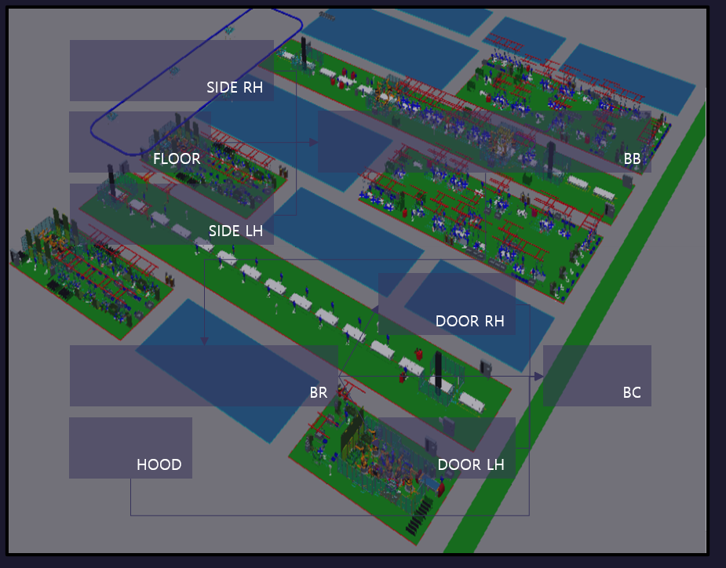

BodyShop
BB
SIDE
FLOOR
BC
MOVING

Slide 2
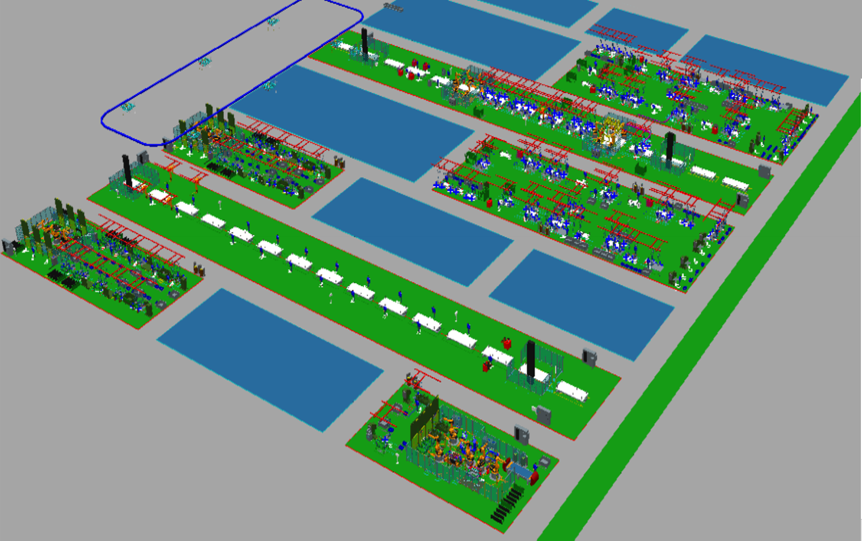
FlowA
RH_LOAD
SIDE RH
SIDE_RH.
RUN
SIDE_RH
.END
FLR
BB
START
RUN
Floor.
RUN
FLR _LOAD
Floor
.END
SIDE_RH.
CLEAR
Floor.
CLEAR
SIDE_LH
.END
SIDE_LH.
CLEAR
START
[START ~ RUN]
SIDE LH
SIDE_LH.
RUN
Sub/Side
[SIDE_LH]
LH_LOAD
Sub/Floor
[Floor]
Sub/Side
[SIDE_RH]

Slide 3
FlowB
./Sub/Sub/LH
[LH]
./Sub/Sub/RH
[RH]
FlowA.BB
DOOR RH
BR
BC1
BC2
BC3
BC4
UNLOAD
END
[BC4 ~ BC4]
DOOR LH
AUTO
CLEAR
UNLOAD
[ UNLOAD ~
UNLOAD ]
MOVING

