Slide 1
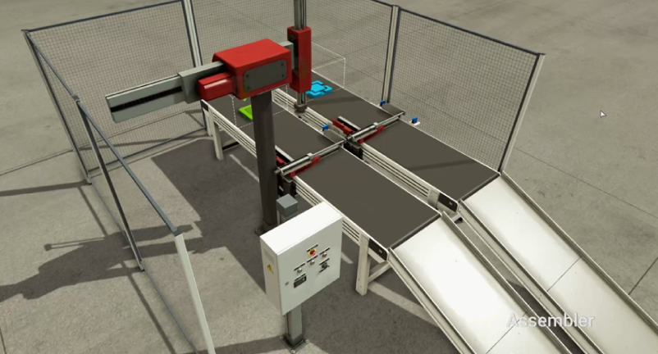
Sub
Conv+
[CV+ ~ Part]
PartOff
[Part Remove ~ _]
Robot X-
Sub
Robot X+
Robot Z-
Clamp+
[v+~s+]
CV+
Part
MAIN
Assy
Robot Z+
Clamp-
[v-~s-]
Part Remove
v+
s+
v-
s-

