Slide 1
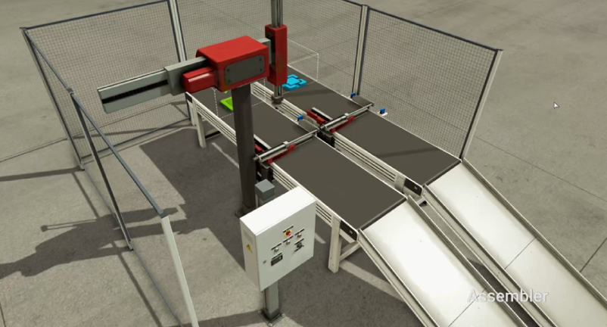
API
StartMain
GoMain~_
StartSub
GoSub~_
Robot X-
JobClear
Clear~_
Sub
Robot X+
Robot Z-
MAIN
Assy
Robot Z+

Slide 2
Line
Go
Main
Go
Sub
Robot X-
Sub
Robot X+
Green공급및고정
Blue공급및고정
Robot Z-
Main$Conv+
Sub$
Conv+
MAIN
Assy
Robot Z+
Main$Clamp+
Sub$
Clamp+
Lib/Robot
[Robot]
Main$Clamp-
Sub$
Clamp-
Robot$X-
Robot$X+
Lib/Main
[Main]
Assy반출
로봇조립Main
로봇조립Sub
Assy반출
Robot$Z+
Assy$
Upper+
Lib/Sub
[Sub]
Robot$Grab+
Robot$Z+
Assy$
UpConv+
Robot$Z-
Robot$X+
Sub$
PartOff
Robot$Grab-
Assy$
Upper-
Lib/Assy
[Assy]
Clear
Main$
PartOff
Robot$X-
Robot$Z-
Assy$
DownConv+

