Slide 1
CVRemove

Slide 2
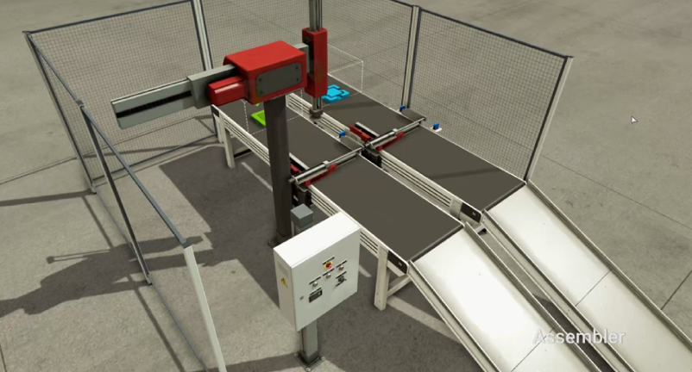
CV
MOVE
[MOVE~ MOVE]
Robot X-
Sub
Robot X+
Robot Z-
MAIN
Assy
REMOVE
[REMOVE ~ REMOVE]
Robot Z+
REMOVE
MOVE

