Slide 1
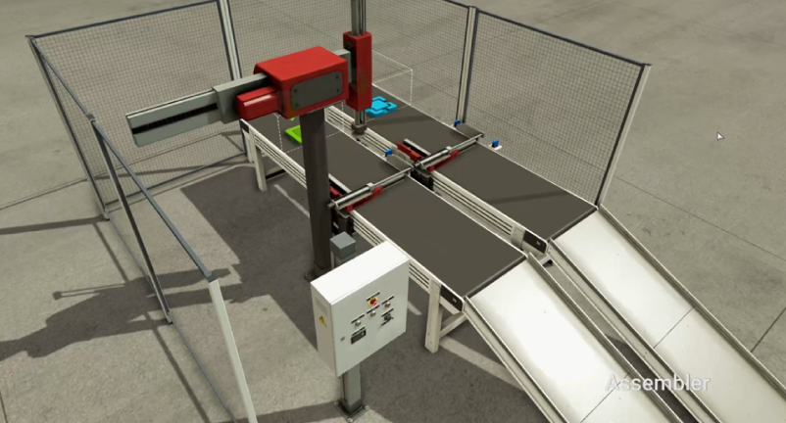
Assy
UpConv+
[UpCV+ ~ PartIn]
JobClear
[work end ~ _]
DownConv+
[DownCV+ ~ PartOut]
Robot X-
Sub
Robot X+
Robot Z-
Upper+
[m+~us+]
UpCV+
PartIn
MAIN
Assy
Robot Z+
Upper-
[중력~us-]
DownCV+
PartOut
work end
m+
us+
중력
us-

