Slide 1
Edges

Slide 2
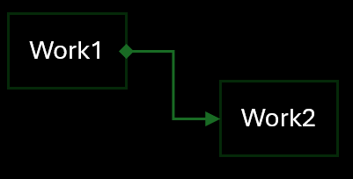
W2 |> W1 > W2
Work1
Work2
Work1 -> Work2: Start, ReverseReset

Slide 3
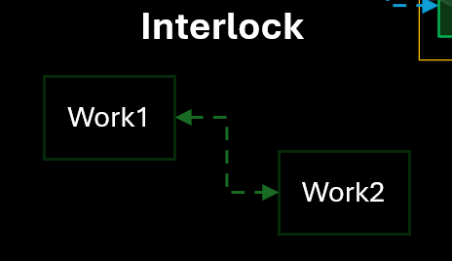
W1 |> W2 |> W1
Work1
Work2
Reset, ReverseReset

Slide 4
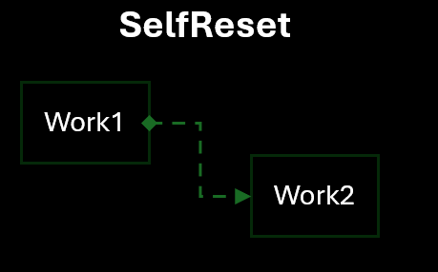
W1 <|> W2; W1 > W2
Work1
Work2
Start + Interlock

Slide 5
W1 > W2
Work1
Work2

Slide 6
W1 |> W2
Work1
Work2

