Slide 1
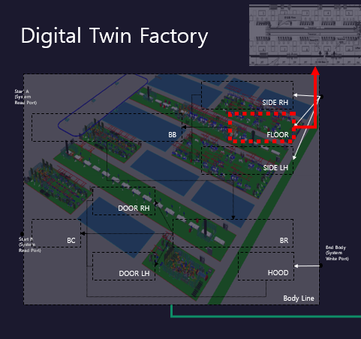
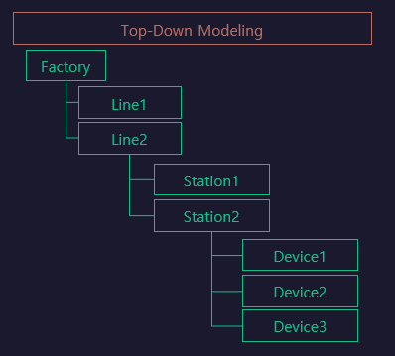
Line

Slide 2
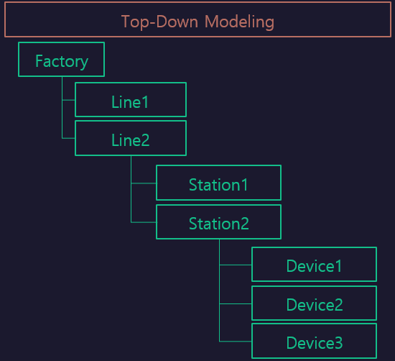

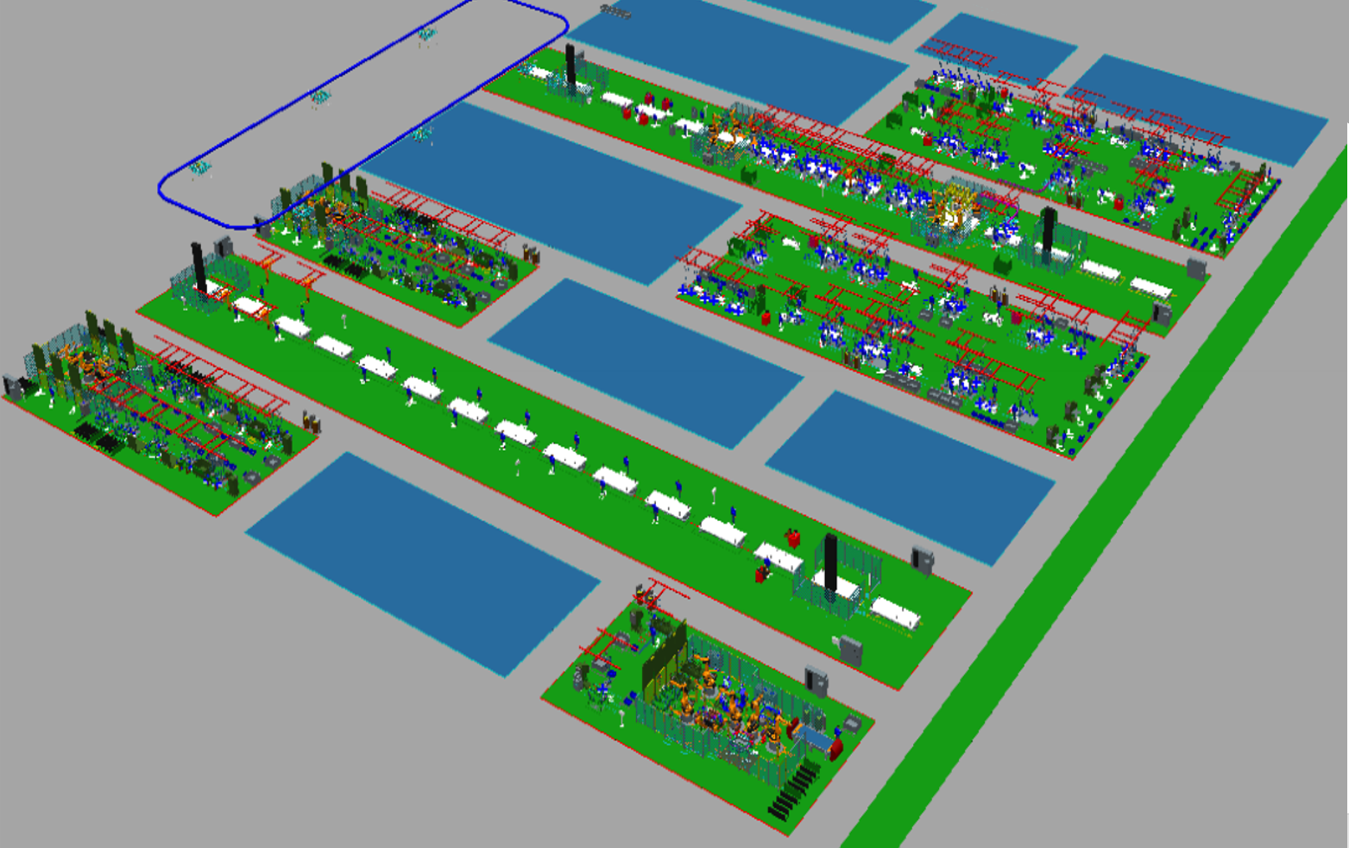
LineFlow
Func1
[START ~ BC]
SIDE RH
BB
FLOOR
Func2
[RESET ~ RESET]
Station $Func2
Station $Func1
SIDE LH
Sub/Sub/Station
[Station]
Unloading
DOOR RH
RUN
START
BC
BR
RESET
DOOR LH
MOVING

