Slide 2
IDE
Controller
engine
Controller
engine
Factory
*.ds
compiler
Controller
engine
OPC
Server
PLC
Core
engine
Rest
PC
Python or KEPServer
PAIX warpper
editor/
monitor
Python
WebGLStudio/
LiteGraph
event
Manager
REST
cloud
remote
monitor
hmi
http://localhost/...
python or node.js
Html, Javascript,
node-opcua
remote
editor
SIM event
Manager
REST
DB
Local database
sqlite
제어는 OPC server와 직접?
remote
hmi
http://localhost/...
SIM hmi
SIM OPC
Server
Html, Javascript
simulator
python
Vscode
확장

Slide 3
Compiler
Input: Input.ds (+ input.ds.ui)
Output
Compiled.cds
Macro(@) 확장
!#import 처리
Hmi.json
Html 에 실어 보냄. Client 에서 UI 생성
Tool
Grammar parser

Slide 4
Core engine

Slide 5
OPC Client/Server
Price
Python : LGPL,
node.js (node-opcua) : Free
Add_Variable() 지원 여부
https://dl.gi.de/bitstream/handle/20.500.12116/34742/C4-8.pdf?sequence=1&isAllowed=y
OPC client
HMI : javascript 필수

Slide 6
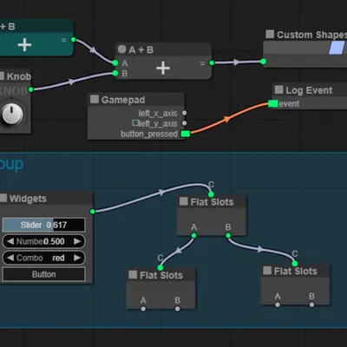
Editor : LiteGraph
Html, js 기반
문제점
Edge 중첩 안됨
Subgraph view 시: 화면 전환
Remote editor/monitor 에서도 동일 방식 지원

