Slide 1
Single
복동 Air 실린더

Slide 2
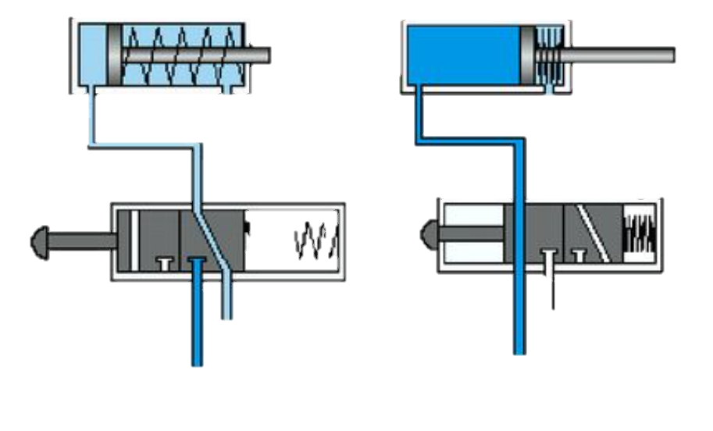
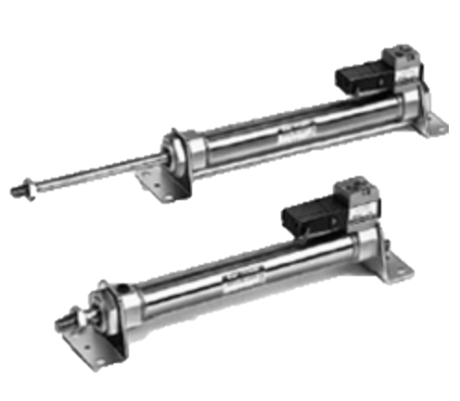
Flow
ADV
[ValveADV ~ SensorADV]
Valve
ADV
Piston
ADV
Sensor
ADV
RET
[SpringPower ~ SensorRET]
Spring
Power
Piston
RET
Sensor
RET

Slide 3
Flow
RET
[ValveADV ~ ValveADV]
Valve
ADV
ADV
[SpringPower ~ SpringPower]
Spring
Power

