Slide 1
TIMER
XGK는 타이머가 8192개인데 XGI는 제한이 없음
https://sol.ls-electric.com/uploads/document/16415181015221/LS%EC%9D%BC%EB%A0%89%ED%8A%B8%EB%A6%AD_XGI%20%EC%A0%9C%ED%92%88%EA%B5%90%EC%9C%A1_V2.2.pdf

Slide 2
Manuals
AB
https://literature.rockwellautomation.com/idc/groups/literature/documents/rm/1756-rm003_-en-p.pdf 영문
https://literature.rockwellautomation.com/idc/groups/literature/documents/rm/1756-rm003_-ko-p.pdf 국문
https://edisciplinas.usp.br/pluginfile.php/184942/mod_resource/content/1/Logix5000%20-%20Manual%20de%20Referencias.pdf
LS 산전
http://www.famart.co.kr/resource/ls/%EC%82%AC%EC%9A%A9%EC%84%A4%EB%AA%85%EC%84%9C_XGI_XGR_XEC_%EB%AA%85%EB%A0%B9%EC%96%B4%EC%A7%91_V2.7.pdf

Slide 3
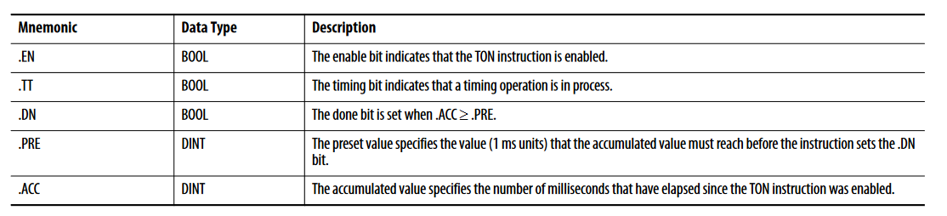
Timer structure
TON 기준

Slide 4
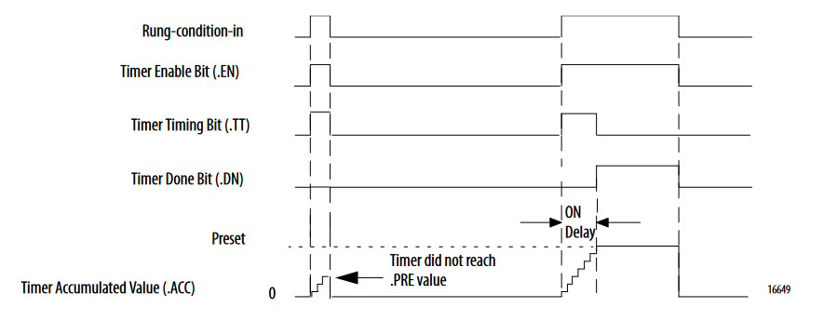
TON
The TON/TOF instruction accumulates time until the following occurs: • The TON/TOF instruction is disabled • The .ACC >= .PRE
When the TON/TOF instruction is disabled, the .ACC value is cleared

Slide 5
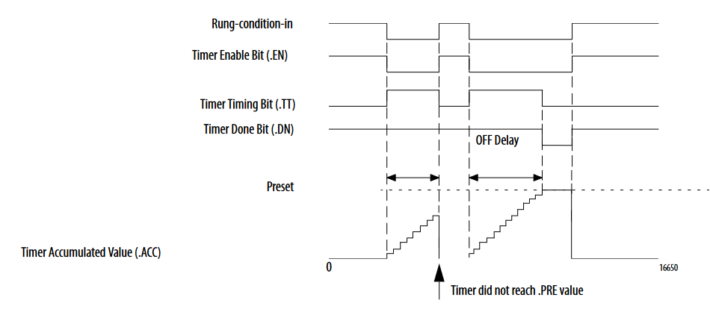
TOF
EN 는 Rung-condition-in 을 따라감
TT 는 timing measure 중에만 ON 됨
! EN && DN
DN 는 counting 완료 후에 OFF, EN ON 시 ON
동영상 https://www.youtube.com/watch?v=KdRpvMTskUI&t=351s 5:25

Slide 6
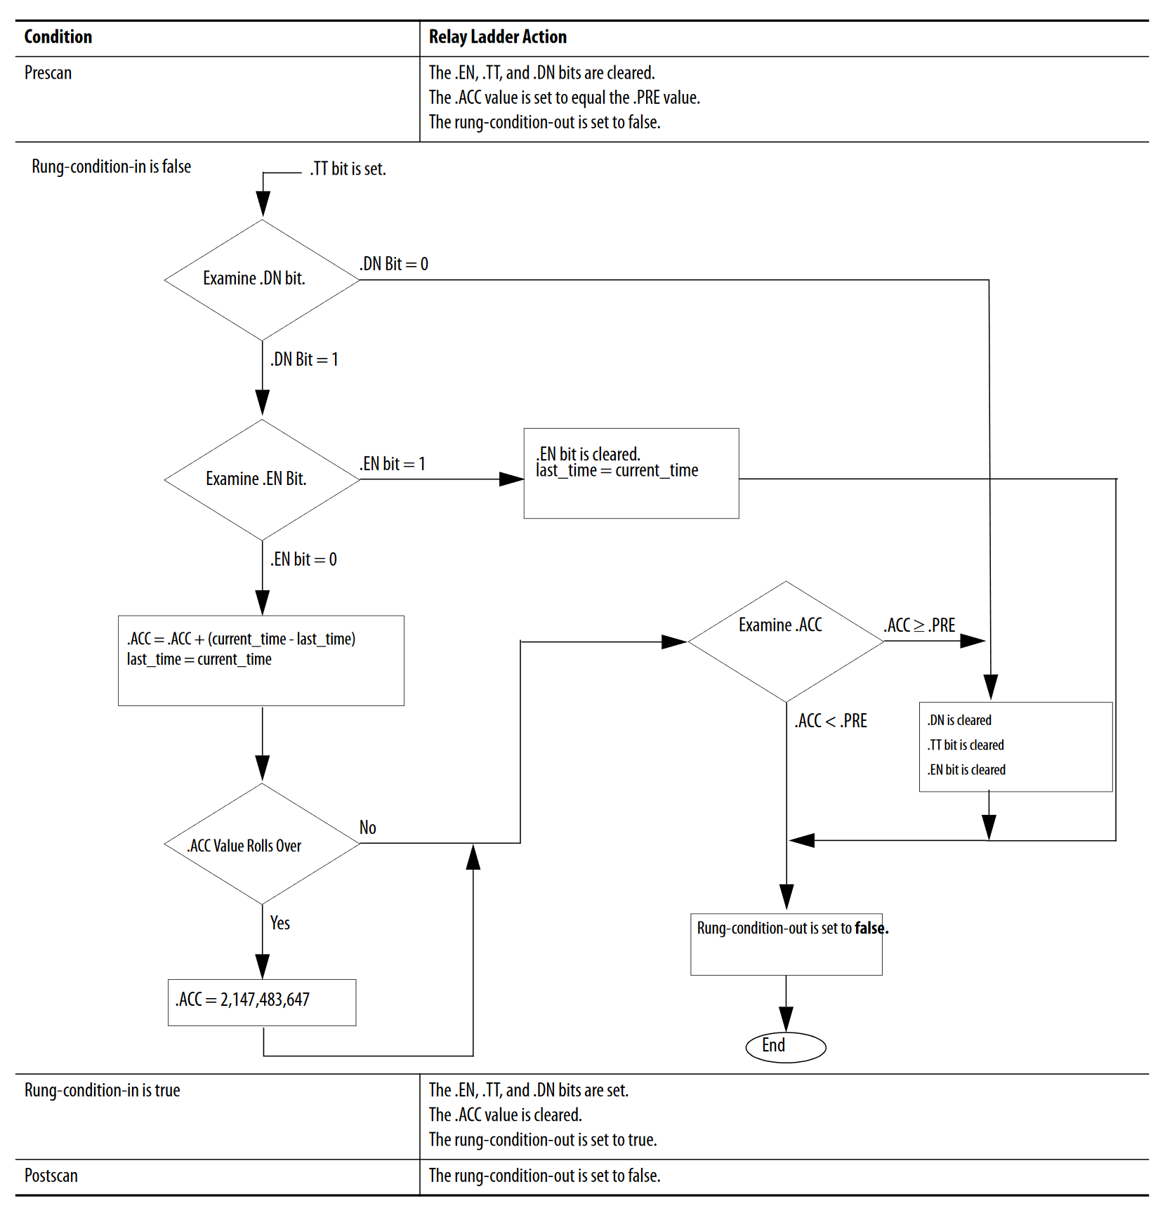
TOF

Slide 7
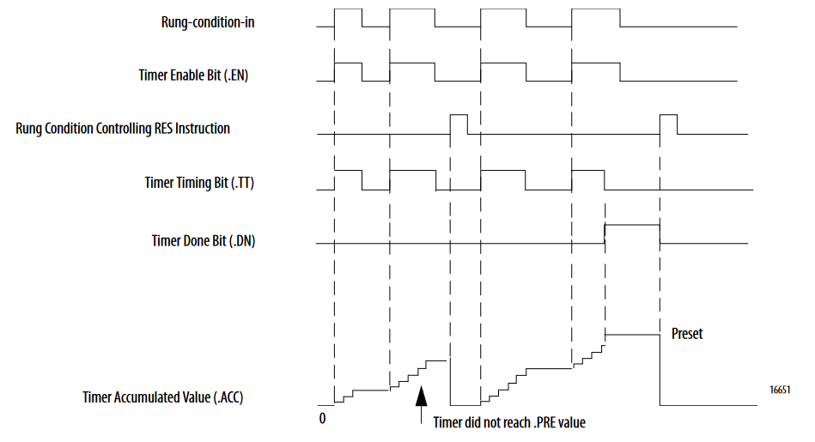
RTO
The RTO instruction accumulates time until it is disabled. When the RTO instruction is disabled, it retains its .ACC value. You must clear the .ACC value, typically with a RES instruction referencing the same TIMER structure. The time base is always 1 ms. For example, for a 2-second timer, enter 2000 for the .PRE value

Slide 8
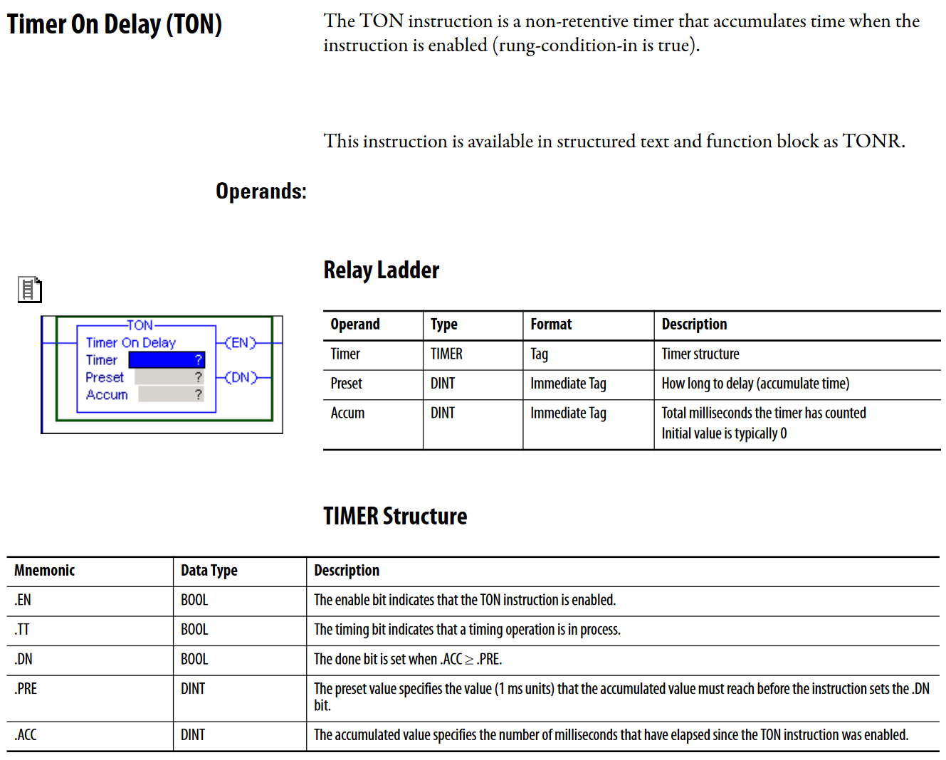
TON (AB)

Slide 9
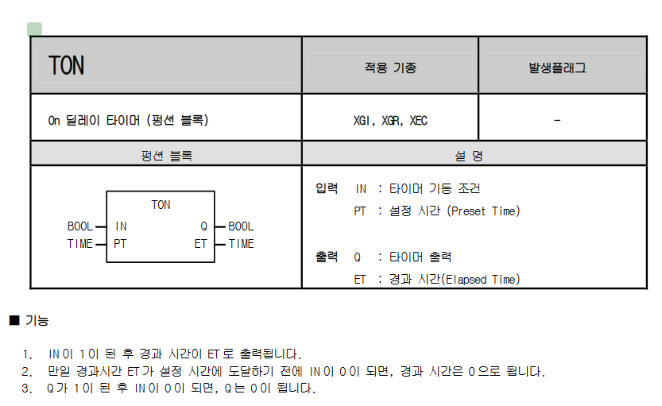
산전 TON

Slide 10
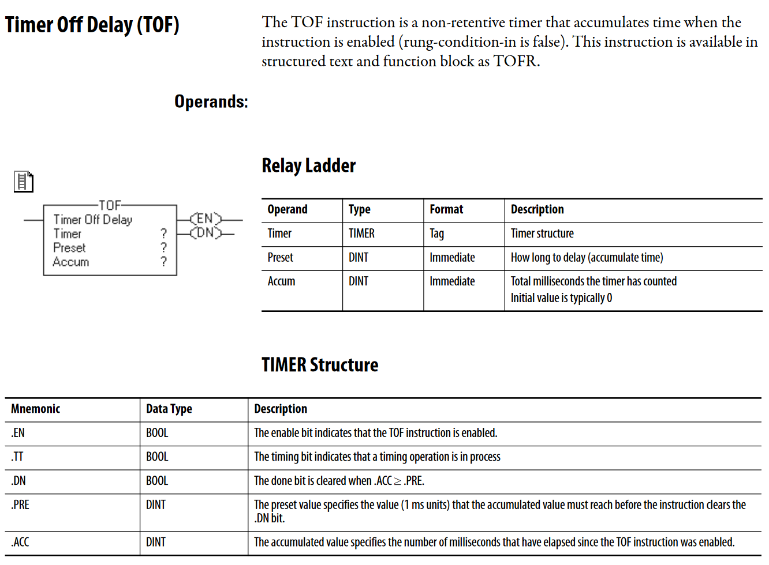
TOF (AB)

Slide 11
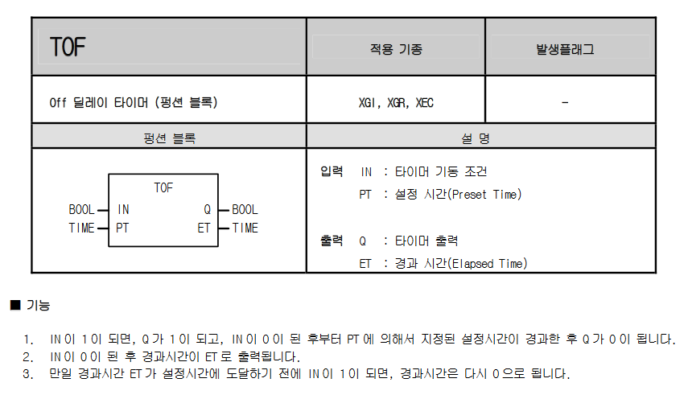
산전 TOF

Slide 12
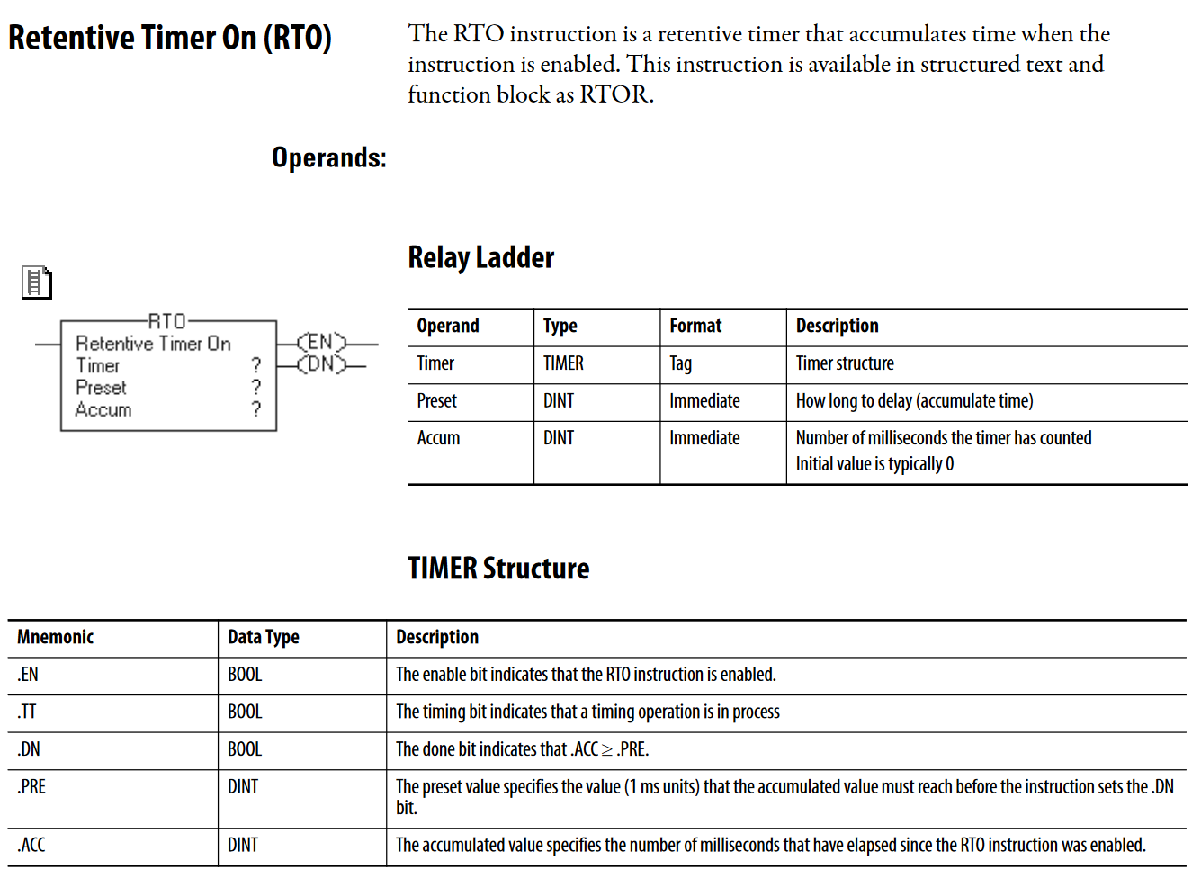
RTO (AB)

Slide 13
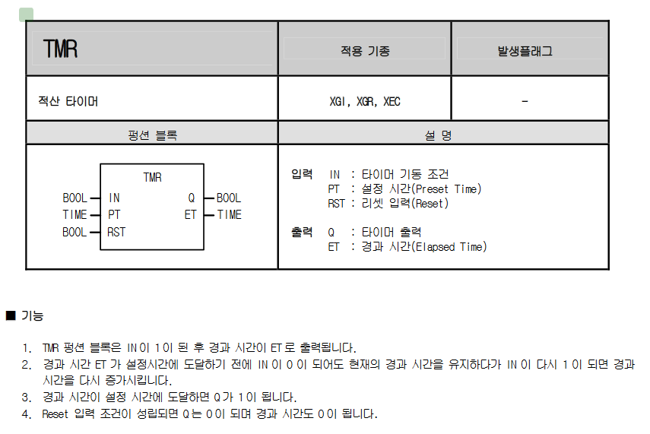
산전 TMR

Slide 14
COUNTER

Slide 15
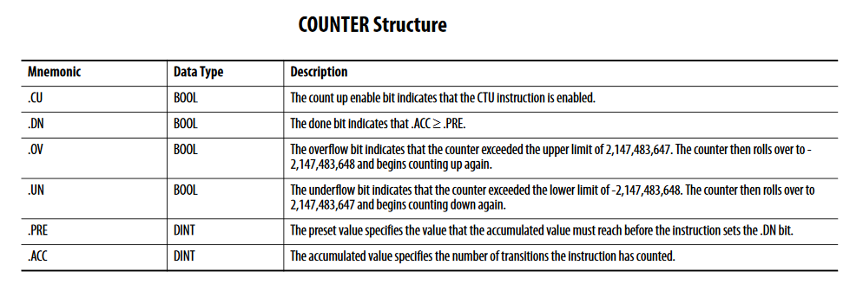
CTU
.CU, .CD

Slide 16
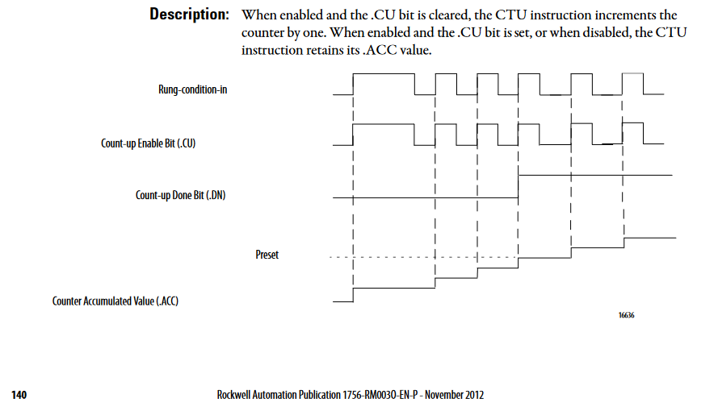
CTU (AB)

Slide 17
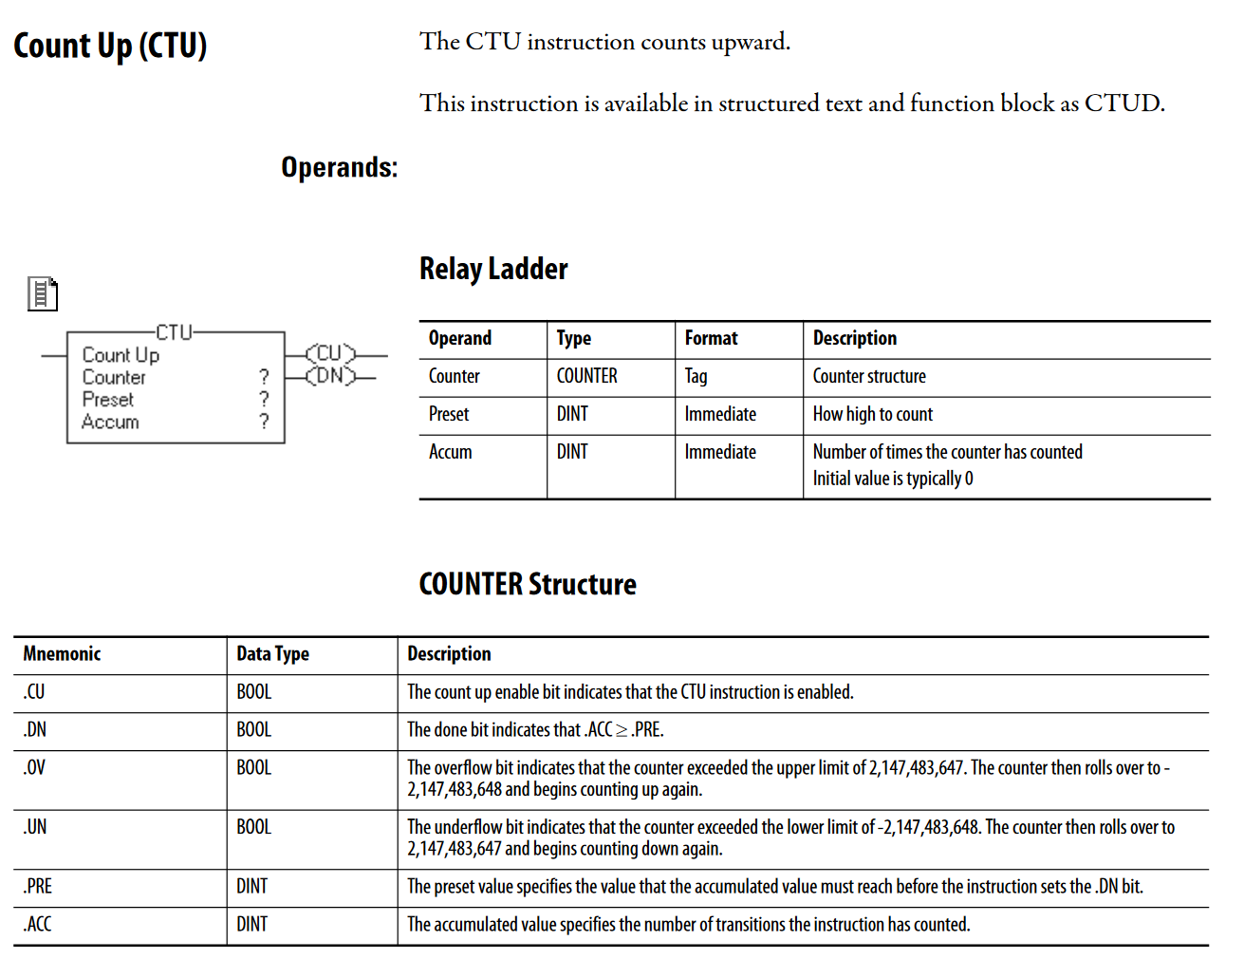
CTU (AB)

Slide 18
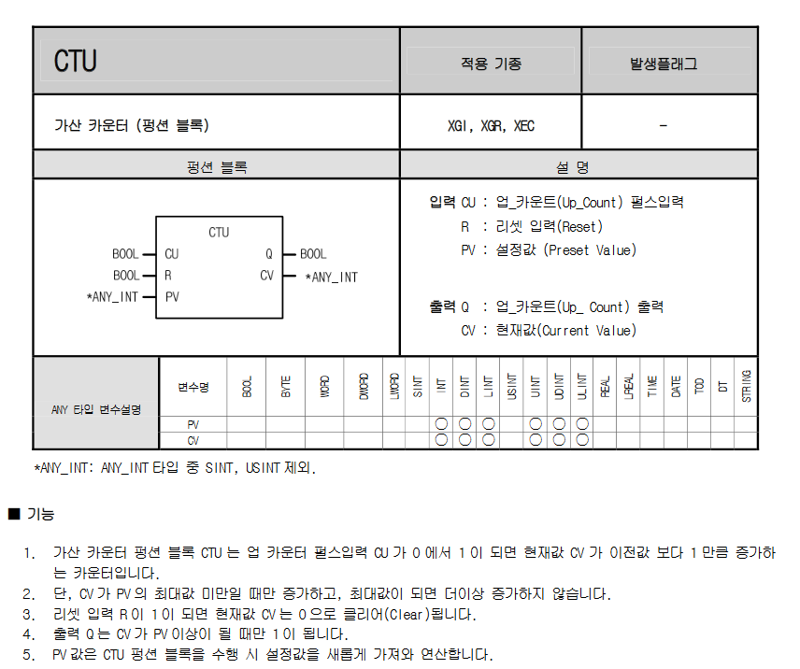
산전 CTU

Slide 19
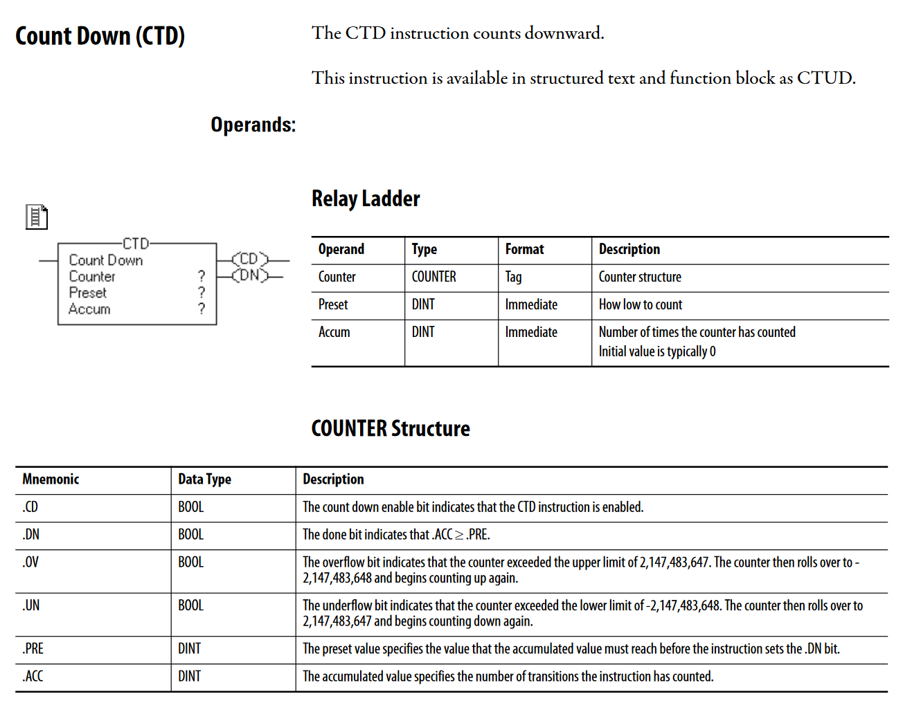
CTD (AB)

Slide 20
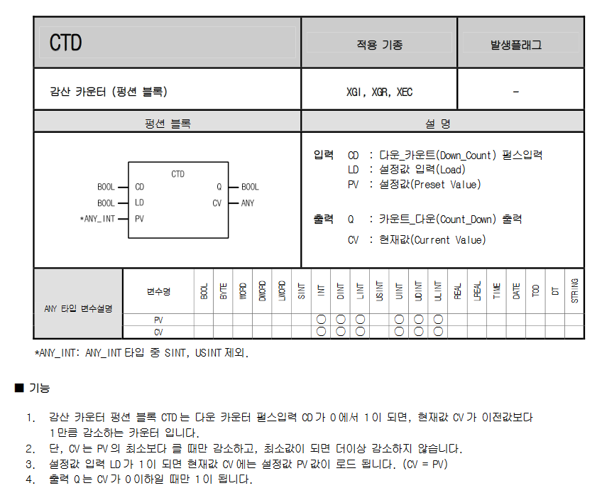
산전 CTD

Slide 21
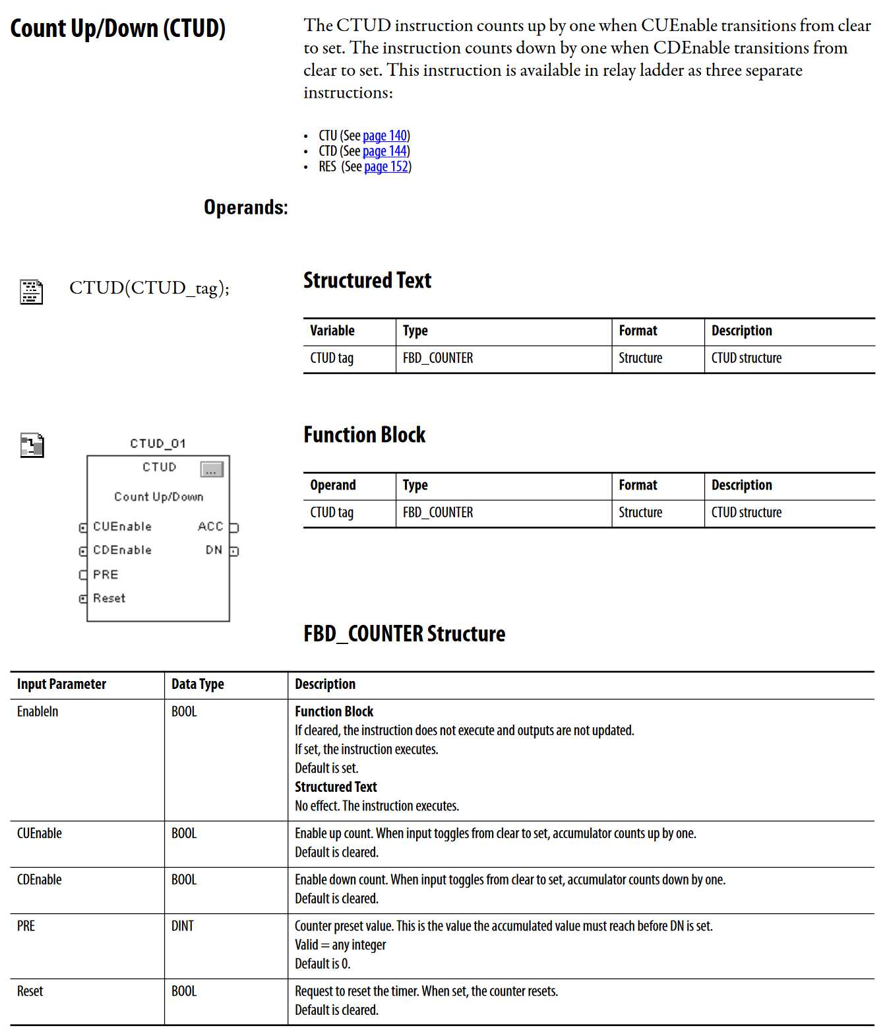
CTUD (AB)

Slide 22
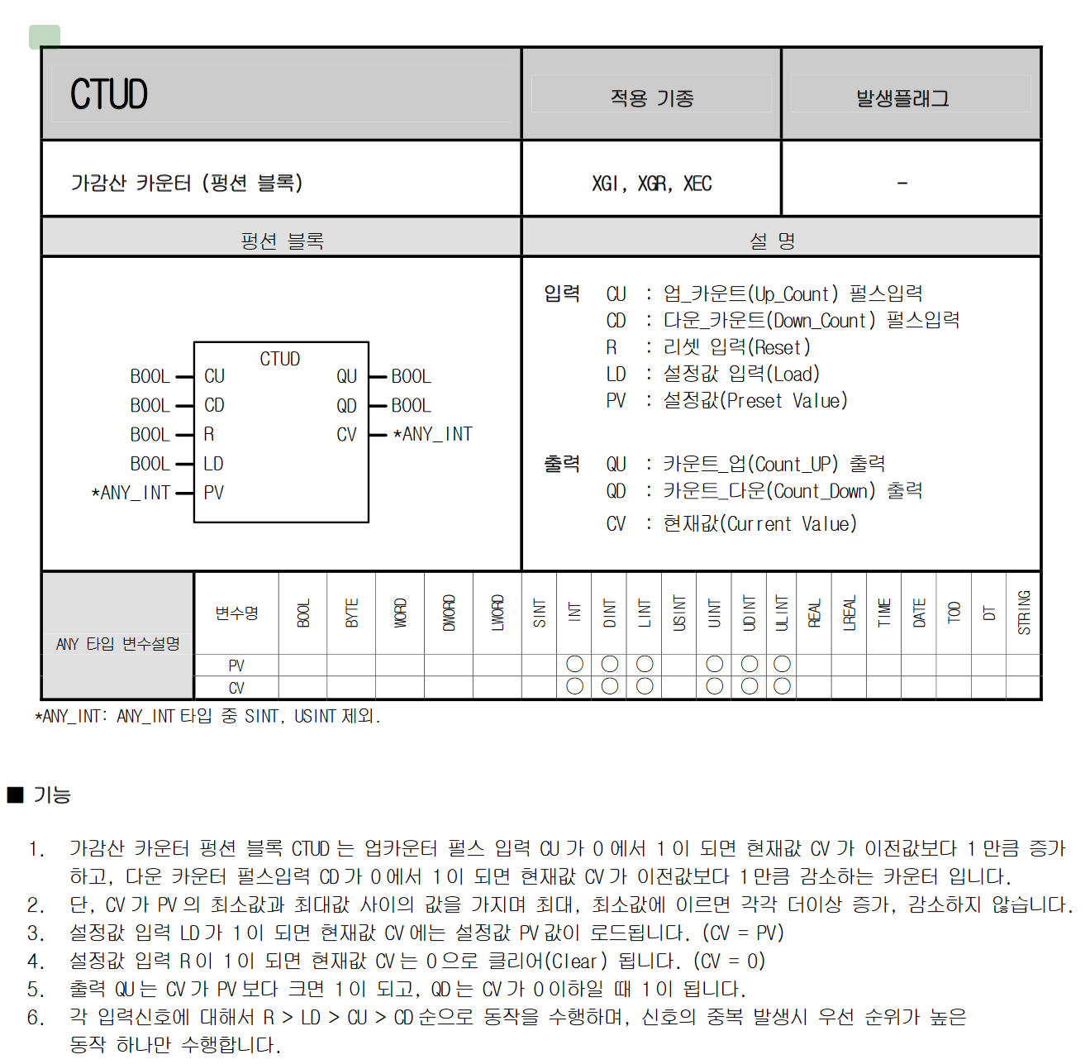
산전 CTUD

Slide 23
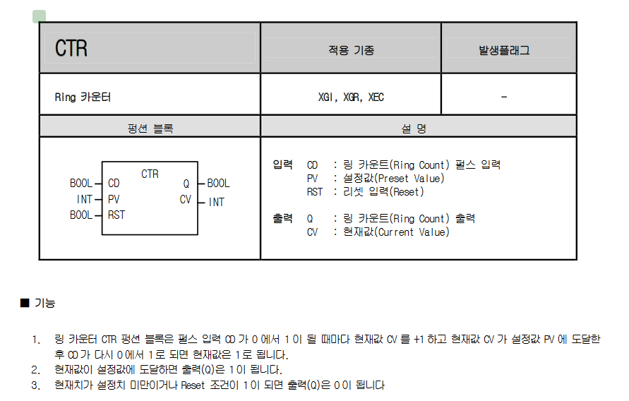
산전 CTR

Slide 24
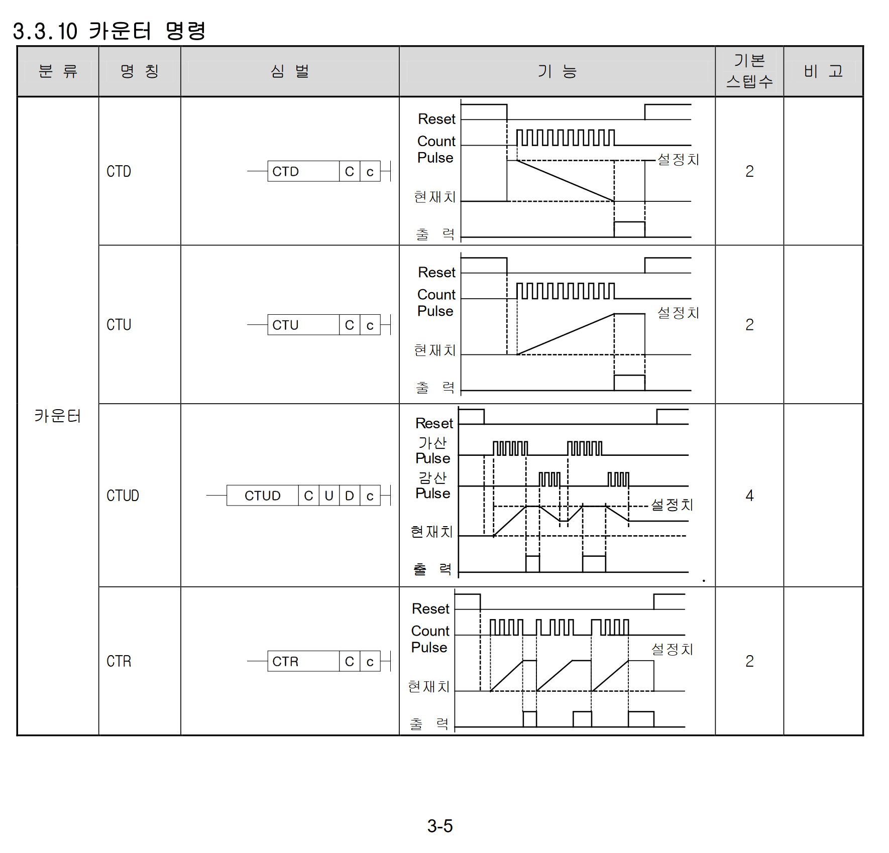
산전 counter

Slide 25
Classes
Timer
TickAccumulator
TimerCounterBaseStruct
Counter
CountAccumulator
TimerStruct
CounterBaseStruct
CTUStruct
CTDStruct
CTUDStruct
TimerStatement
CounterStatement

Slide 26
Classes : Timer/Counter top level
type Statement =
| DuAssign of expression:IExpression * target:IStorage
| DuVarDecl of expression:IExpression * variable:IStorage
| DuTimer of TimerStatement
| DuCounter of CounterStatement
type TimerStatement = {
Timer:Timer
RungInCondition: IExpression<bool> option
ResetCondition: IExpression<bool> option
}
type CounterStatement = {
Counter:Counter
UpCondition: IExpression<bool> option
DownCondition: IExpression<bool> option
ResetCondition: IExpression<bool> option
}

Slide 27
Classes : Timer statements
type Timer internal(typ:TimerType, timerStruct:TimerStruct) =
let accumulator = new TickAccumulator(typ, timerStruct)
member _.Type = typ
member _.Name = timerStruct.Name
member _.EN = timerStruct.EN
member _.TT = timerStruct.TT
member _.DN = timerStruct.DN
member _.PRE = timerStruct.PRE
member _.ACC = timerStruct.ACC
member _.RES = timerStruct.RES
member val InputEvaluateStatements:Statement list = [] with get, set
interface IDisposable with
member _.Dispose() = (accumulator :> IDisposable).Dispose()

Slide 28
생성 : from code
let storages = Storages()
let t1 = PlcTag("my_timer_control_tag", "%M1.1", false)
let condition = tag2expr t1
let statement = TimerStatement.CreateTON(storages, "myTon", 2000us, condition) // 2000ms = 2sec
let timer = statement |> toTimer
timer.TT.Value === false
timer.EN.Value === false
timer.DN.Value === false
timer.PRE.Value === 2000us
timer.ACC.Value === 0us

Slide 29
생성: from ds text
"ton mytimer3 = createTON(1000us, $tag1 || $tag2)"

Slide 30
작화 특성

Slide 31
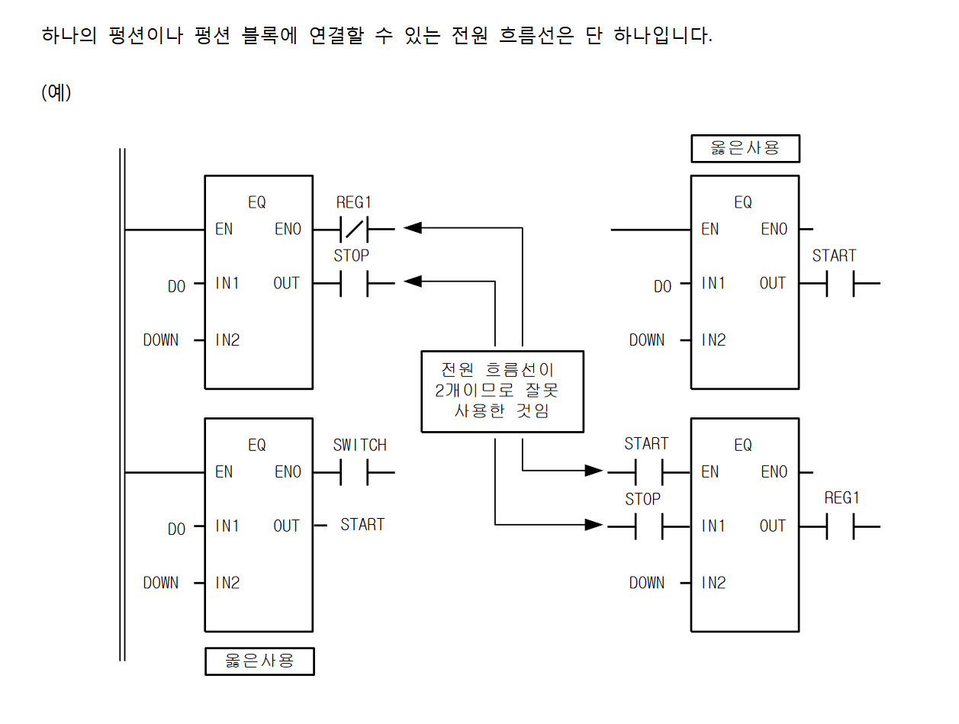
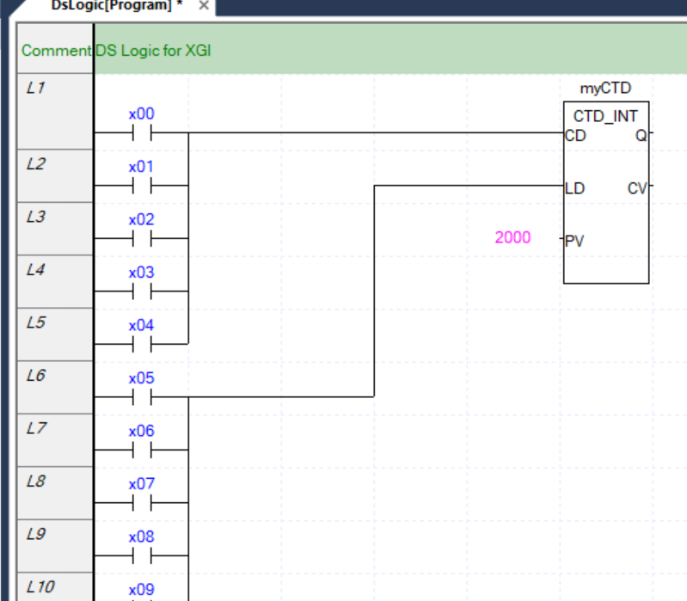
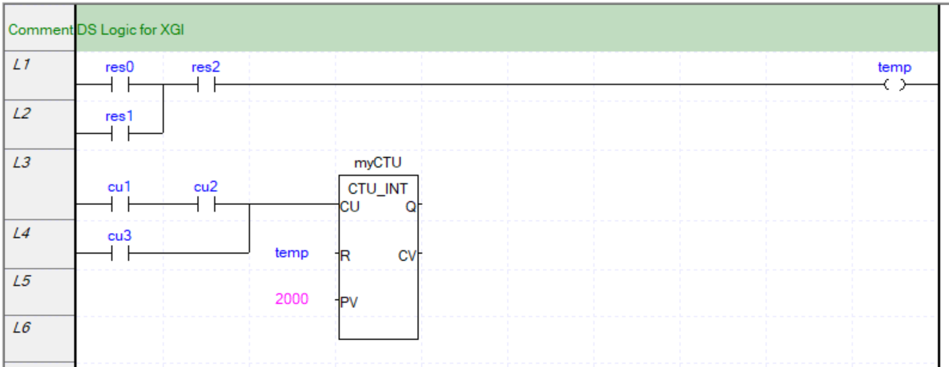
Input side 다릿발
http://duduji.iptime.org/gnuboard/data/file/du_board_study/XGI_%EC%B4%88%EA%B8%89(V18).pdf pp.43
OK
Input 쪽 bool 값은 복수개로 전원 연결 가능

