Slide 1
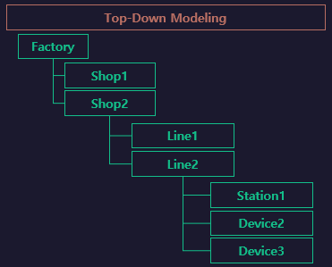
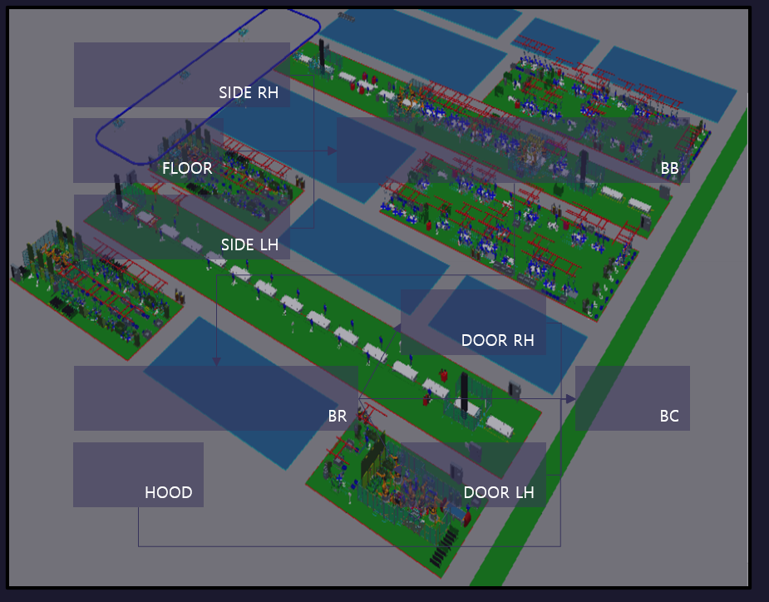

BodyShop
BB
SIDE
FLOOR
BC
MOVING

Slide 2
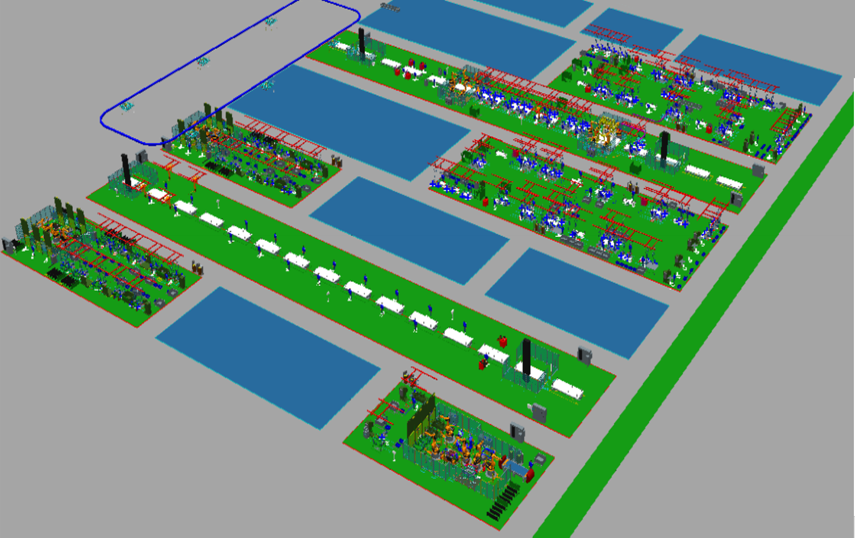
FlowA
RH_LOAD
START
SIDE RH
SIDE_RH.
START
Buffer1
SIDE_RH
.END
FLR
BB
Buffer2
Floor.
START
FLR _LOAD
Floor
.END
SIDE_RH.
UNLOAD
Floor.
UNLOAD
SIDE_LH
.END
SIDE_LH.
UNLOAD
START
[START ~ START]
SIDE LH
SIDE_LH.
START
Sub/Side
[SIDE_LH]
LH_LOAD
Sub/Floor
[Floor]
Sub/Side
[SIDE_RH]

Slide 3
FlowB
FlowA.BB
DOOR RH
BR
BC1
BC2
BC3
BC4
UNLOAD
[UnloadClear
~ UnloadClear]
END
[BC4 ~ BC4]
DOOR LH
UnloadClear
UnloadClear
Clear

