Slide 1
TIMER

Slide 2
Manuals
AB
https://literature.rockwellautomation.com/idc/groups/literature/documents/rm/1756-rm003_-en-p.pdf 영문
https://literature.rockwellautomation.com/idc/groups/literature/documents/rm/1756-rm003_-ko-p.pdf 국문
https://edisciplinas.usp.br/pluginfile.php/184942/mod_resource/content/1/Logix5000%20-%20Manual%20de%20Referencias.pdf

Slide 3
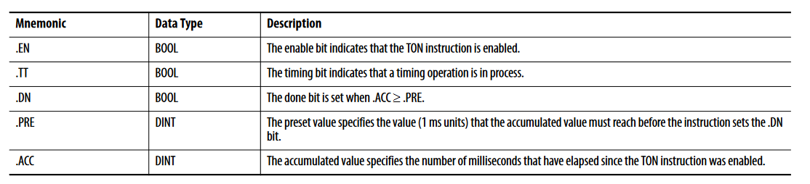
Timer structure
TON 기준

Slide 4
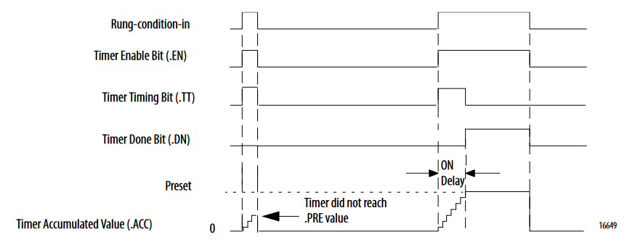
TON
The TON/TOF instruction accumulates time until the following occurs: • The TON/TOF instruction is disabled • The .ACC >= .PRE
When the TON/TOF instruction is disabled, the .ACC value is cleared

Slide 5
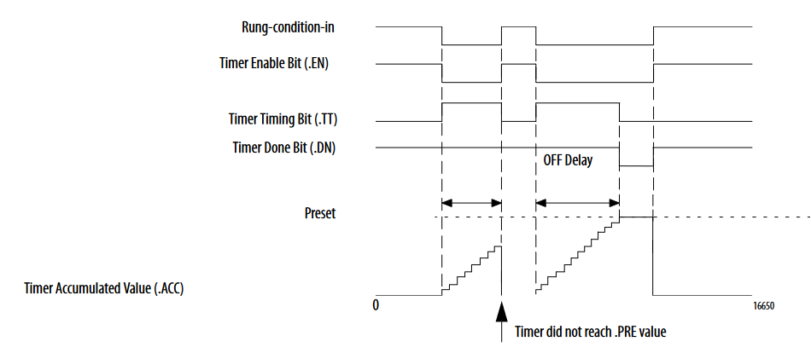
TOF

Slide 6
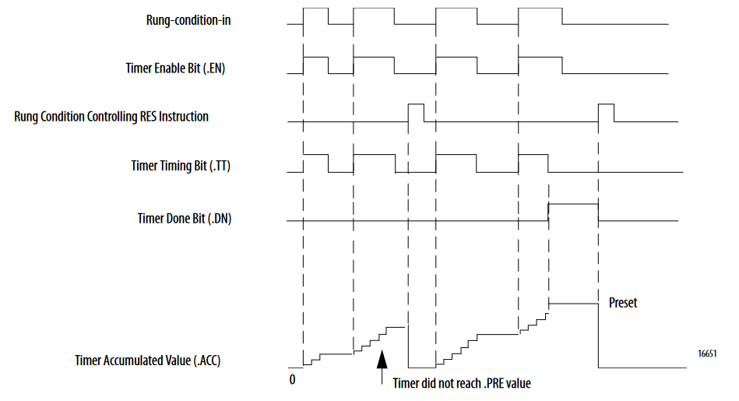
RTO

