Slide 1
Cylinder
단동 Air 실린더

Slide 2
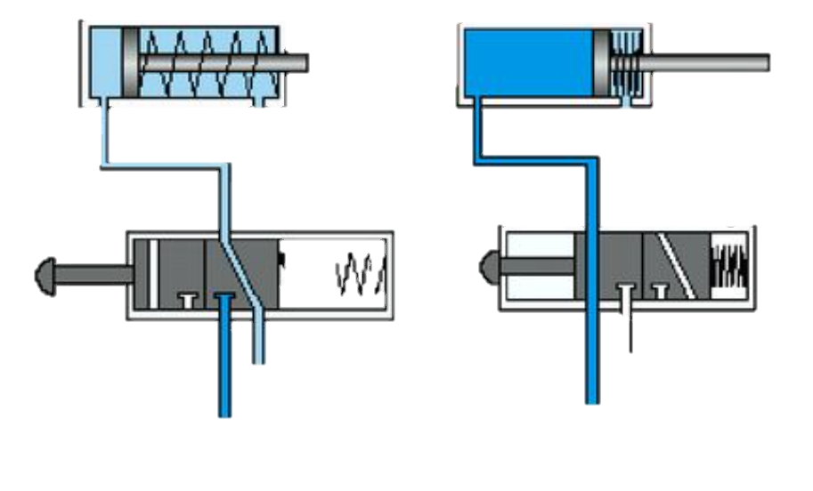
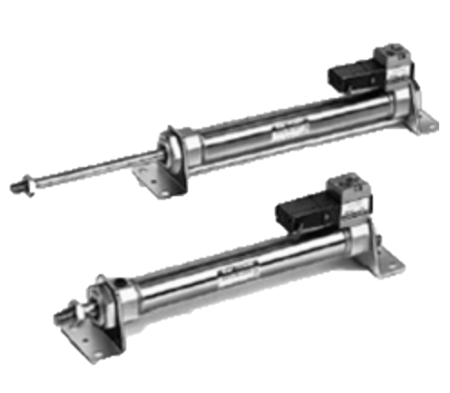
Flow
ADV
[Valve ~ PositionADV]
Valve
Piston
ADV
Position
ADV
RET
[SpringPower ~ PositionRET]
Spring
Power
Piston
RET
Position
RET

