Slide 1
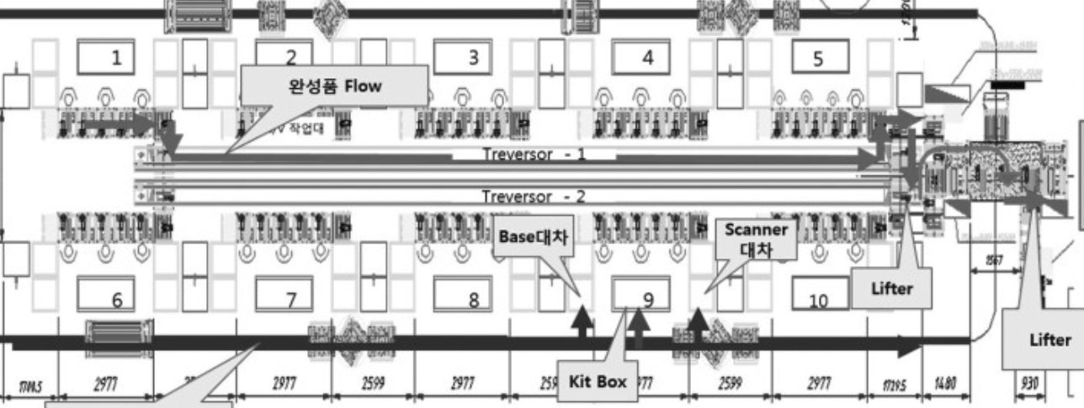
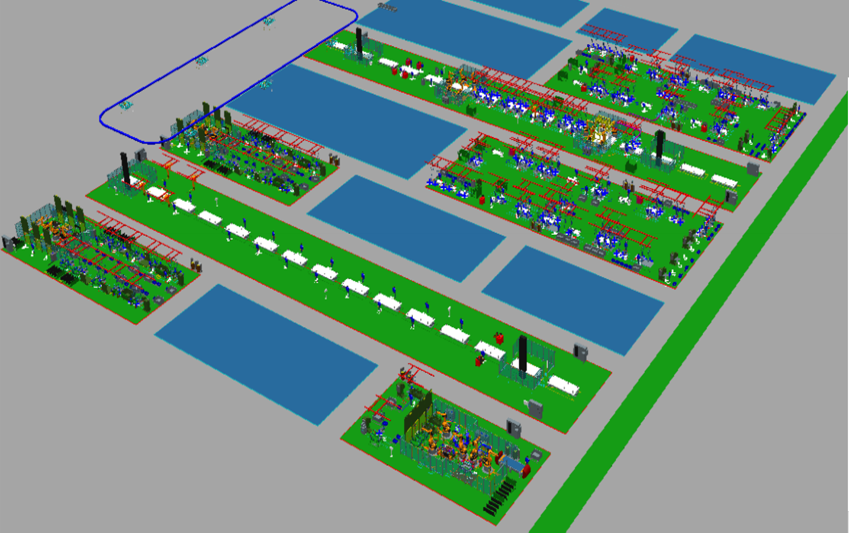
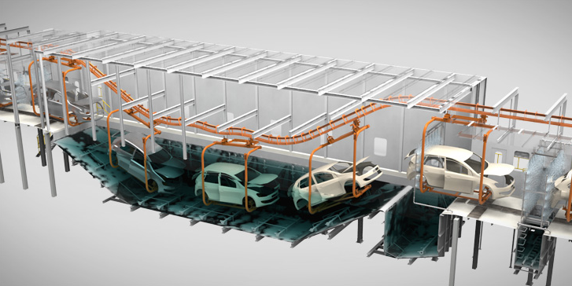
Digital Twin Factory
Top-Down Modeling
Factory
Line1
Line2
Body Line
Start A
(System Read Port)
SIDE RH
Station1
Station2
FLOOR
BB
Device1
Device2
SIDE LH
Device3
DOOR RH
Paint Line
P1
P2
BR
BC
Start Paint
(System Read Port)
Start B
(System Read Port)
P3
End Body
(System Write Port)
P4
HOOD
DOOR LH
P5
P6
End Paint
(System Write Port)

Slide 2
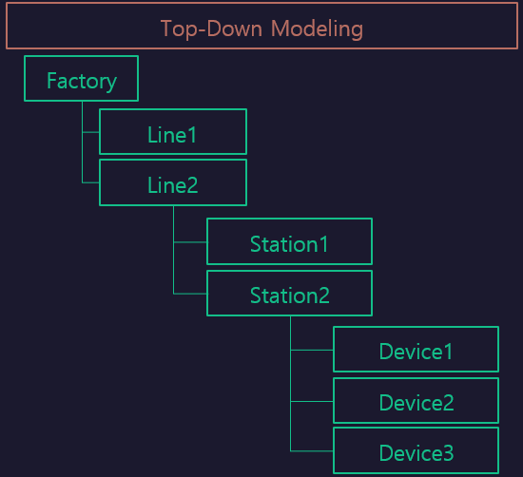

FactoryFlow
Line1_Work
Line2_Work
Sub/Line
[Line1]
Line1 $Func1
Line2 $Func1
Sub/Line
[Line2]
Line1_Remove
Line1 $Func2
Loading Name $ Api
시스템 Interface 는 ’$‘ 기호로 호출한다.

