Slide 1
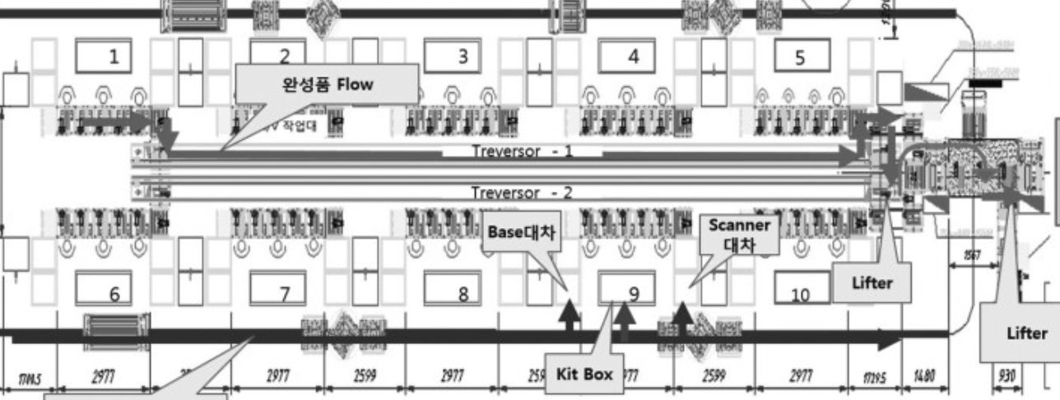
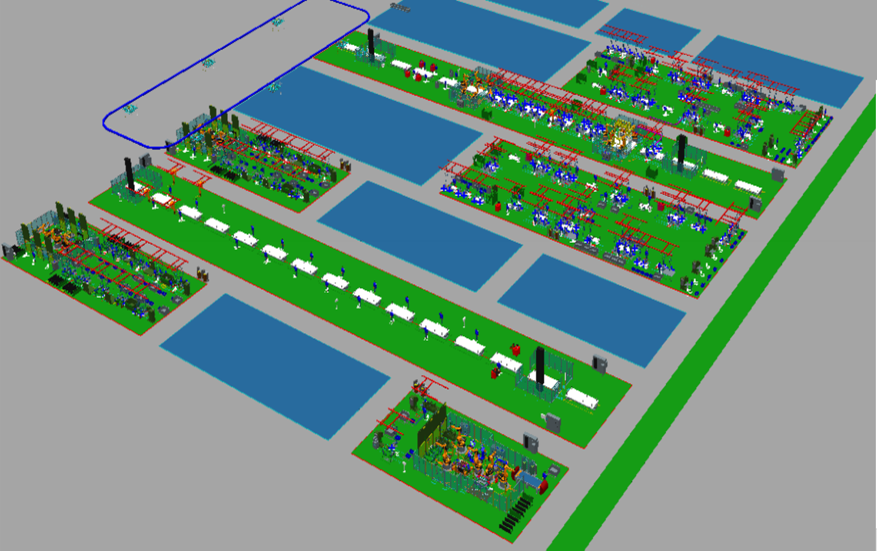
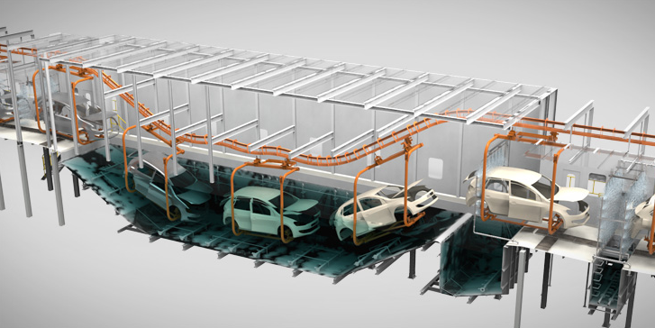
Digital Twin Factory
Top-Down Modeling
Factory
Line1
Line2
Body Line
Start A
(System Read Port)
SIDE RH
Station1
Station2
FLOOR
BB
Device1
Device2
SIDE LH
Device3
DOOR RH
Paint Line
P1
P2
BR
BC
Start Paint
(System Read Port)
Start B
(System Read Port)
P3
End Body
(System Write Port)
P4
HOOD
DOOR LH
P5
P6
End Paint
(System Write Port)

Slide 2
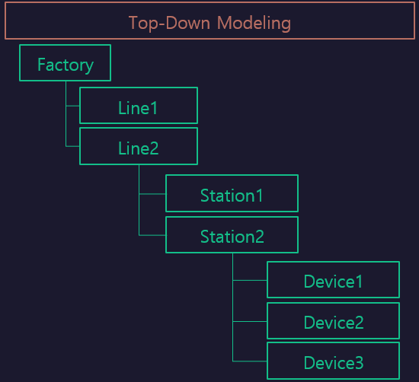

StationFlow
LH_WORK
LH$
Func1
LH$
Func2
Func1
[START
~FINISH]
START
FINISH
Func2
[RESET
~]
RH_WORK
RH$
Func1
RH$
Func2
Sub/StationLH
[LH]
Sub/StationRH
[RH]
RESET

