Slide 1
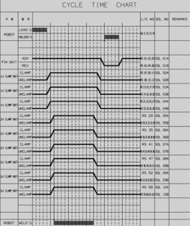
TEST
WORK
RBT_LOAD1
RBT_LOAD2
RBT_LOAD3
PART_ON
SSSS
CLAMP_1st
CLAMP_2nd
RBT1_Weld
RBT2_Weld
RBT3_Weld
RBT4_Weld
UNCLAMP_2nd
UNCLAMP_1st
PIN_DOWN
RBT_UNLOAD
PIN_UP

