Slide 1
TIMER

Slide 2
Manuals
AB
https://literature.rockwellautomation.com/idc/groups/literature/documents/rm/1756-rm003_-en-p.pdf 영문
https://literature.rockwellautomation.com/idc/groups/literature/documents/rm/1756-rm003_-ko-p.pdf 국문
https://edisciplinas.usp.br/pluginfile.php/184942/mod_resource/content/1/Logix5000%20-%20Manual%20de%20Referencias.pdf
LS 산전
http://www.famart.co.kr/resource/ls/%EC%82%AC%EC%9A%A9%EC%84%A4%EB%AA%85%EC%84%9C_XGK_XGB_%EB%AA%85%EB%A0%B9%EC%96%B4%EC%A7%91_%EA%B5%AD%EB%AC%B8_V2.3.pdf

Slide 3
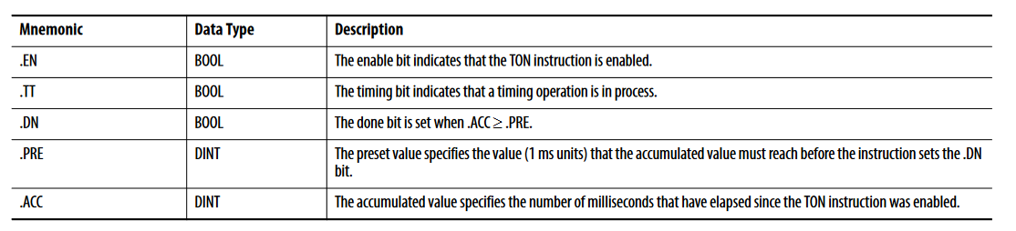
Timer structure
TON 기준

Slide 4
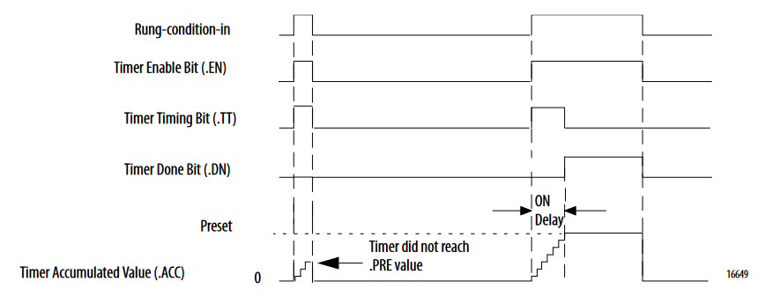
TON
The TON/TOF instruction accumulates time until the following occurs: • The TON/TOF instruction is disabled • The .ACC >= .PRE
When the TON/TOF instruction is disabled, the .ACC value is cleared

Slide 5
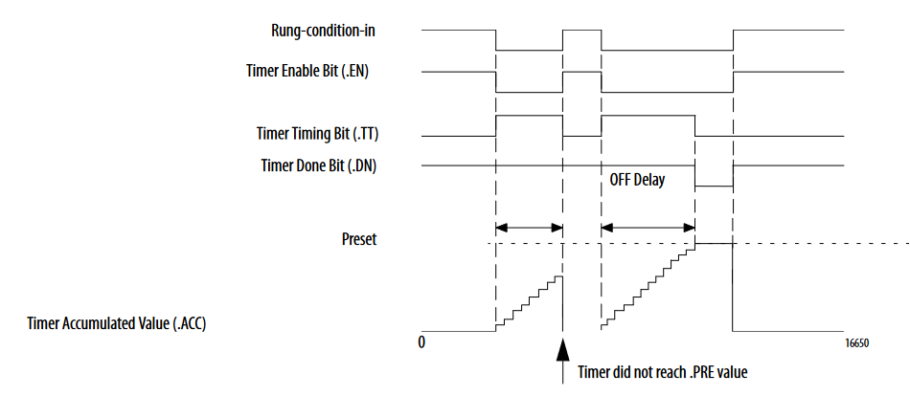
TOF
EN 는 Rung-condition-in 을 따라감
TT 는 timing measure 중에만 ON 됨
! EN && DN
DN 는 counting 완료 후에 OFF, EN ON 시 ON
동영상 https://www.youtube.com/watch?v=KdRpvMTskUI&t=351s 5:25

Slide 6
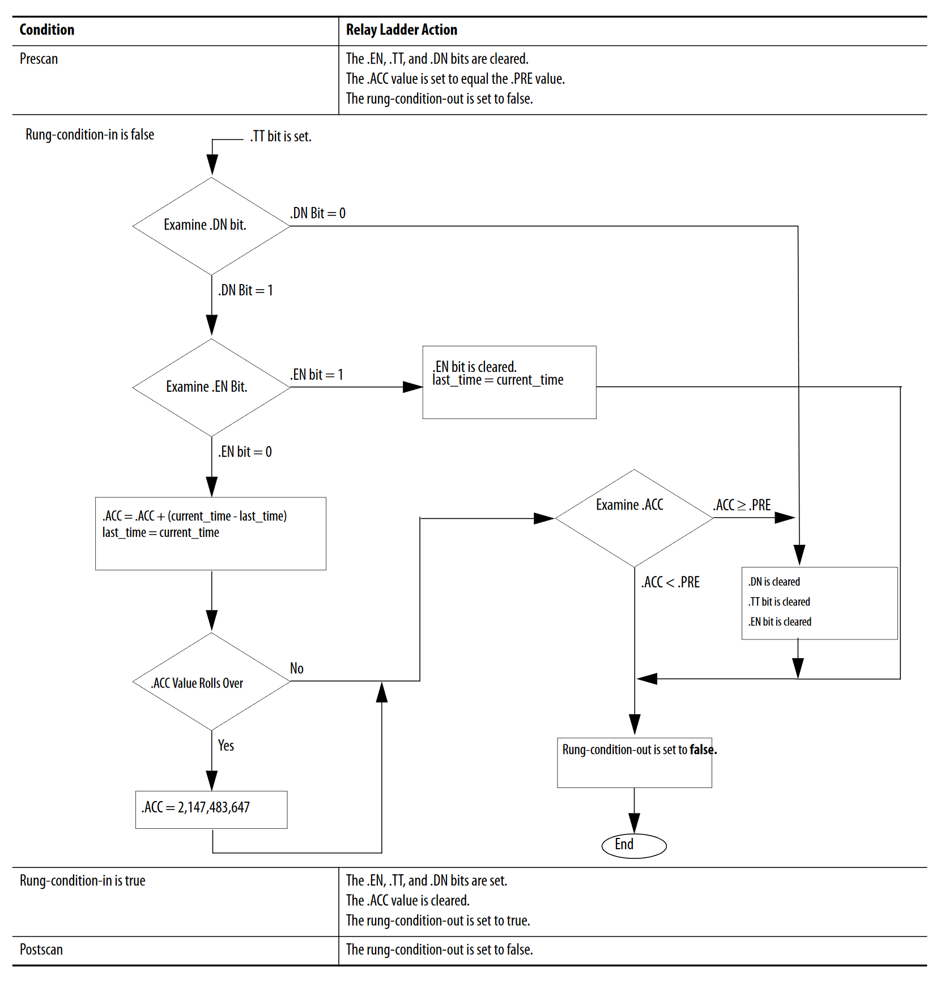
TOF

Slide 7
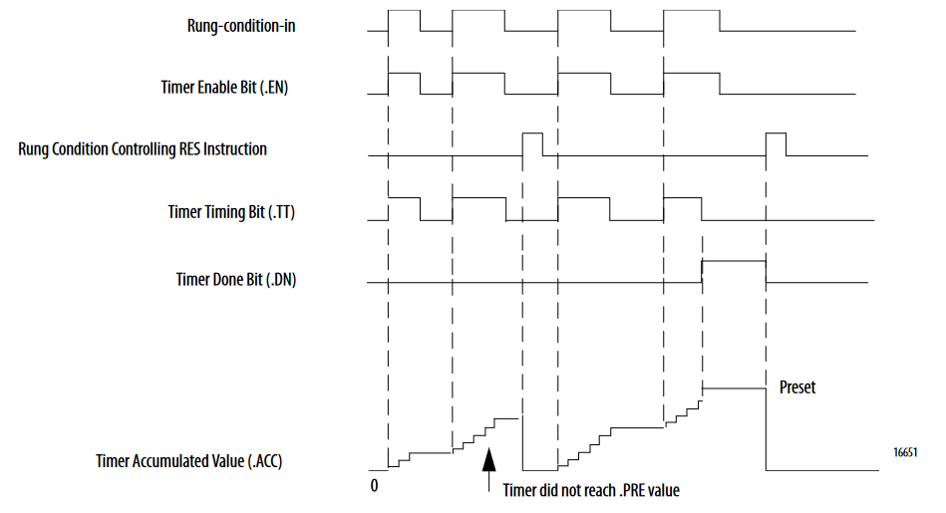
RTO
The RTO instruction accumulates time until it is disabled. When the RTO instruction is disabled, it retains its .ACC value. You must clear the .ACC value, typically with a RES instruction referencing the same TIMER structure. The time base is always 1 ms. For example, for a 2-second timer, enter 2000 for the .PRE value

Slide 8
COUNTER

Slide 9
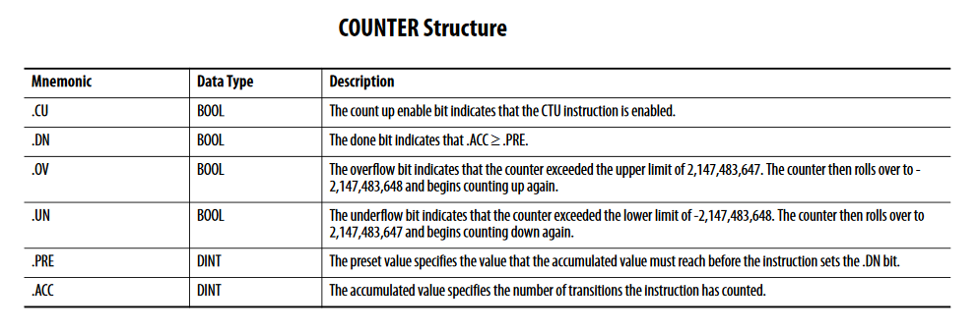
CTU
.CU, .CD

Slide 10
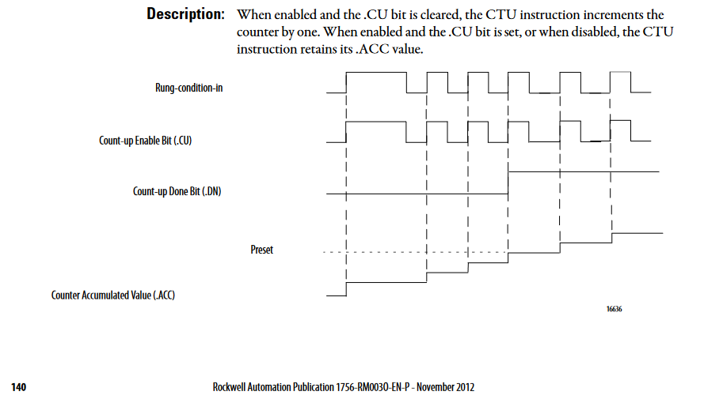
CTU (AB)

Slide 11
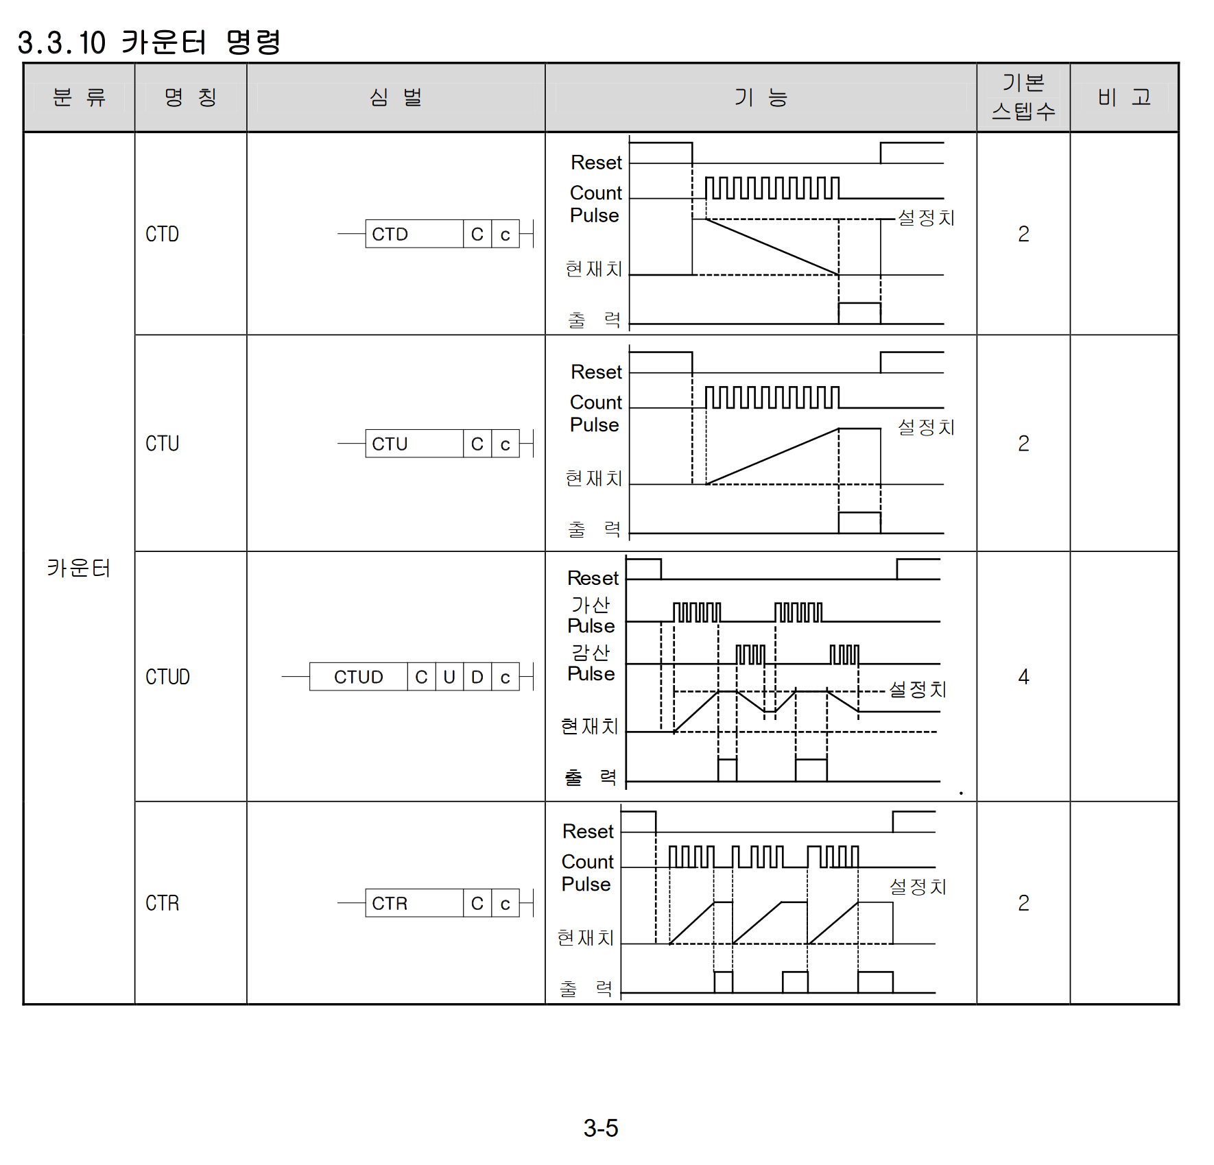
산전 counter

Slide 12
Classes
Timer
TickAccumulator
TimerCounterBaseStruct
Counter
CountAccumulator
TimerStruct
CounterBaseStruct
CTUStruct
CTDStruct
CTUDStruct
TimerStatement
CounterStatement

Slide 13
Classes : Timer/Counter top level
type Statement =
| DuAssign of expression:IExpression * target:IStorage
| DuVarDecl of expression:IExpression * variable:IStorage
| DuTimer of TimerStatement
| DuCounter of CounterStatement
type TimerStatement = {
Timer:Timer
RungInCondition: IExpression<bool> option
ResetCondition: IExpression<bool> option
}
type CounterStatement = {
Counter:Counter
UpCondition: IExpression<bool> option
DownCondition: IExpression<bool> option
ResetCondition: IExpression<bool> option
}

Slide 14
Classes : Timer statements
type Timer internal(typ:TimerType, timerStruct:TimerStruct) =
let accumulator = new TickAccumulator(typ, timerStruct)
member _.Type = typ
member _.Name = timerStruct.Name
member _.EN = timerStruct.EN
member _.TT = timerStruct.TT
member _.DN = timerStruct.DN
member _.PRE = timerStruct.PRE
member _.ACC = timerStruct.ACC
member _.RES = timerStruct.RES
member val InputEvaluateStatements:Statement list = [] with get, set
interface IDisposable with
member _.Dispose() = (accumulator :> IDisposable).Dispose()

Slide 15
생성 : from code
let storages = Storages()
let t1 = PlcTag("my_timer_control_tag", "%M1.1", false)
let condition = tag2expr t1
let statement = TimerStatement.CreateTON(storages, "myTon", 2000us, condition) // 2000ms = 2sec
let timer = statement |> toTimer
timer.TT.Value === false
timer.EN.Value === false
timer.DN.Value === false
timer.PRE.Value === 2000us
timer.ACC.Value === 0us

Slide 16
생성: from ds text
"ton mytimer3 = createTON(1000us, $tag1 || $tag2)"

